Slide 1
Contiki and Code Composer Studio
Convenient step-debugging on all platforms

Slide 2
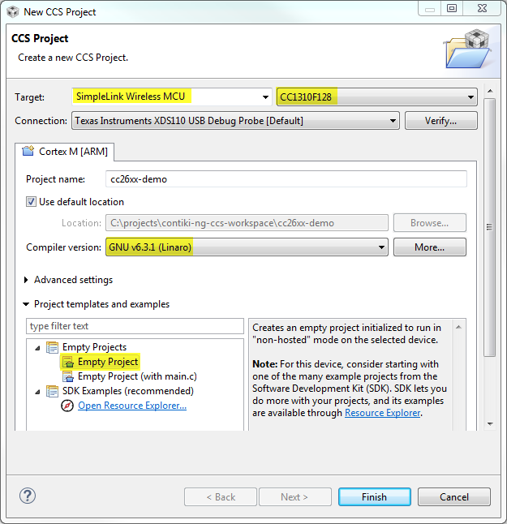
1. Create an empty CCS project
Create a new workspace
Create a bare-metal project and select the GCC toolchain

Slide 3
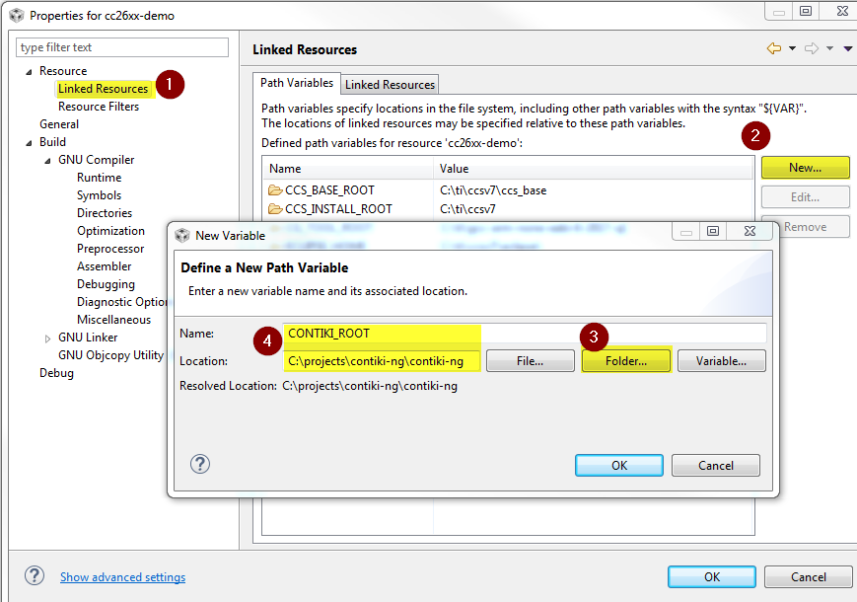
2. Add a path variable for Contiki
Just for Convenience
Allows us to refer to the Contiki source folder later
Makes it possible to switch to another contiki folder without changing the project

Slide 4
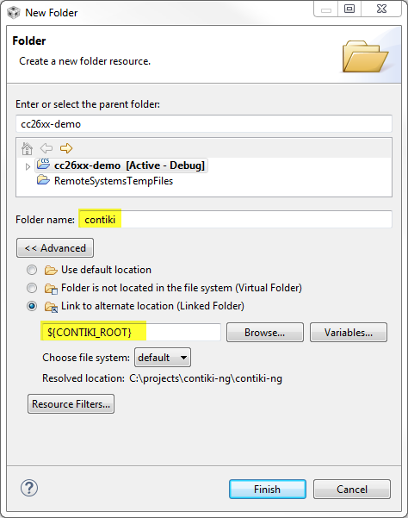
3. Add Contiki sources
Add a link to the Contiki source folder based on the CONTIKI_ROOT variable.
This allows to browse Contiki files whithout copying them into the project folder.
CCS may find .cfg files in the Contiki source tree and asks whether it should build them with XDCTools. Click «No».

Slide 5
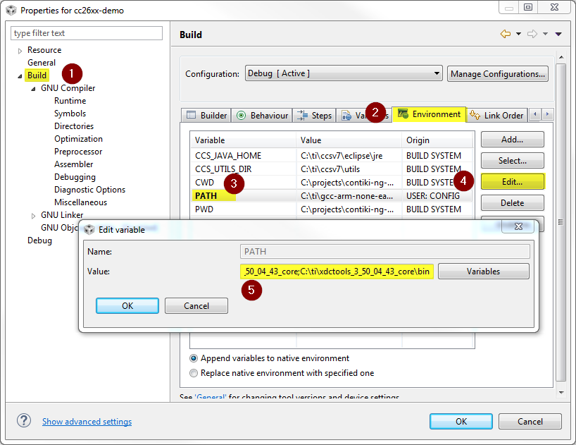
4. Adjust PATH environment variable
The Contiki build system needs git, make and some other shell tools to be in the PATH environment variable.
XDCTools provides GNU make and the necessary shell tools
Git Bash is git distribution for Windows
Example: Append
;C:\ti\xdctools_3_50_04_43_core;C:\ti\xdctools_3_50_04_43_core\bin;C:\Program Files\Git\bin

Slide 6
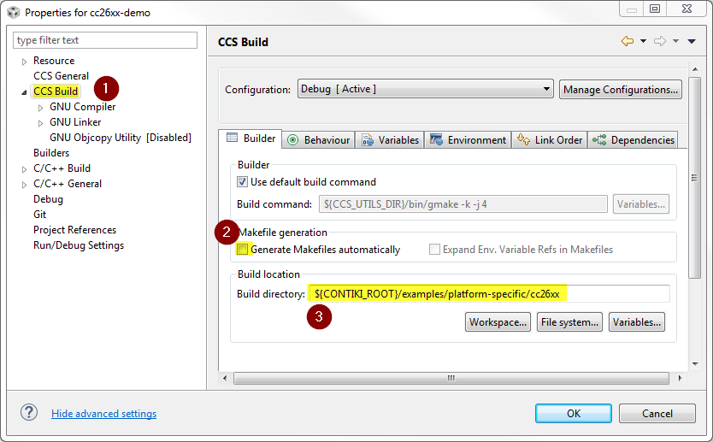
5. Adjust Builder settings
Do not let CCS generate makefiles
For building an example, use the example’s source directory as build directory
Note: When creating your own applications, put the application sources and the Makefile into your project directory, not in the Contiki directory.

Slide 7
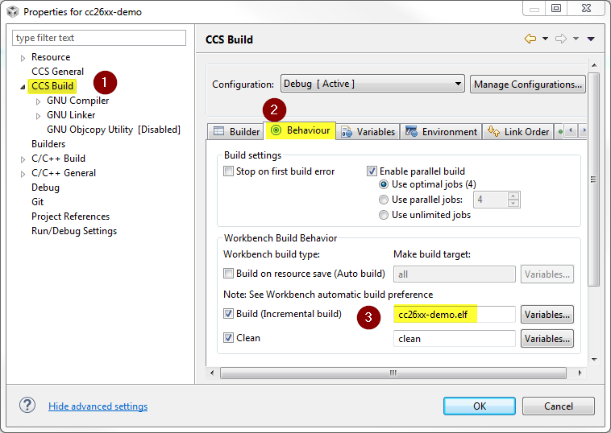
6. Modify the build target
It is sufficient, to build the executable (.elf)
No need to do hex conversion which requires srecord

Slide 8
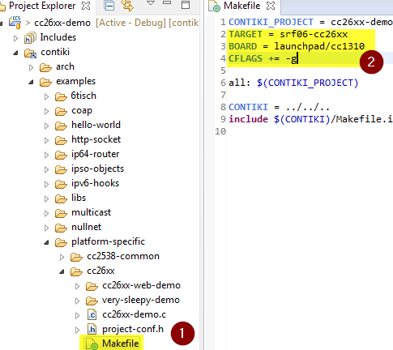
7. Add board and target variables, debug symbols
You can set those variables either in the Makefile or in the CCS environment just like PATH
TARGET=srf06-cc26xx for CC13x0 and CC26x0 devices
BOARD=launchpad/cc1310 for the CC1310 launchpad
Add CFLAGS += -g to enable debug symbols

Slide 9
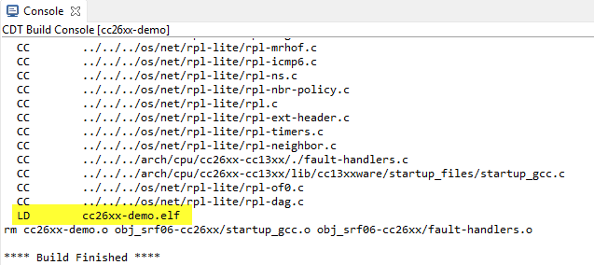
8. Build the project
CCS should now be able to build the .elf file
If something goes wrong, it is usually due to tools not being found. Check the PATH environment variable in that case.

Slide 10
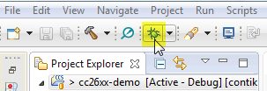
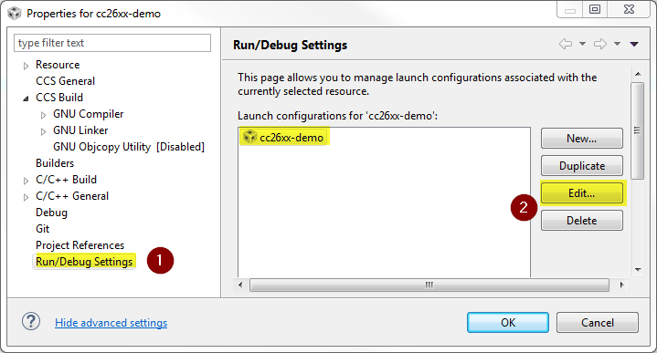
9. Create a default debug session
Start a debug session and let CCS create a default debug configuration for the XDS110 debug interface.
This is expected to fail because the executable filepath guessed by CCS is wrong.
Open the newly created launch session for that project.

Slide 11
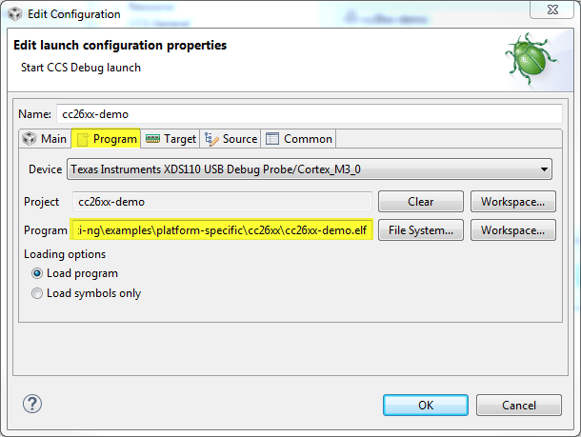
10. Set the correct executable path
CCS tries to deduce the executable filepath from a magic variable.
But we are building it with an external makefile.
The executable path needs to be hard-coded (unless we find a simpler solution)

Slide 12
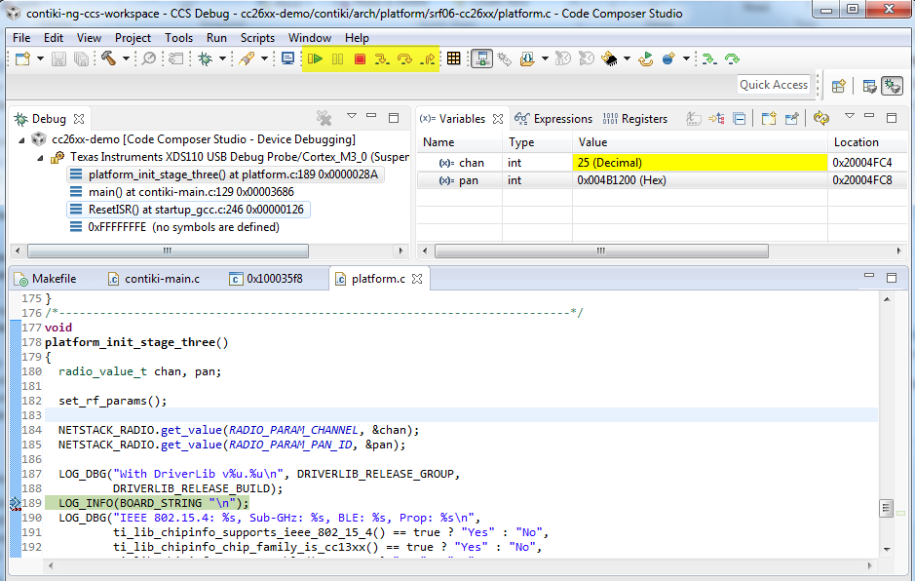
11. Start debugging
Now that the launch configuration points to the correct file, start the debug session again.
You are now able to step through the source code.

