Slide 1
Development environment
DSP : TMS320C6748
Compiler : CCS7
NAND Flash Memory : MT29F4G16ABADAH4-IT:D
JTag : XDS200
DSP Custom Board
I Want
How to NAND Flash Download for CCS7 ?!

Slide 2
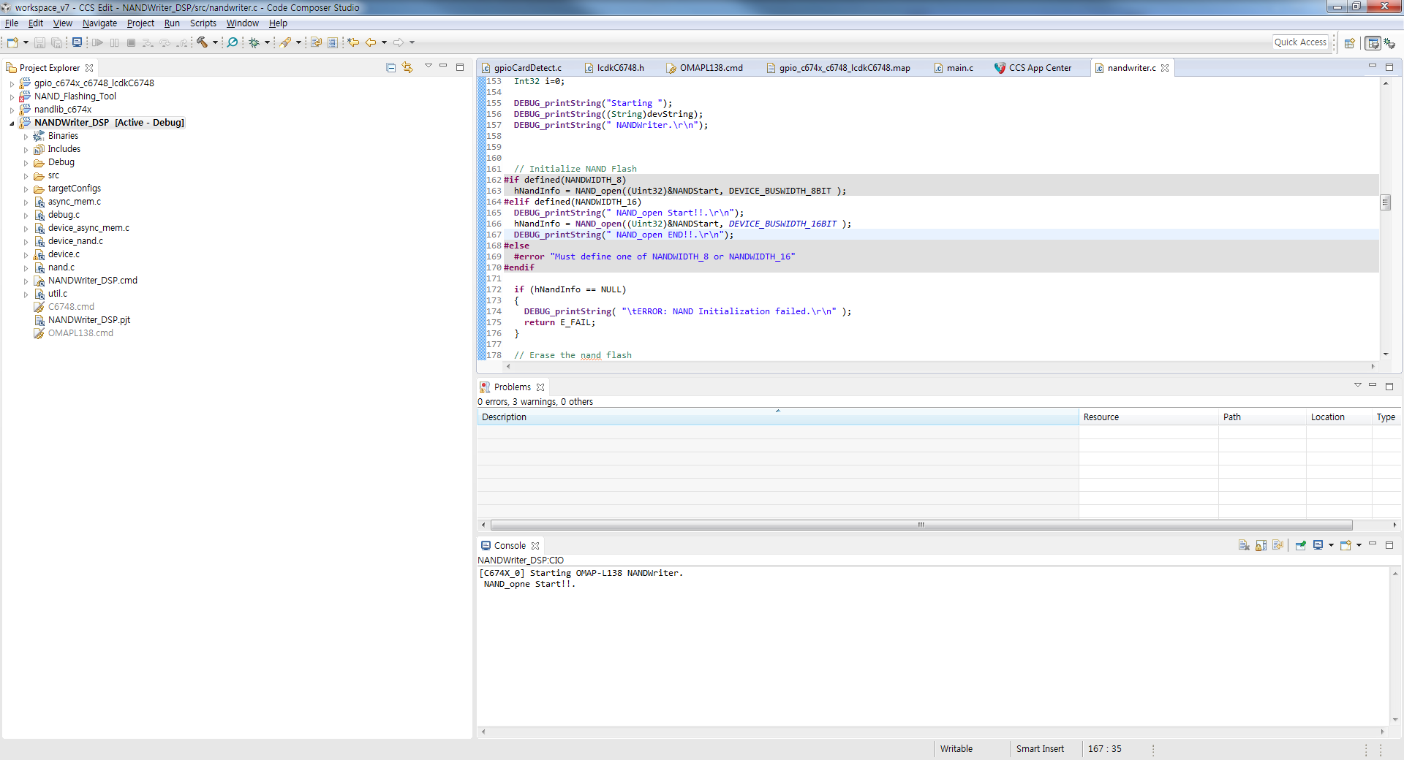
I try, nand flash download for CCS. Complied finish, not errors. But this problem.
Project name : NANDWriter_DSP
Nandwriter.c -> change code : #define NANDWIDTH_16
//#define NANDWIDTH_8
See Console : Stop Processor at line 166. not print “NAND_open END!!.”

Slide 3
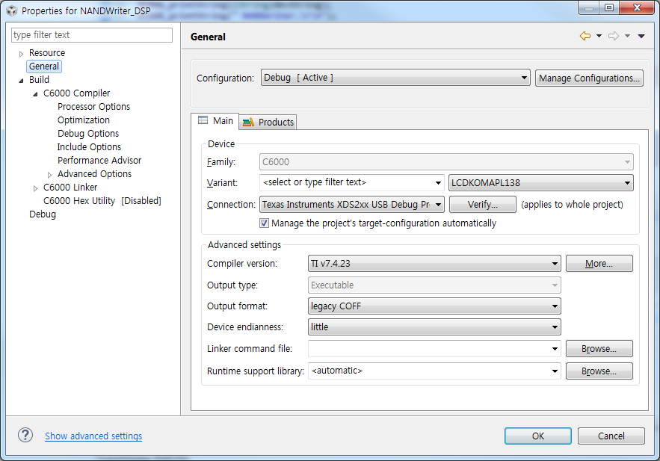
Properties for NANDWriter_DSP

