Slide 1
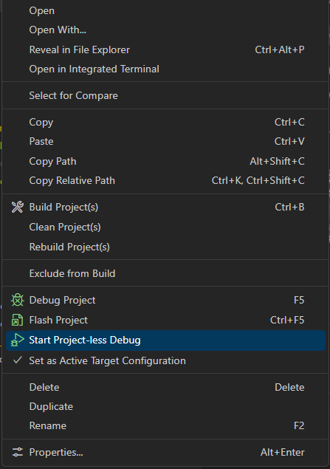
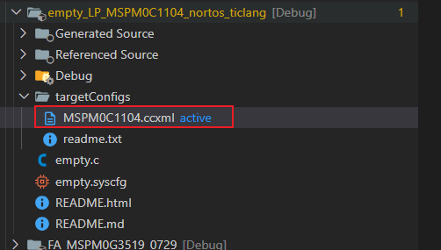
Step1 . Start target configuration

Slide 2
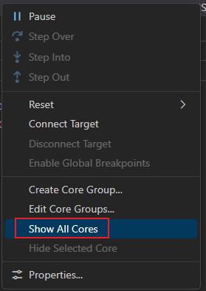
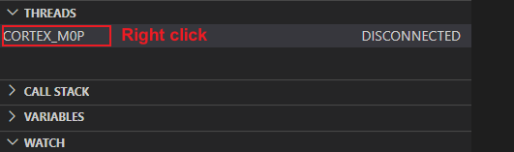
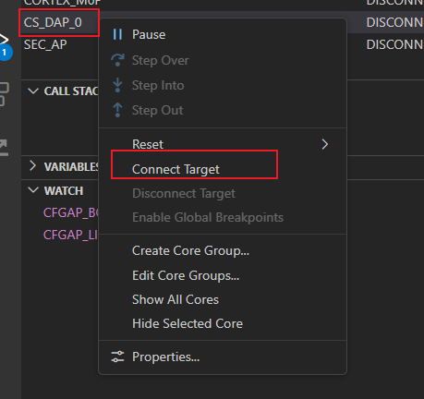
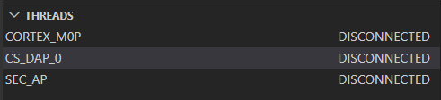
Step2 . Connect DAP core

Slide 3
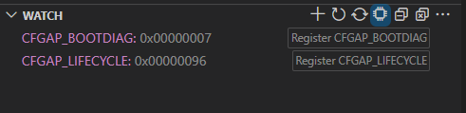
Step3 . Add WATCH
Add CFGAP_BOOTDIAG and CFGAP_LIFECYCLE to see the value.
If the value is the same as the image, the MCU is normal

