Slide 1
TMS5700714APZQQ1 RELAY signal exception analysis report
制作：姜婷
日期：2024/9

Slide 2
1、Problem description
问题描述
问题1： | 1.2024/9 Found that 3PCS product RELAY movement lag: SN1：P1764634-02-F:SLXS24209001483 SN2：P1764634-02-F:SLXS24225000532 SN3： P1764634-02-F:SLXS24209000850
问题2 | 2. In 2024/9, it was found that 1PCS product RELAY has been moving forward for too long SN1：P1764634-02-F:SLXS24225001297

Slide 3
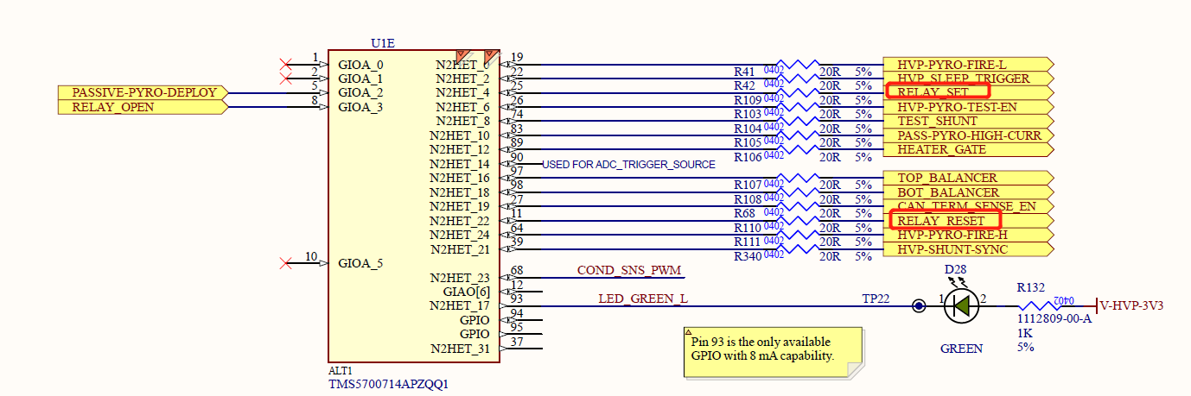
2、 RELAY movement caton analysis
1. Undesirable phenomena: After checking the schematic diagram, it was found that the signals controlling the RELAY to advance and reset were sent by U1 chip, and the MPN of U1 chip was TMS5700714APZQQ1. We decided to first measure whether the RELAY_SET and RELAY_RESET signals were normal.

Slide 4
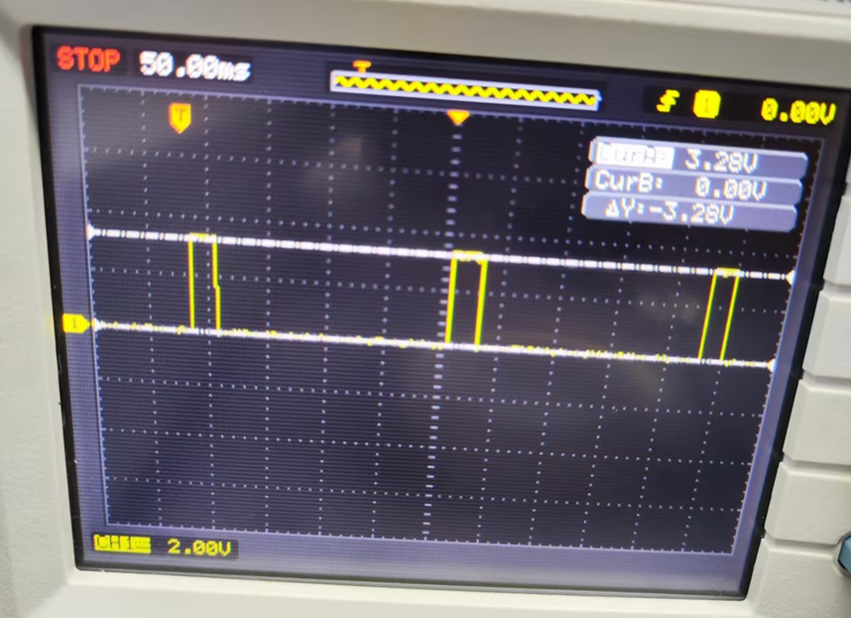
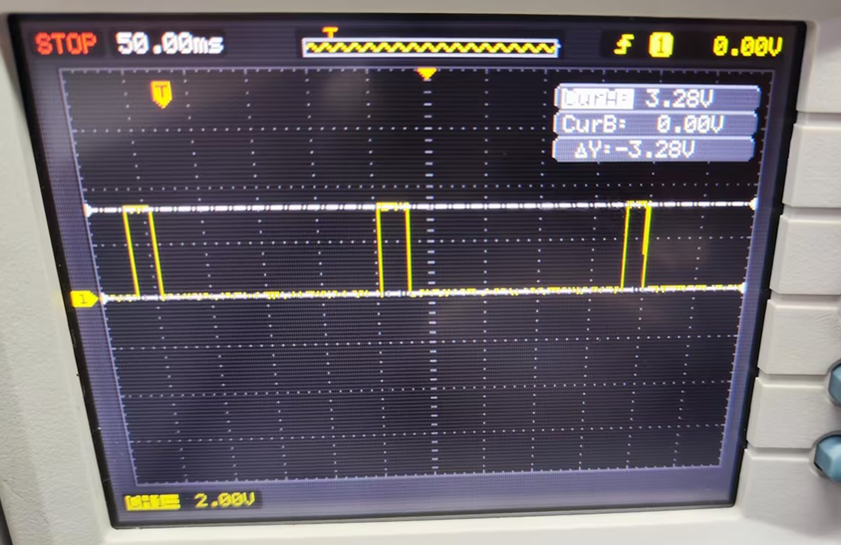
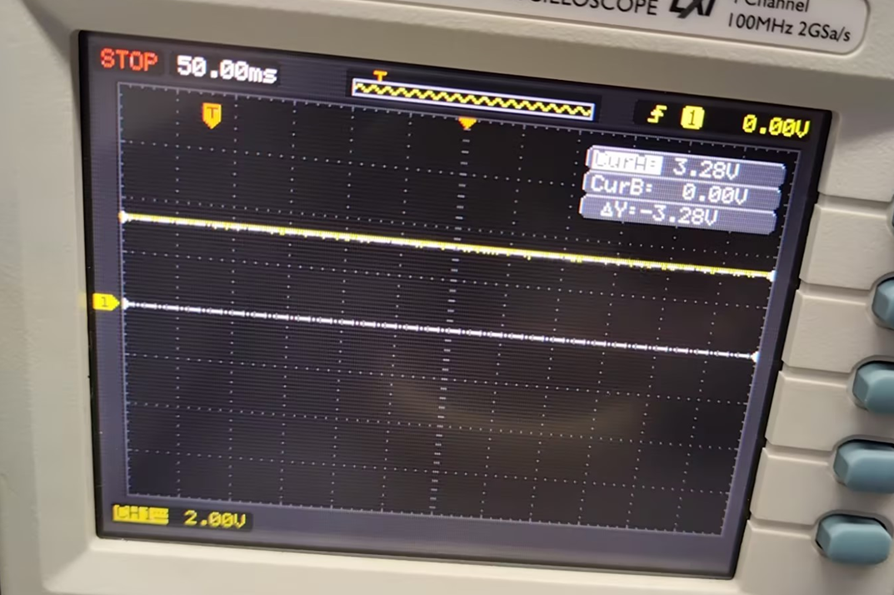
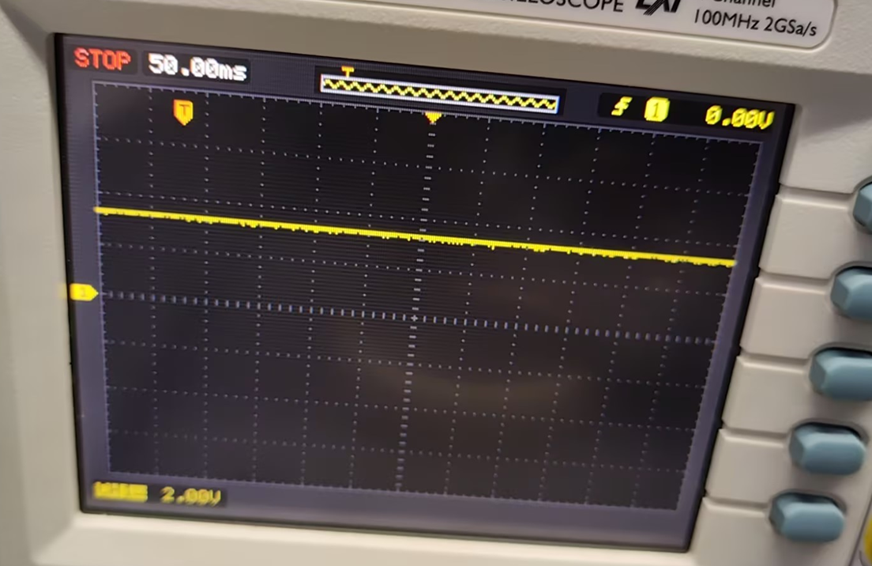
2、 RELAY movement caton analysis
2. After sending RELAY advance and reset commands, measure the following two signals of the defective U1 respectively:
RELAY_SET： RELAY_RESET：
After sending RELAY advance and reset instructions, measure the following two signals of OK U1 respectively:
RELAY_SET： RELAY_RESET：
According to the measurement results, it can be clearly seen that the signal output of the defective U1 is abnormal.

Slide 5
2、 RELAY movement caton analysis
3. Exchange the U1 chip of the defective part and the OK part. The test results are as follows:
SN | Test results before exchange | Test results after exchange
P1764634-02-F:SLXS24209001483(NG product) | NG | PASS
P1764634-02-F:SLXS24174001108(OK product) | PASS | NG
Therefore, it can be confirmed that the bad cause of RELAY movement stuttering is U1.
Next plan: analysis of defective chip U1 sent to supplier TI, U1 MPN is TMS5700714APZQQ1, part number is 13604-S080014H-13.The material batches are as follows:

Slide 6
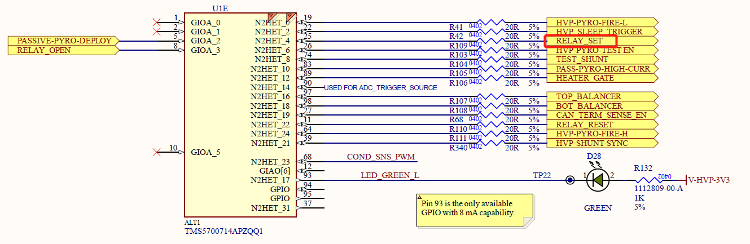
3、 RELAY has been moving forward for too long analysis
1. Adverse phenomenon: the RELAY of one product took too long to move forward after sending instructions. After checking the schematic diagram, it was found that the signal controlling the RELAY advance was sent by U1 chip, and the U1 chip MPN was TMS5700714APZQQ1.

Slide 7
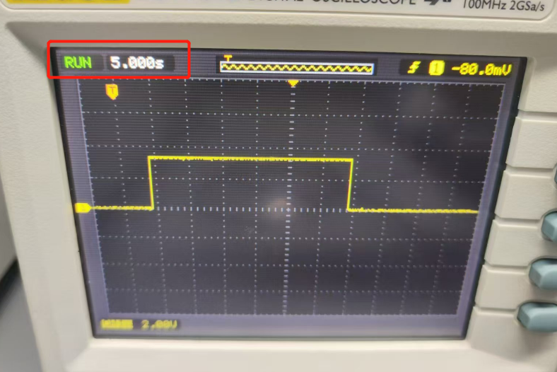
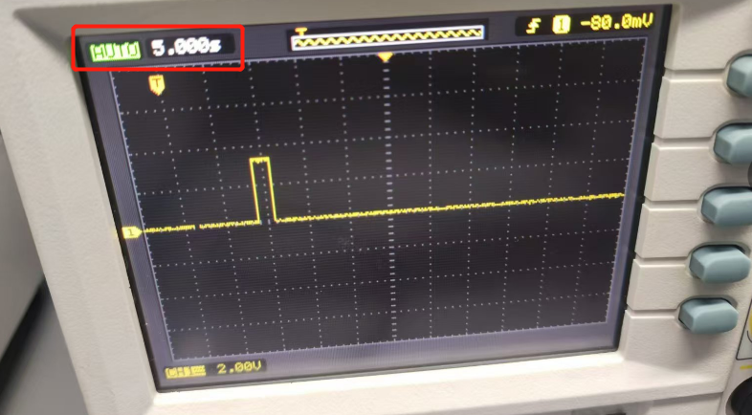
3、 RELAY has been moving forward for too long analysis
2. After sending the RELAY advance command, measure the RELAY_SET signal of the defective U1:
RELAY_SET：
After sending the RELAY advance command, measure the RELAY_SET signal of the OK U1:
RELAY_SET：
According to the measurement results, it can be seen that the RELAY_SET signal output time of the defective U1 is about 30s, while the RELAY_SET signal output time of the OK part is about 2s.

Slide 8
3、 RELAY has been moving forward for too long analysis
3. Exchange the U1 chip of the defective part and the OK part. The test results are as follows:
SN | Test results before exchange | Test results after exchange
P1764634-02-F:SLXS24225001297(NG product) | NG | PASS
P1764634-02-F:SLXS24244001037(OK product) | PASS | NG
In this way, it can be confirmed that the RELAY advance time is too long because U1 is abnormal
Next plan: analysis of defective chip U1 sent to supplier TI, U1 MPN is TMS5700714APZQQ1, part number is 13604-S080014H-13.The material batches are as follows:

Slide 9
Thank you!
谢 谢!

