Slide 1
How to connect MCU in low power mode with J-link
MSP
Notes:
Note: Use this PowerPoint template if your presentation contains information classified as TI Confidential – NDA Restrictions. Details at cip.ti.com.

Slide 2
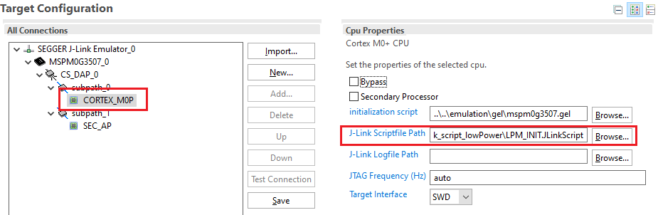
CCS
Add J-link script file in project Target configuration

Slide 3
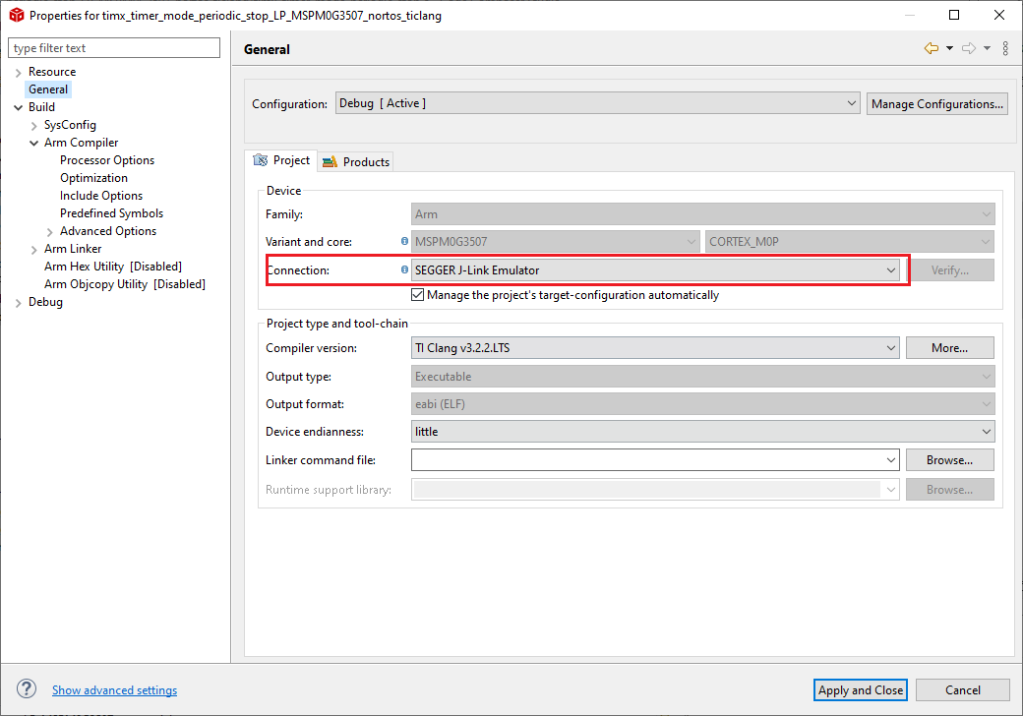
CCS
Change the debugger

Slide 4
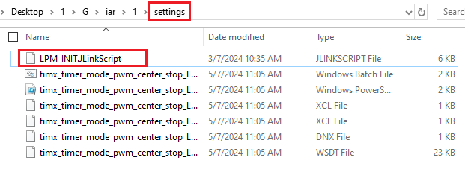
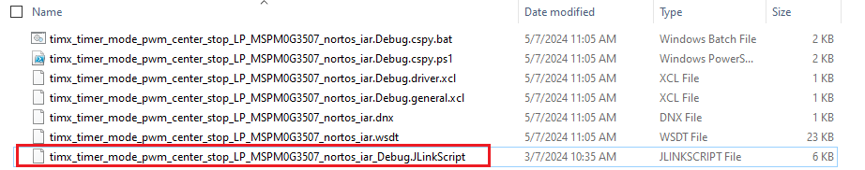
IAR
1. Move script file to the project setting folder
2. rename the script file: project name + “_Debug”

Slide 5
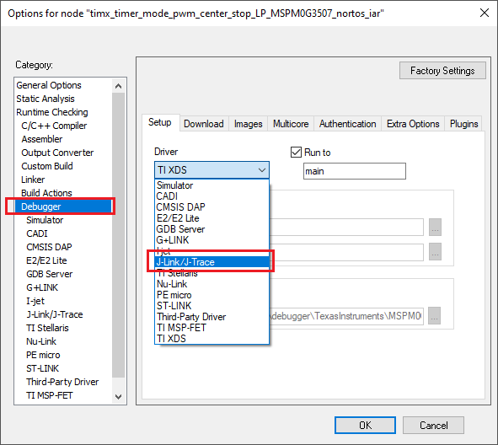
IAR
3. Change the debugger

Slide 6
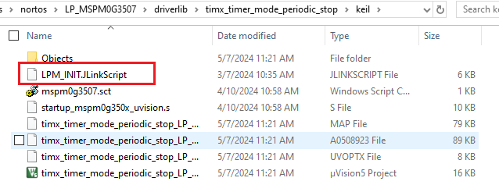
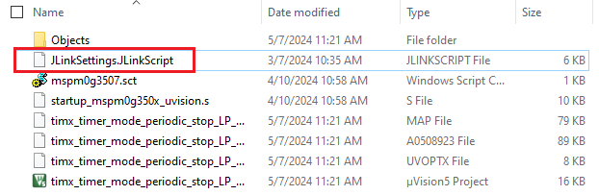
Keil
1. Move script file to the project root
2. rename the script file: “JLinkSettings.JLinkScript”

Slide 7
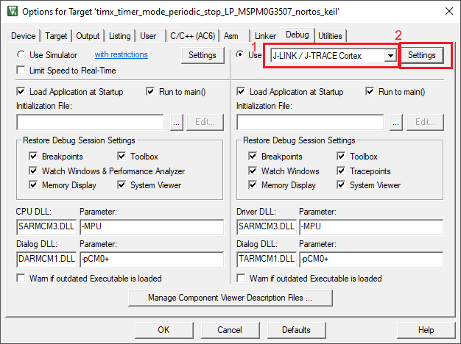
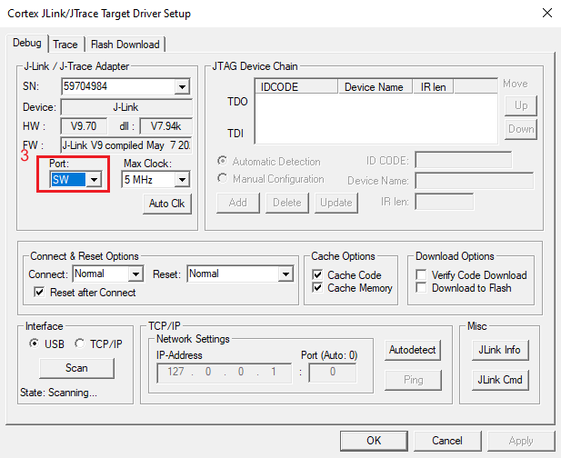
Keil
3. Change the debugger

Slide 8
Thanks

