Slide 1
How to use SWD password in CCS
MSP Team

Slide 2
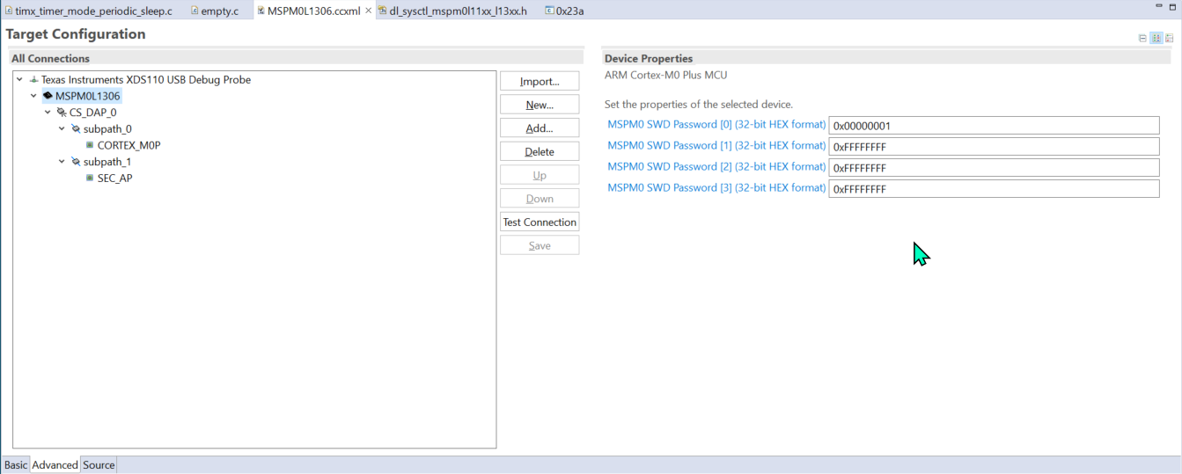

Slide 3
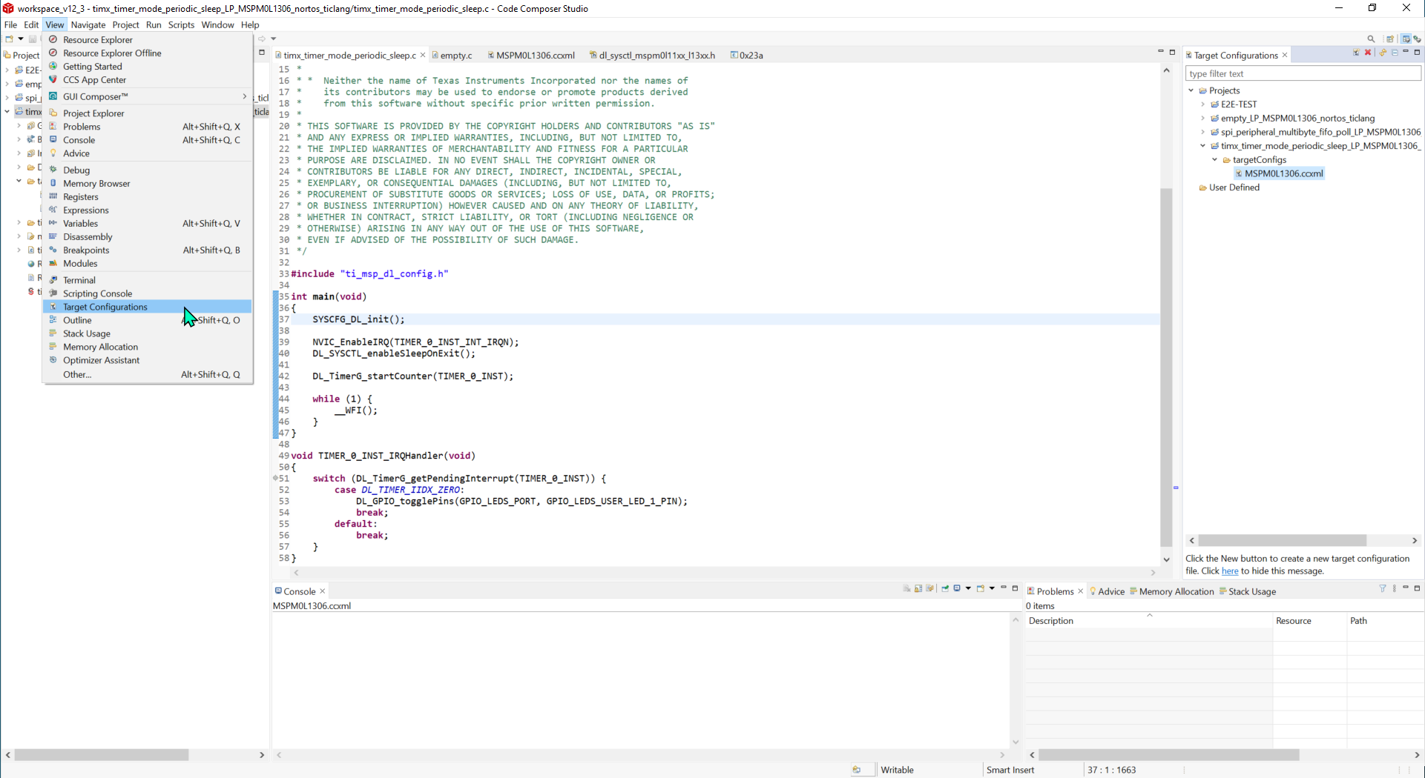

Slide 4
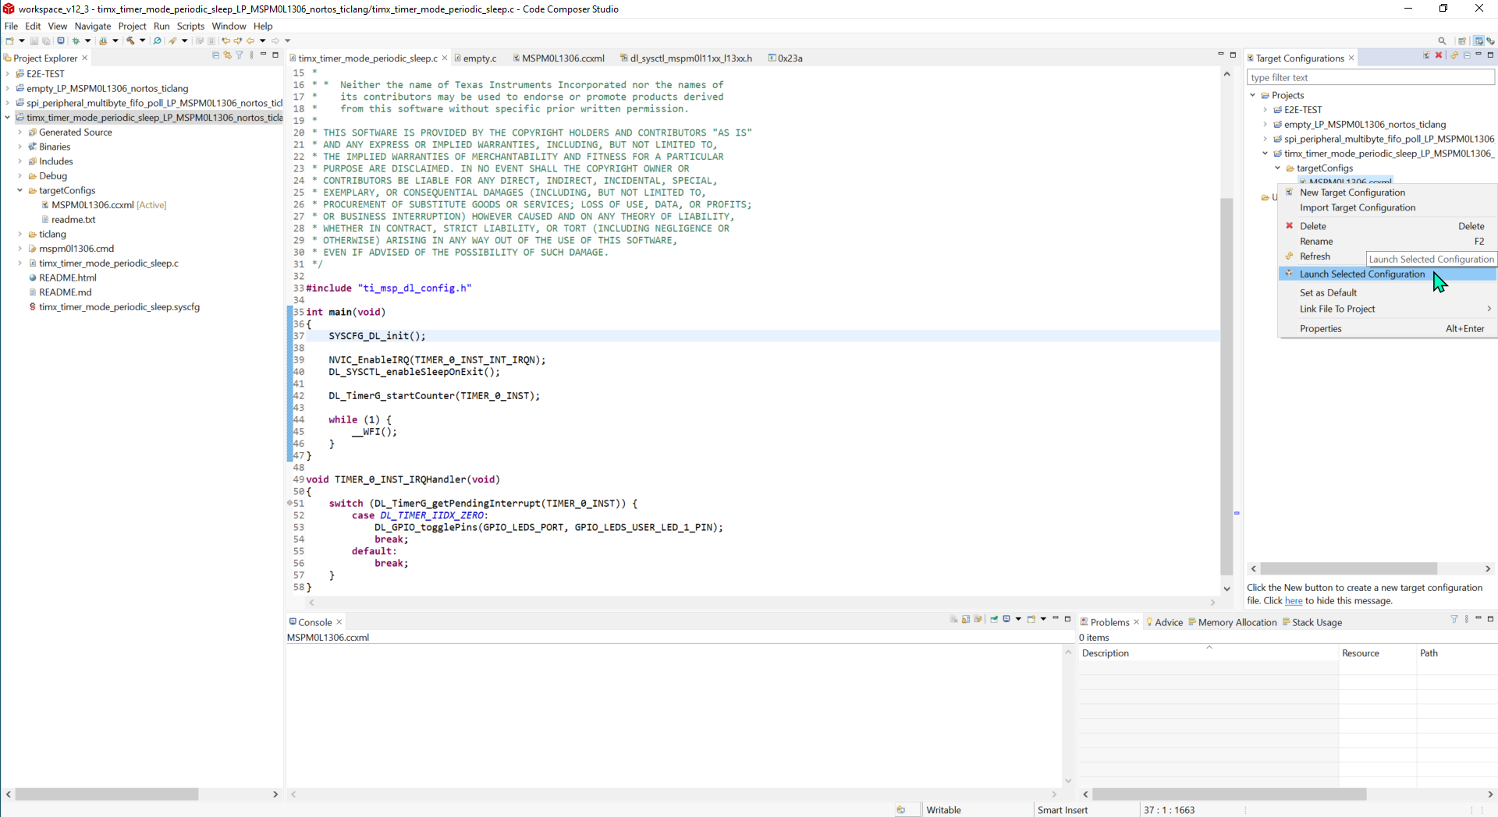

Slide 5
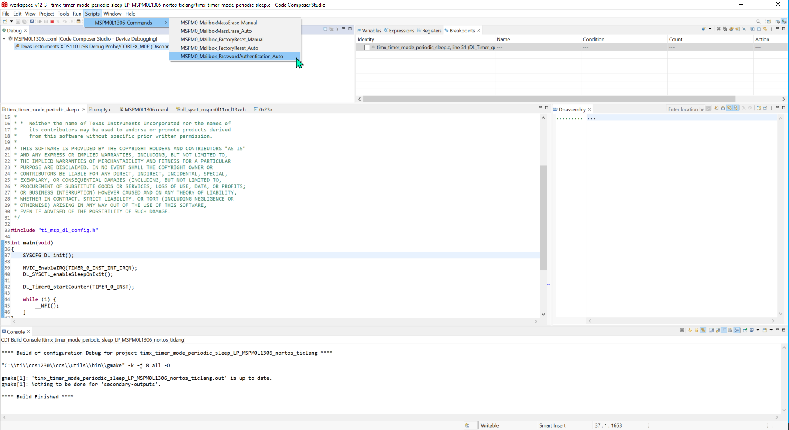

Slide 6
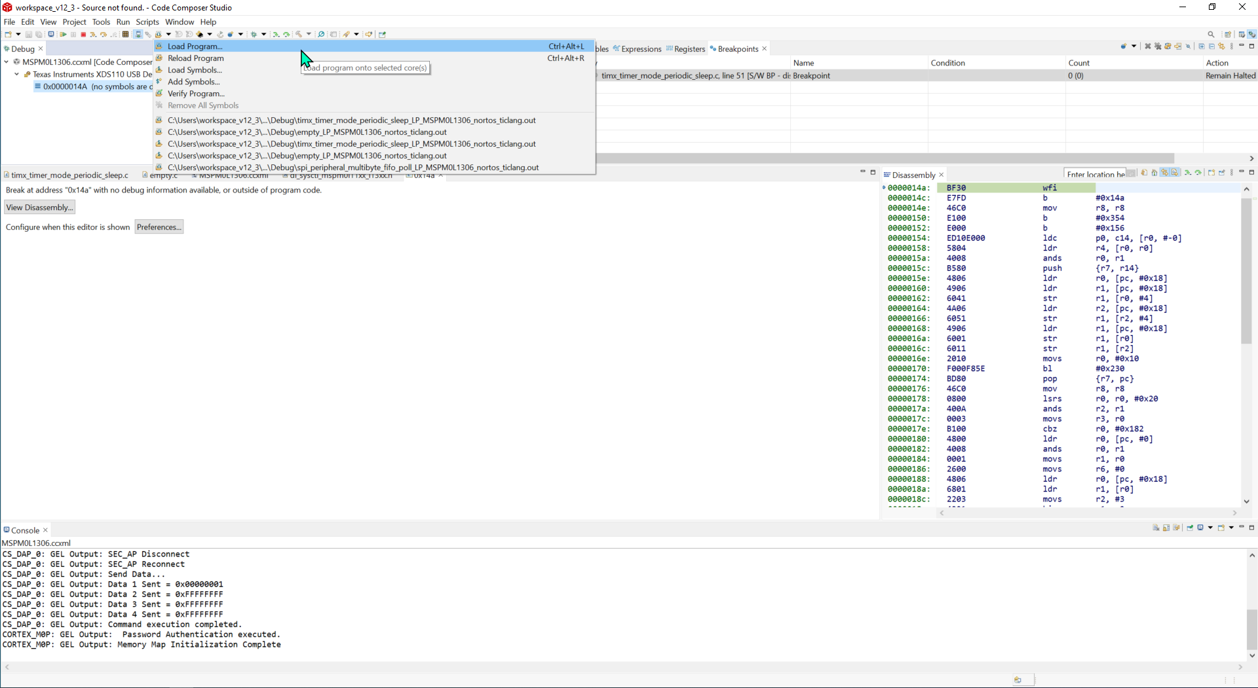

Slide 7
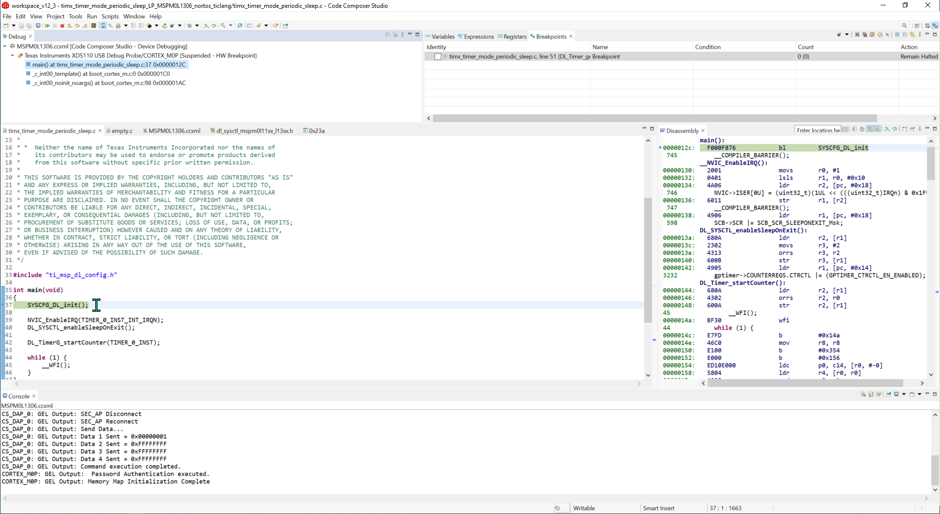

Slide 8
Other tips
When you successfully access device with SWD password, then if you do not reset device or re-power on, the device will keep connected and you can do any SWD operations (like CCS load/debug, UniFlash connection) without password.
The reason is that only in the boot code, does the M0 device need check SWD password, after successfully password check, then there will be no more password demand.
Useful link: https://software-dl.ti.com/msp430/esd/MSPM0-SDK/1_00_00_04/docs/english/tools/ccs_ide_guide/doc_guide/doc_guide-srcs/ccs_ide_guide.html#dssm-swd-password-mechanism

Slide 9
Standalone XDS110
SWD Password Procedure
MSP Team

Slide 10
Summary
When using SWD password function via standalone XDS110, there is unknown issue about Reset.
Add a MSPM0_Mailbox_PasswordAuthentication_Manual function to .gel file, so you can press Reset button manually.

Slide 11
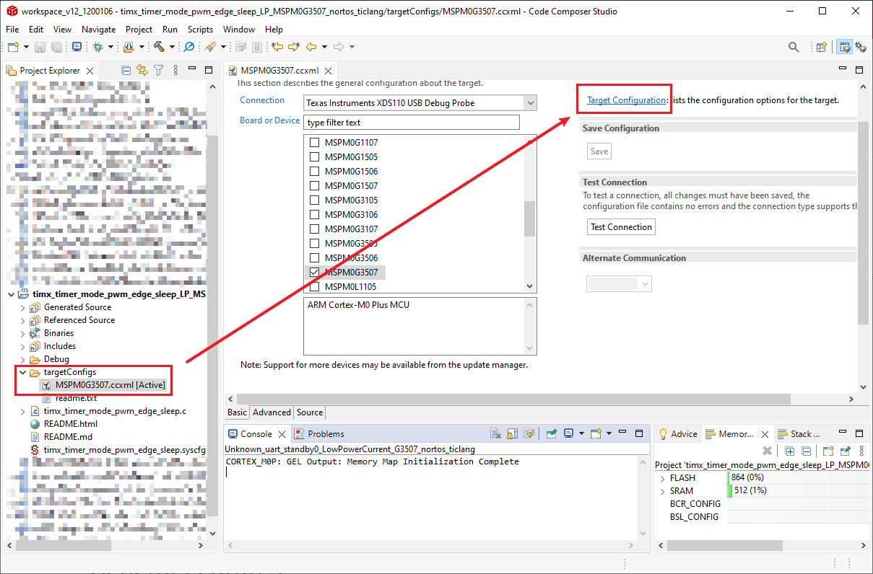
Step 1: Open Target Configuration
Open .ccxml file of your project.
Click Target Configuration.

Slide 12
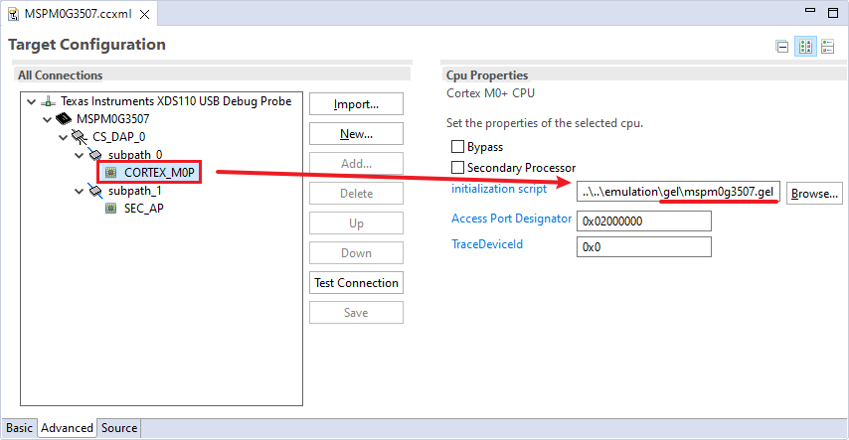
Step 2: Check .gel file name and open it
path to .gel file: C:\ti\ccs1250\ccs\ccs_base\emulation\gel
Open CORTEX_M0P
Remember you .gel file’s file name.
Open and Edit .gel file via file path.

Slide 13
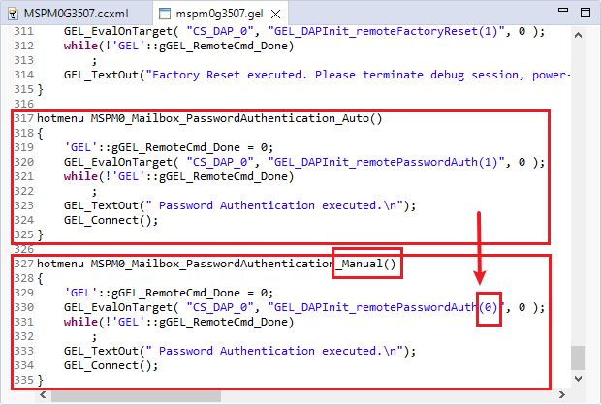
Step 3: Edit .gel file
Open .gel file
Copy and paste a new Password function.
Change the name to Manual and (1) to (0).

Slide 14
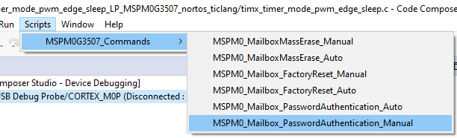
Step 4: Retry the Password Authentication Manual
Retry your Project’s Password Authentication procedure
Using MSPM0_Mailbox_PasswordAuthentication_Manual
During the procedure, need to press RESET button once.

