Slide 1
Instability at startup in HW1

Slide 2
Problem Description
I have used “hello_world_am263x-cc_r5fss0-0_freertos_ti-arm-clang” example from “AM263x MCU+ SDK 09.00.00” as the base software and added 84 GPIOs to the syscfg file. Only one of these 84 IOs is used as LED and remaining 83 IOs are only initialized in the Sysconfig generated files and never used in the main code.
The problem arises when the board is powered up after being off for a while, the MCU sends garbage to the UART console and it takes time (about 15 seconds) to be fixed and normal data is received on UART. After stablization if the board is turned off and powered up again without significant delay it works fine without problem. Otherwise, if it is off long time the garbages come again.
The duration of being off has direct relation to the time that the board takes to be stabilized and working fine.
An important point to mention is that the same code works completely fine in AM263x Control Card EVM.

Slide 3
Detailed description of the UART Console with problematic code

Slide 4
The RBL and SBL are working fine. But the problem arises in problematic code when the main application starts working.

Slide 5
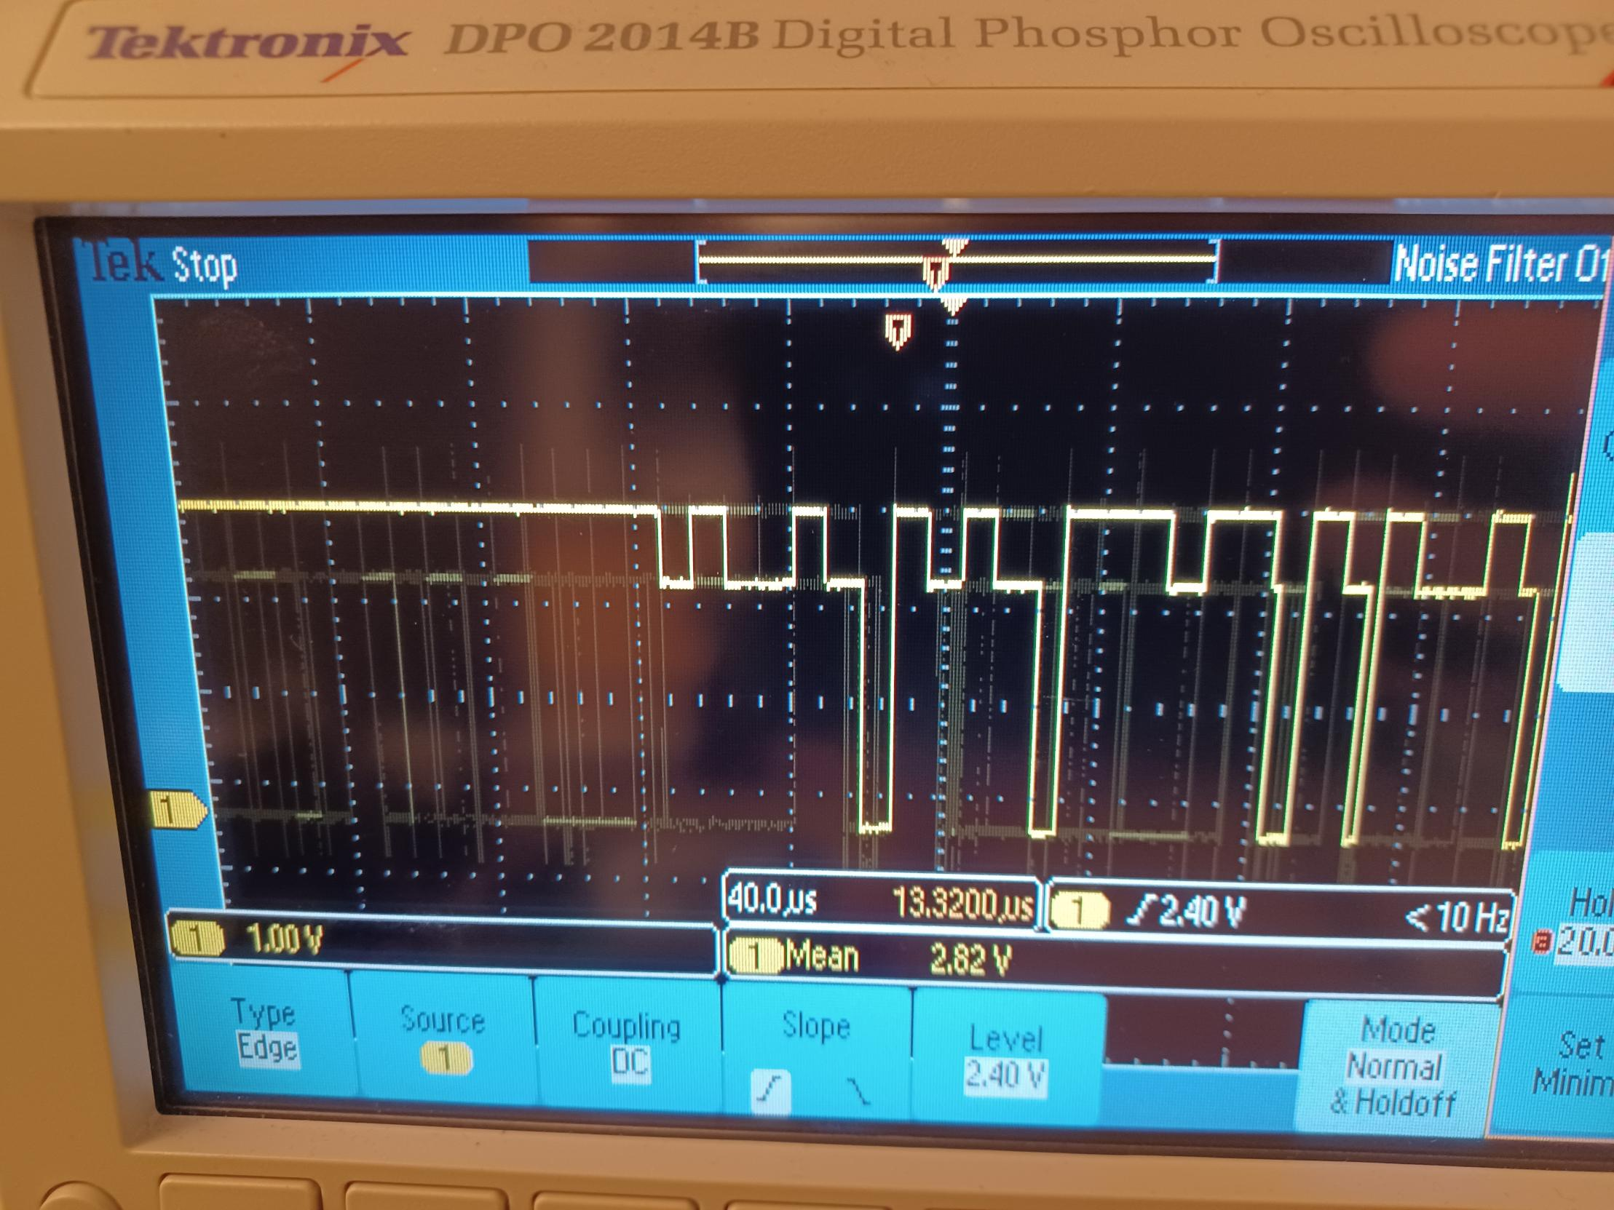
UART-TX data during startup instability time

Slide 6
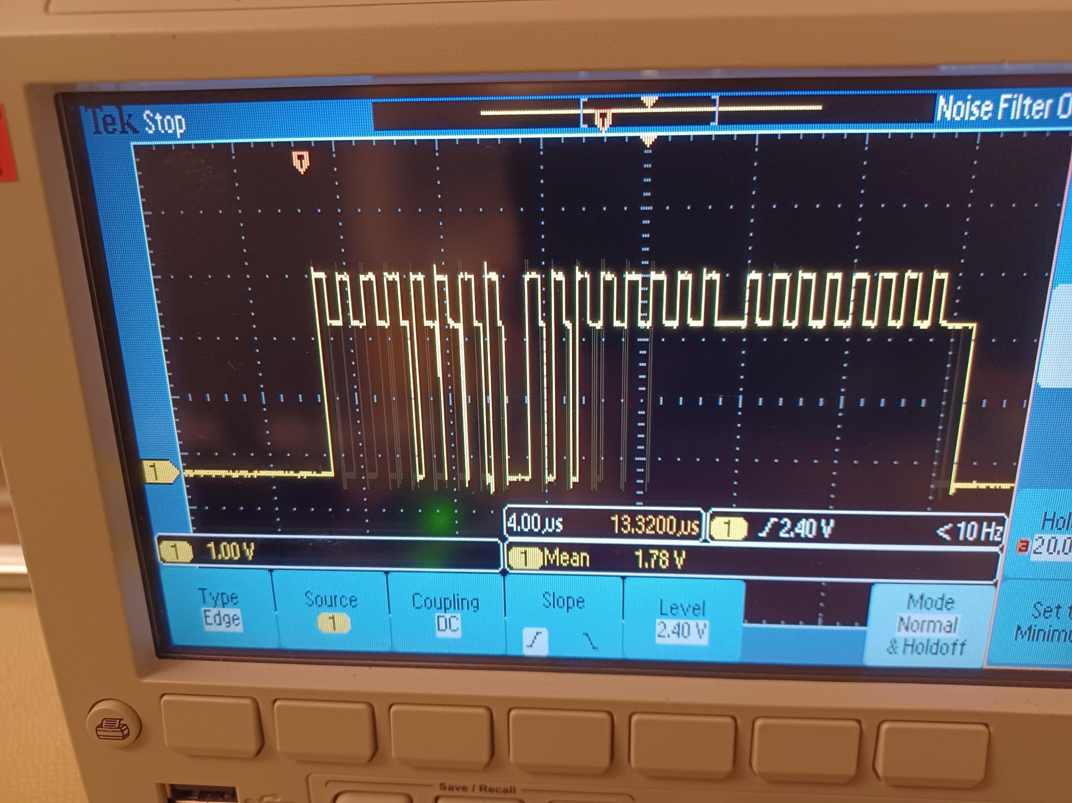
The same experiment in SPI communication
Furthermore, When I have added SPI interface to the code which has 84 GPIOs, the instability is seen also in SPI clock signal.
SPI Clock during startup instability time

Slide 7
The direct relation between instability and the number of added GPIOs
It seems that the more GPIOs added to the code the worse the instability arises in the MCU. For example, when I add 15 GPIOs, rarely could I see the problem and by adding 10 GPIOs the problem is not seen anymore.

Slide 8
The direct relation between instability time and the duration that the board has been off
It seems that the more time the board has been off, the longer the instability shows up. For example, if the board has been off for a long time it takes about 30 seconds for stabilization, but after stabilization, if the board is powered down and off without significant delay, the instability does not occur or occur for a short period.

Slide 9
The same code works fine in TI-AM263x CC EVM board
It seems that it is not a software issue since the same code is working fine on the EVM board.

