Slide 1
J-Flash Operation Guide
MSP Team

Slide 2
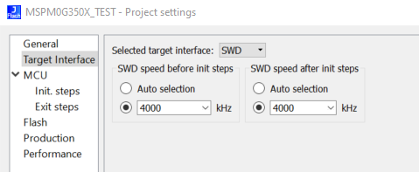
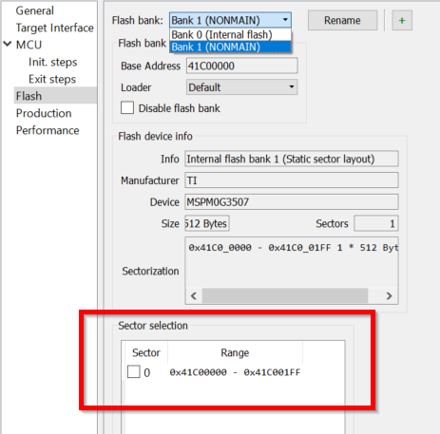
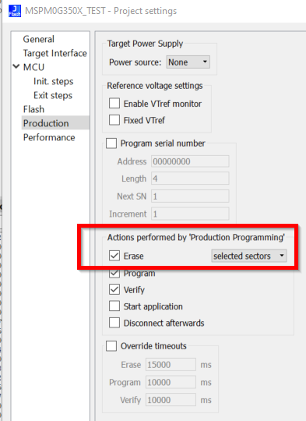
Basic setting for development
Important note:
Make sure you do NOT erase the NONMAIN Flash area if you do not loading a new NONMAIN value to device.
An empty NONMAIN will make the device can NOT be accessed anymore.

Slide 3
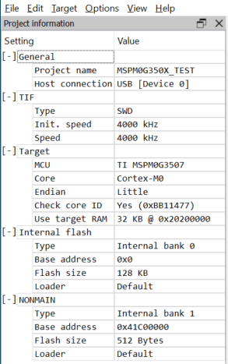
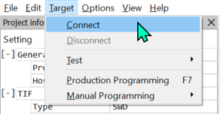
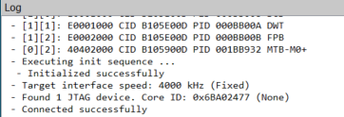
Connect the device

Slide 4
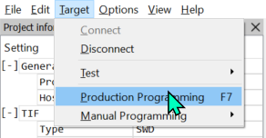
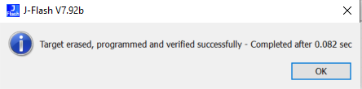
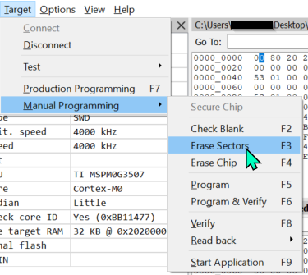
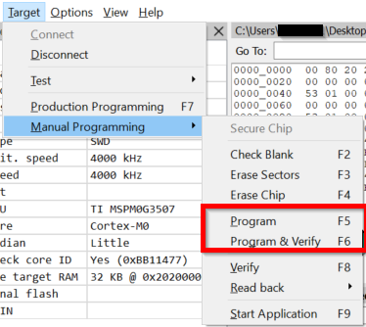
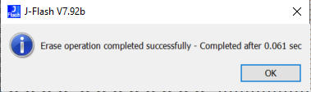
Load the firmware to the device
Method 1
Important note: Make sure you don’t erase the NONMAIN
Method 2

Slide 5
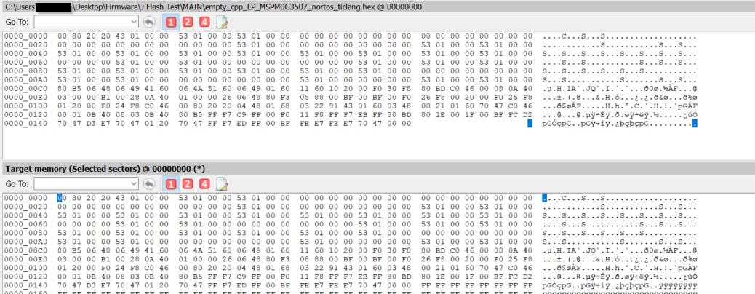
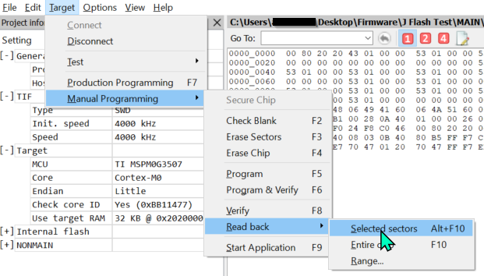
Read the firmware

Slide 6
Tips:
If you erased NONMAIN wrongly, but no new data was written.
Please write new NONMAIN value while maintaining the connection. As long as the connection is not disconnected, the debugger can always access and program firmware.

