Slide 1
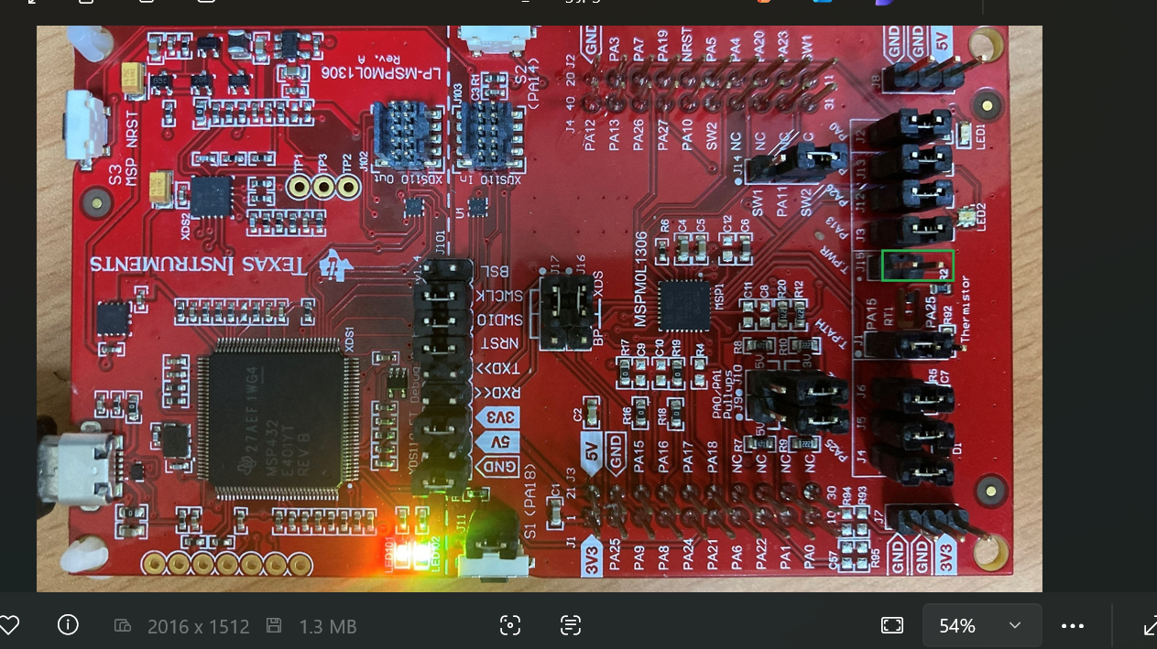
1. Hardware is MSPM0L1306 LaunchPad
4. Remove J15 jumper on LaunchPad to cut thermistor
Remove J15 jumper

Slide 2
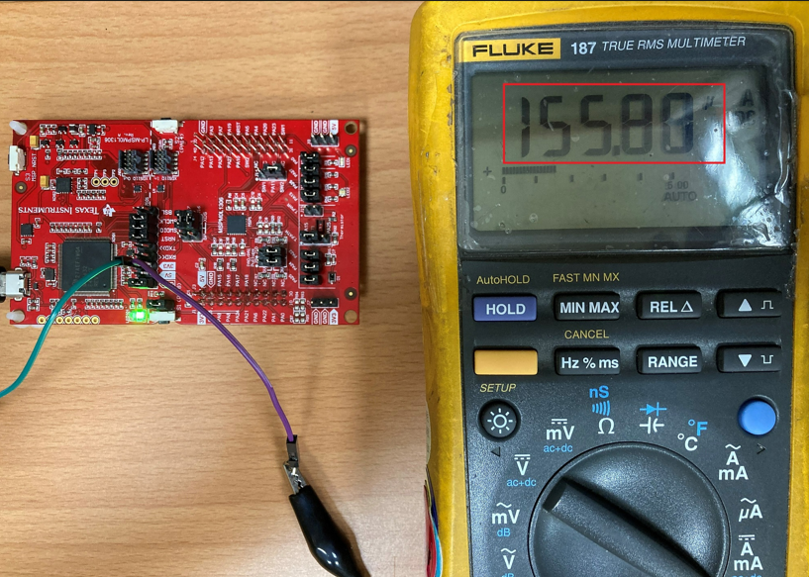
Measurement: use multimeter to measure the current from XDS2 to MSPM0L1306SRHB
Remove J101 3v3 Jumper to measure the current from from XDS2 to MSPM0L1306SRHB

Slide 3
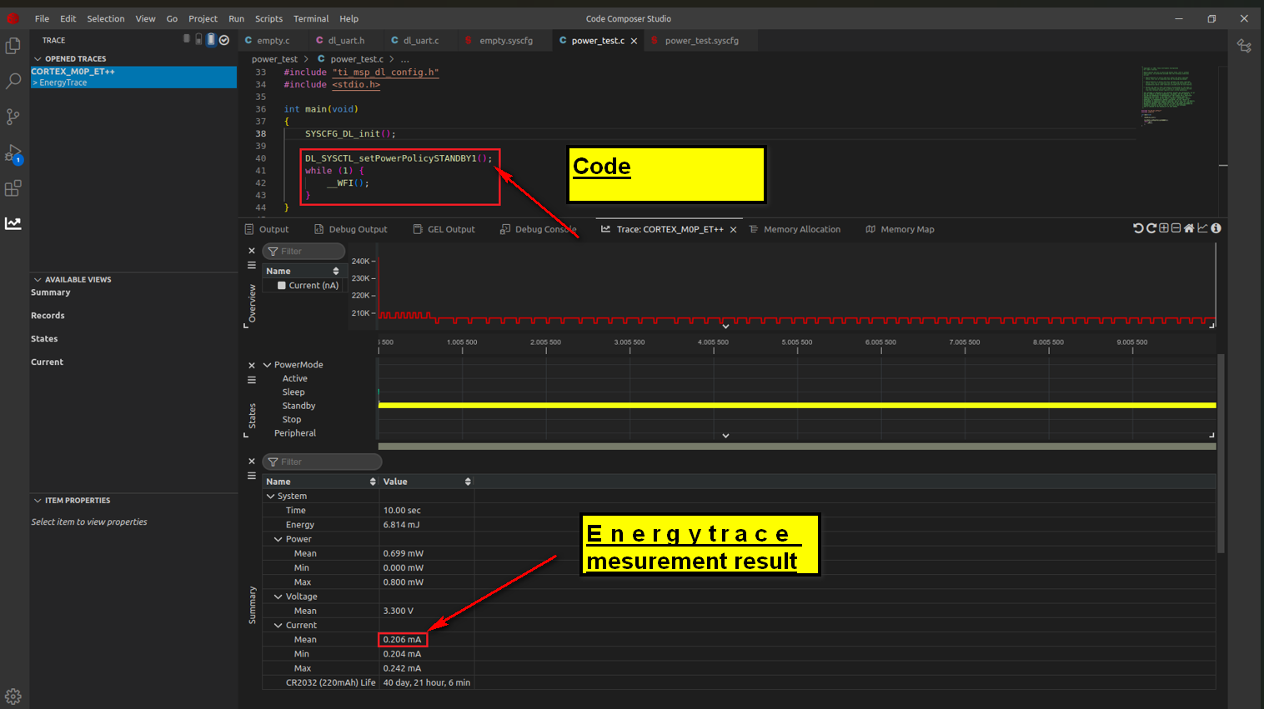

Slide 4
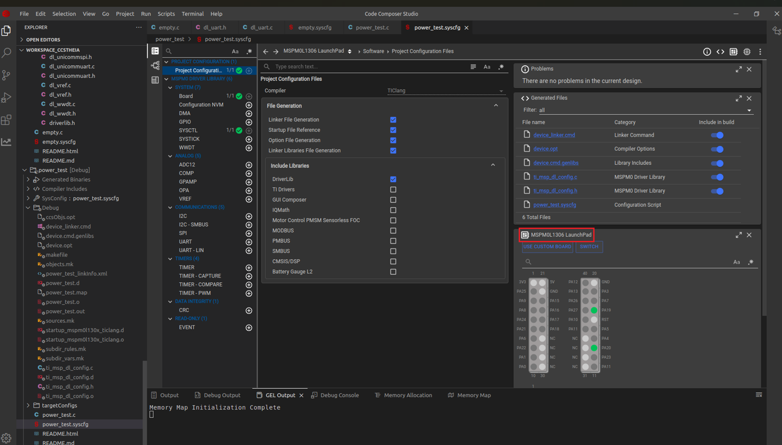
Software configures unused Pins to input and pull low

Slide 5
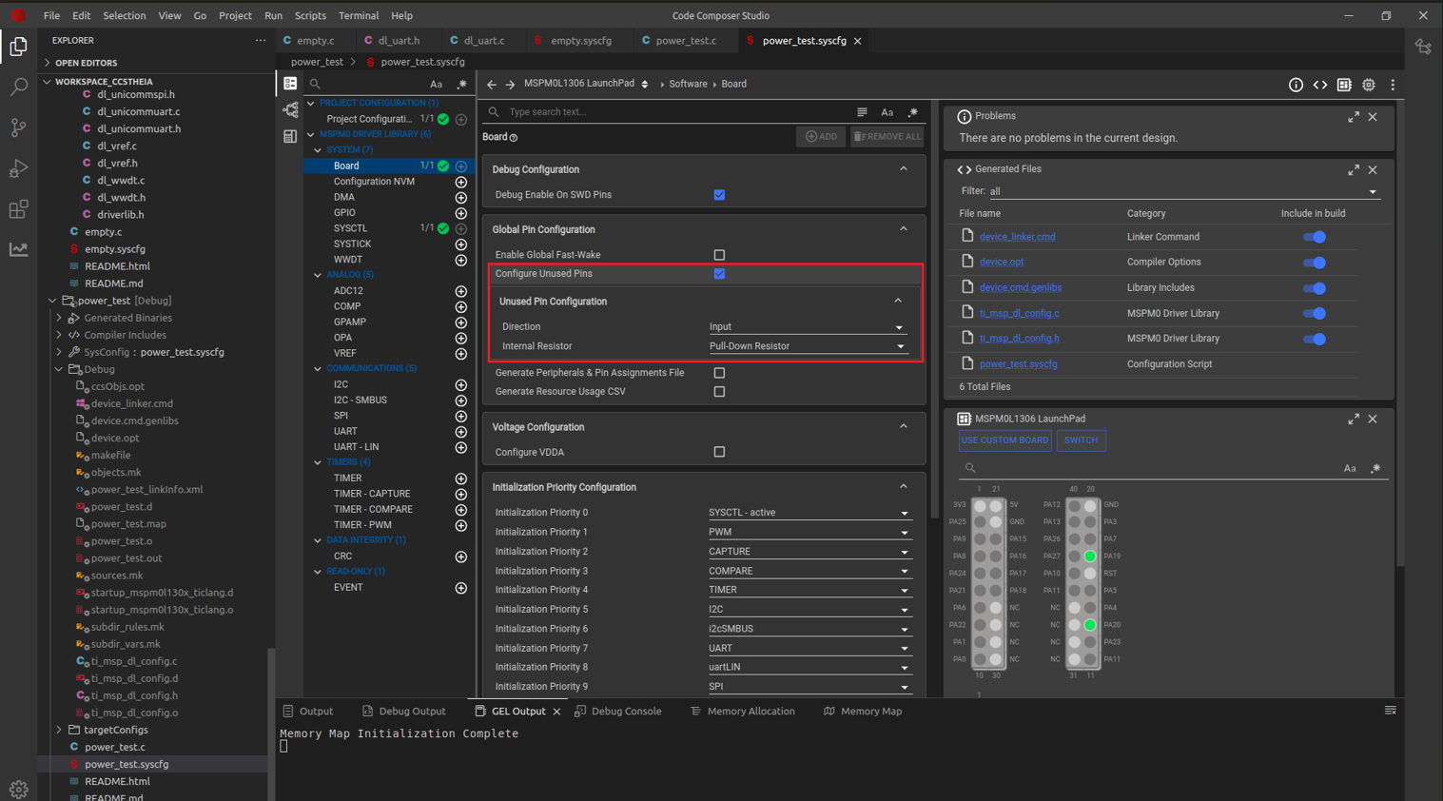
Software configures unused Pins to input and pull low

Slide 6
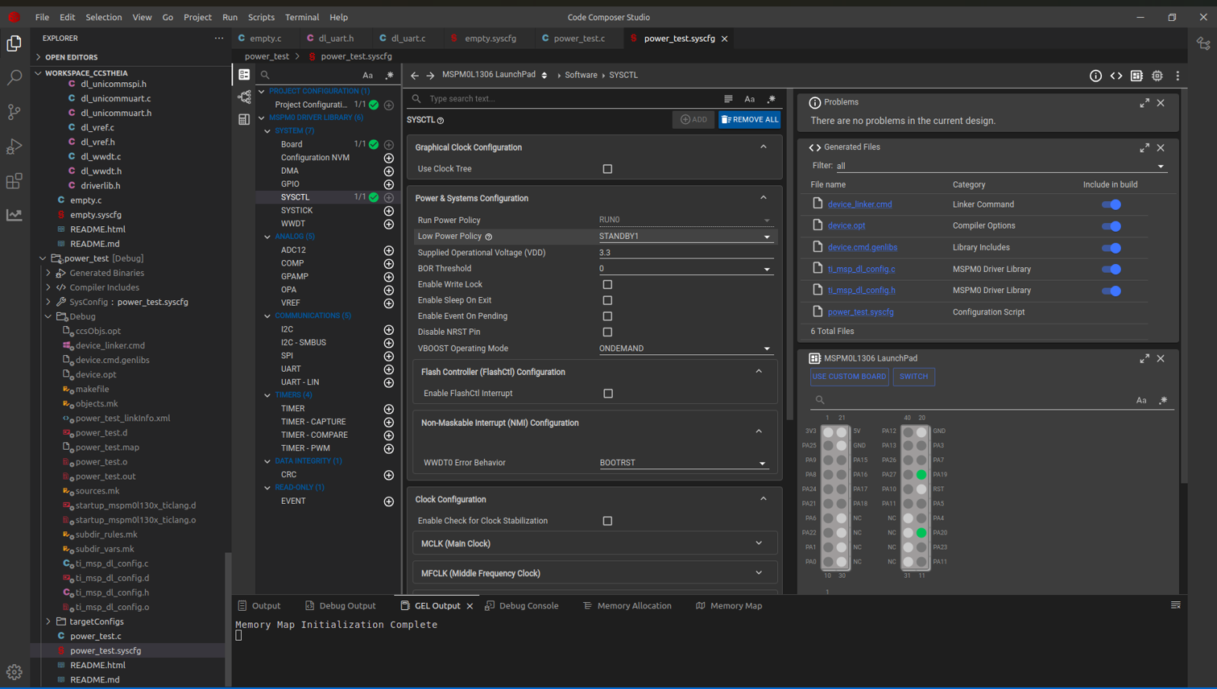

Slide 7
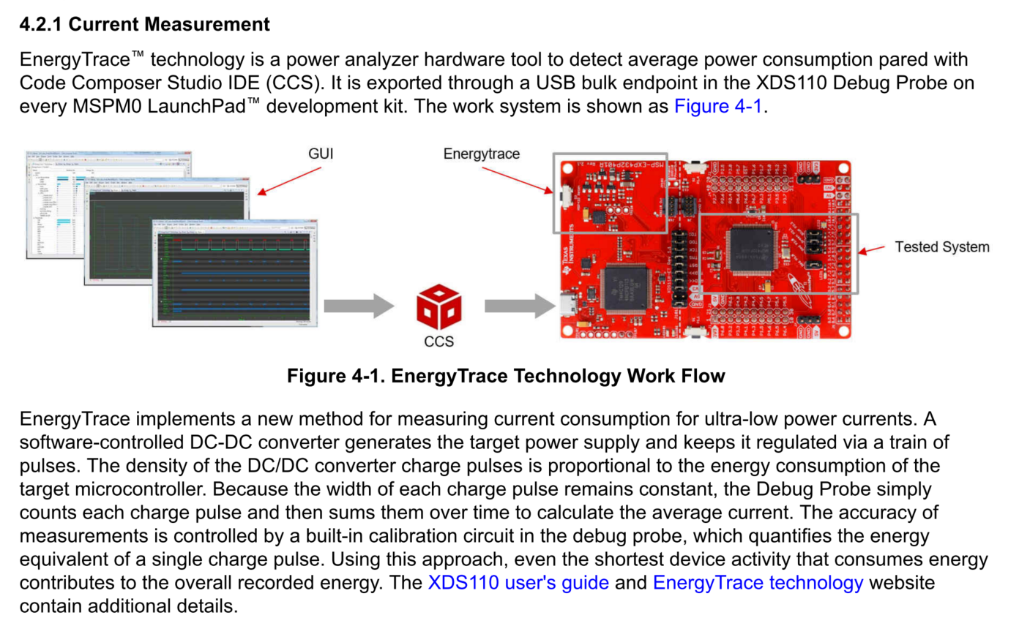
SLAAE72 – DECEMBER 2022

Slide 8
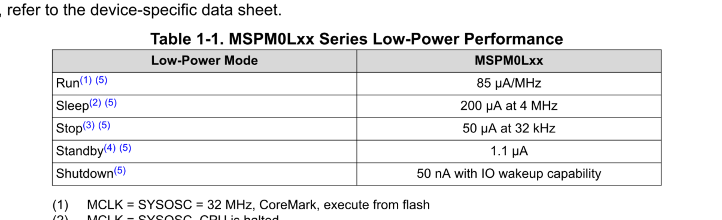
SLAAE72 – DECEMBER 2022

