Slide 1
MCAN Transmitter Delay Compensation (TDC)
EP-ASM Applications
Zackary Fleenor

Slide 2
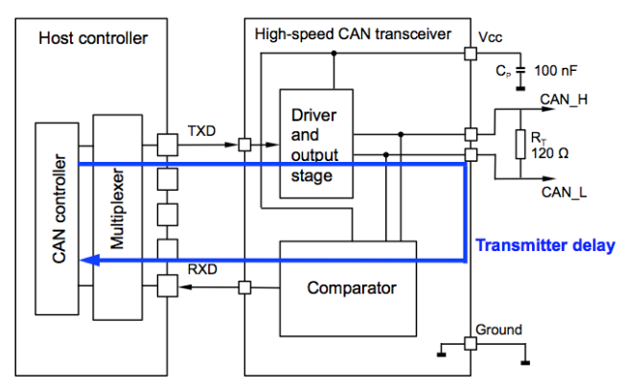
What is the point of TDC?
TD is the delay from the CAN FD controller’s transmit FlipFlop to its receive FlipFlop. This means, when the CAN FD controller sends a bit, this bit appears at the CAN FD controller’s receive pin after TD. The TD includes the host controller internal delay, the transceiver delay and the delay on the ECU.

Slide 3
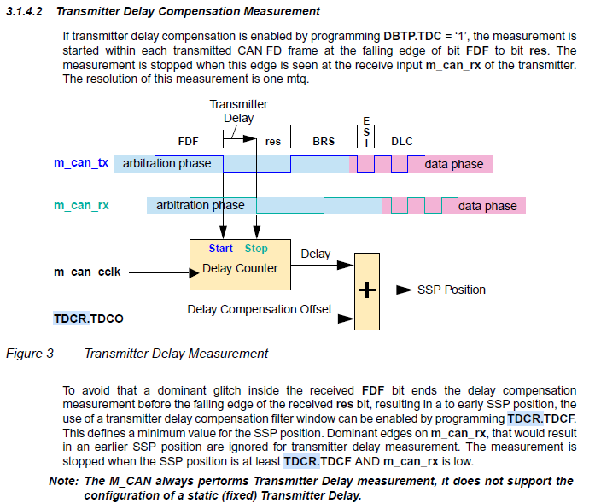

Slide 4
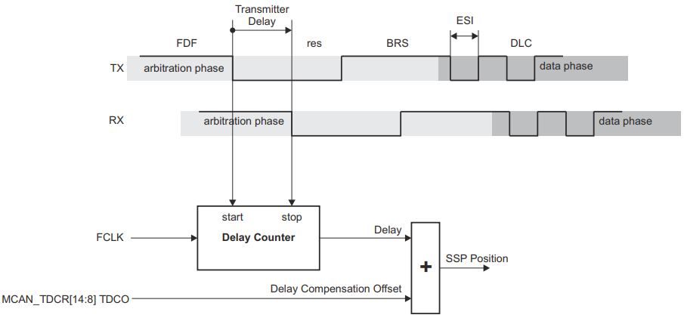
Transmitter Delay Compensation Diagram

Slide 5
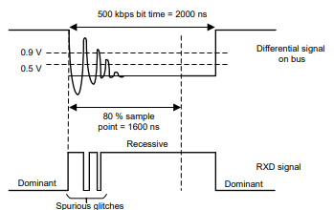

Slide 6
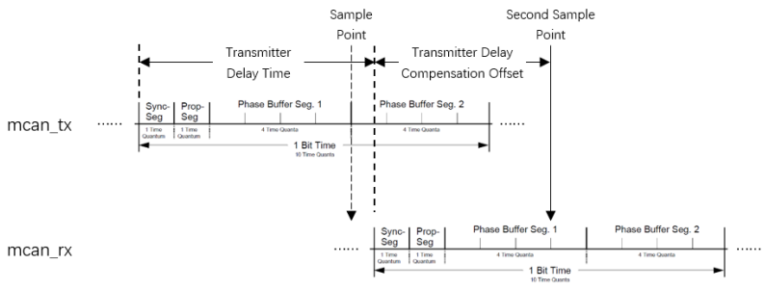

Slide 7
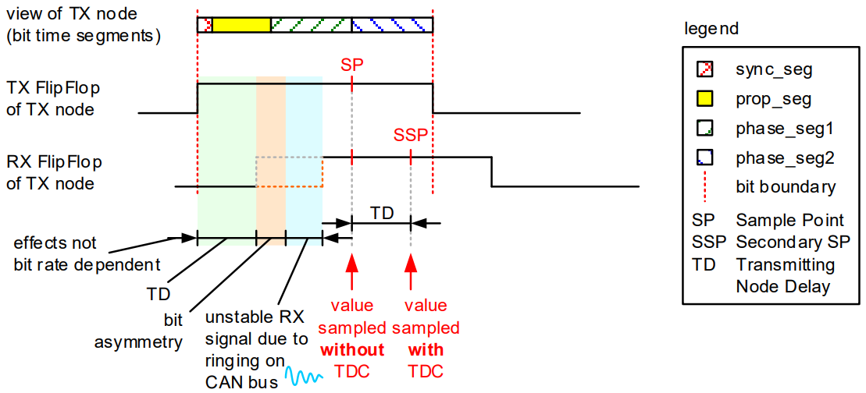
Sampling of a recessive bit with and without TDC

Slide 8
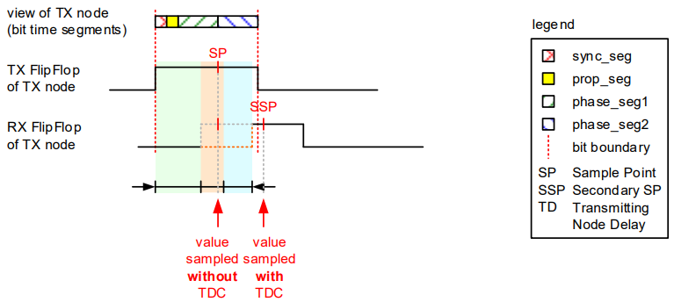
Failure Case when NOT using TDC

Slide 9
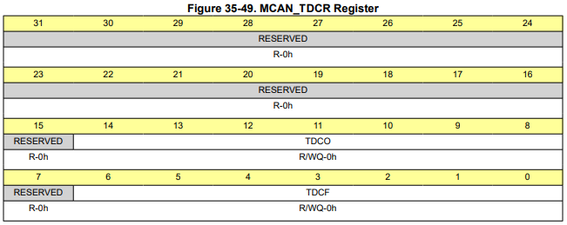
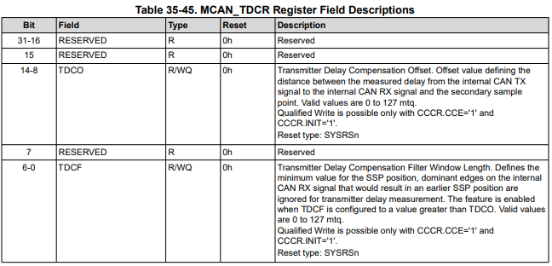
Transmitter Delay Compensation (TDCR) Register

Slide 10
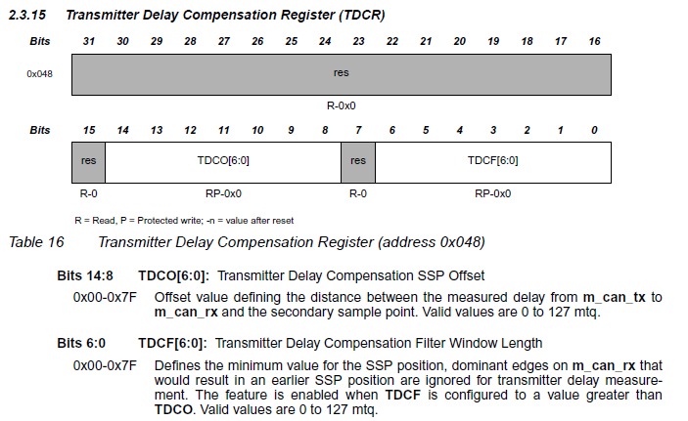

Slide 11
Transmitter Delay Compensation Description
The protocol unit of the MCAN has a delay compensation mechanism to compensate the transmitter delay. This enables configurations where the data bit time is shorter than the transmitter delay. It is enabled by setting the TDC bit in the DBTP register. The TDCO field in the TDCR register is used for setting the transmitter delay compensation offset. The offset value defines the distance between the measured delay from MCAN_TX to MCAN_RX and the secondary sample point (SSP).
In case TDC is enabled, a CAN FD controller acting as transmitter measures the TD based on the recessive-to-dominant edge from FDF-bit to res-bit. It performs the measurement once within each FD frame that uses bit-rate switching. When TDC and bit-rate switching are enabled, the CAN FD controller compares in the data phase its transmitted bit to the received bit at the SSP.

Slide 12
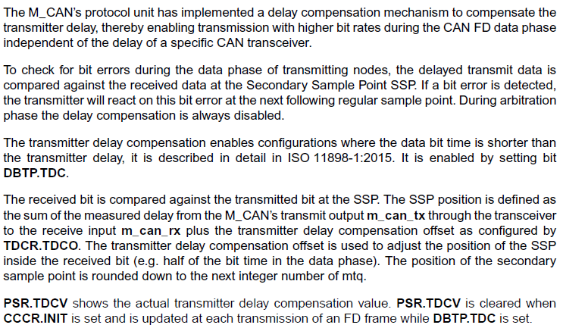

Slide 13
TDCO and TDCF Definitions
TDCR.TDCO:
Transmitter Delay Compensation Offset:
Offset value defining the distance between the measured delay from the internal CAN TX signal to the internal CAN RX signal and the secondary sample point.
Valid values are 0 to 127 mtq.
TDCR.TDCF:
Transmitter Delay Compensation Filter Window Length:
Defines the minimum value for the SSP position, dominant edges on the internal CAN RX signal that would result in an earlier SSP position are ignored for transmitter delay measurement.
The feature is enabled when TDCF is configured to a value greater than TDCO.
Valid values are 0 to 127 mtq.
(TDCO + the actual transmitter delay measurement) defines the SSP position
TDCF defines a filter window to avoid an early SSP position due to any glitch (dominant) during the delay measurement. (Sets a Minimum value for SSP position)

Slide 14
BACKUP

Slide 15
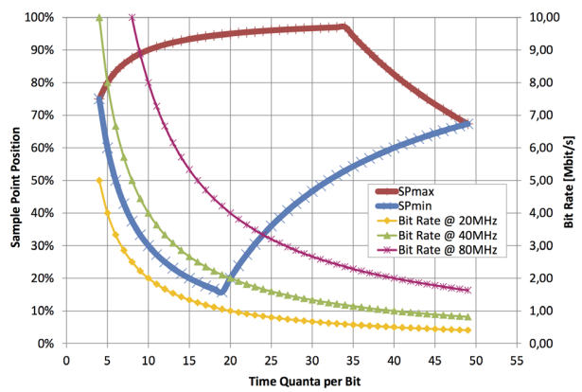
SSP to TQperBit across Bit Rate

Slide 16
The TDCF (Transmitter Delay Compensation Filter Window Length) register is used to configure the transmitter delay compensation filter window length feature. This feature is enabled when the TDCF value is greater than the TDCO (Transmitter Delay Compensation Offset) value. When this feature is enabled, the MCAN module ignores dominant edges on the internal CAN RX signal that would result in an earlier SSP (Secondary Sample Point) position. The TDCF register is used to specify the minimum value for the SSP position. If the SSP position is less than the value specified in the TDCF register, the MCAN module will ignore the dominant edge on the internal CAN RX signal and wait for the SSP position to reach the specified value before proceeding with the transmission. In other words, the TDCF register is used to prevent the MCAN module from transmitting too early due to a dominant edge on the internal CAN RX signal. This helps to ensure that the transmission is properly synchronized with the reception. The TDCF register is typically used in situations where the CAN bus is subject to electromagnetic interference (EMI) or other forms of noise that can cause dominant edges on the internal CAN RX signal. By enabling the transmitter delay compensation filter window length feature, the MCAN module can help to improve the reliability and accuracy of the transmission.

Slide 17
Here are some scenarios where the TDCF register might be used:
**High-noise environments**: In environments with high levels of electromagnetic interference (EMI) or other forms of noise, the TDCF register can help to prevent the MCAN module from transmitting too early due to dominant edges on the internal CAN RX signal.
**Long bus lines**: On long bus lines, the TDCF register can help to prevent the MCAN module from transmitting too early due to signal reflections or other forms of noise.
**High-speed CAN networks**: In high-speed CAN networks, the TDCF register can help to prevent the MCAN module from transmitting too early due to signal skew or other forms of noise.

Slide 18
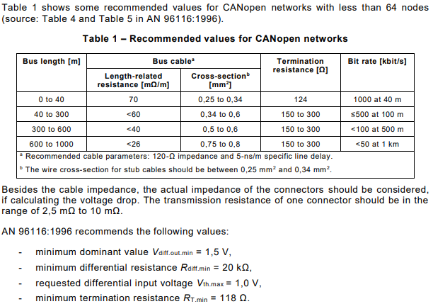
CANopen
Recommended
Configuation

Slide 19
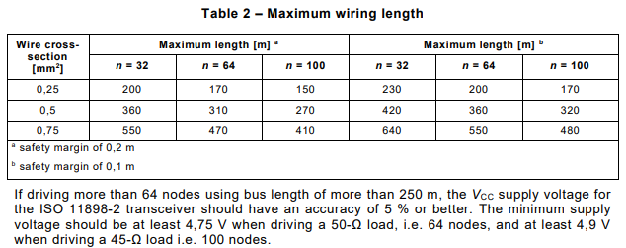
CANopen Max Wire Length per Node Count

