Slide 1
MSPM0 Blocking Issue Debug Flow
MSP
2026

Slide 2
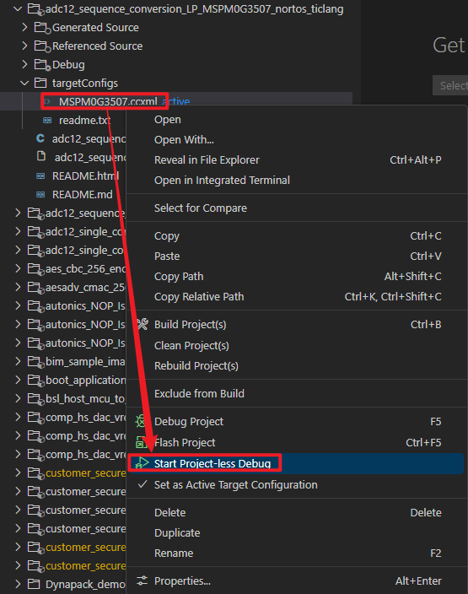
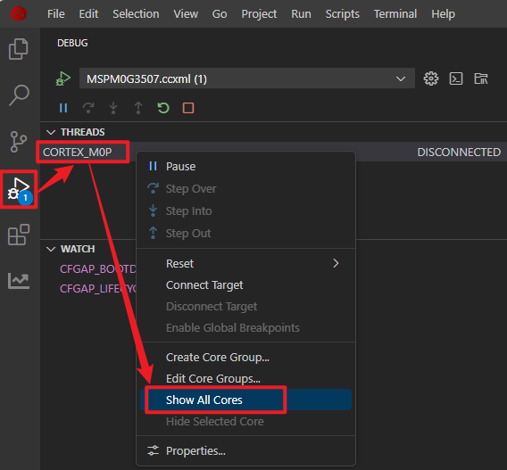
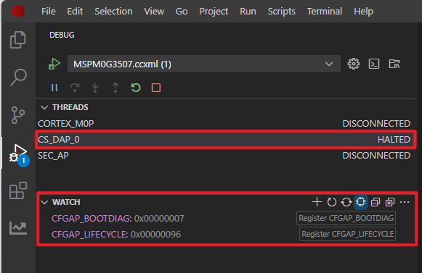
1. Check MCU Boot Status
Need to use XDS110 debugger
Firstly, add the below lines in the file: <ccs_path>\ccs\ccs_base\common\targetdb\Modules\AP\CFGAP.xml, where <ccs_path> is your current CCS version such as ccs1281, ccs2020…
  <register id="CFGAP_BOOTDIAG" offset="0x00010" width="32" page="121" acronym="CFGAP_BOOTDIAG"/>
  <register id="CFGAP_LIFECYCLE" offset="0x0014" width="32" page="121" acronym="CFGAP_LIFECYCLE"/>
Import any MSPM0 SDK example to your workspace, and find the .ccxml file under targetConfigs folder.
Start Project-less Debug to Launch debug session.
In debug Window, right click on CORTEX_M0P and select “Show All Cores”. It should list all the debug ports in device. And then right click on CS_DAP_0 and “Connect Target”.
In expressions/WATCH window, add CFGAP_BOOTDIAG and CFGAP_LIFECYCLE, read the data. The data is expected to be 0x07 and 0x96. If any other value is observed, contact TI support team for help.
2

Slide 3
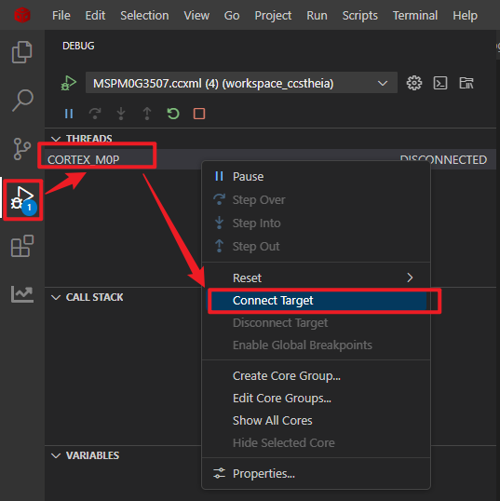
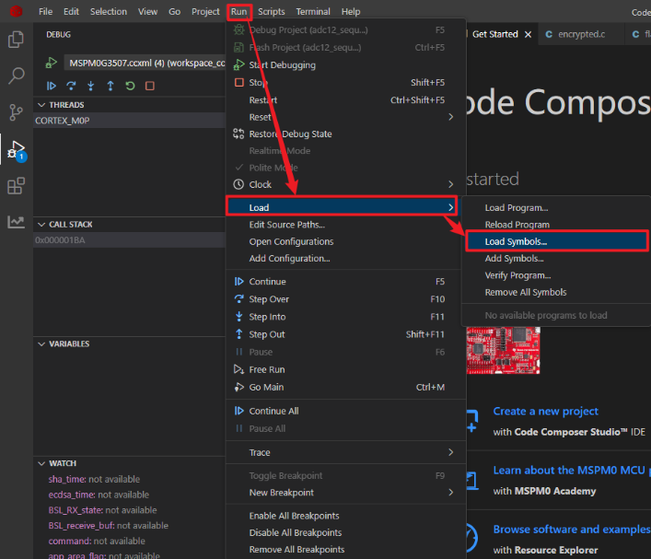
2. CCS Connect and Debug with application program
Import any of the MSPM0 SDK example to your workspace, and find the .ccxml file under targetConfigs folder.
Start Project-less Debug and Connect Target.
Load Program and select .out file that you want to load to MCU Flash.
If there is already a program running in MCU. And you do not want to load new program to MCU flash, just want to debug with existing program, try Load symbols of the MCU existing program.
3

Slide 4
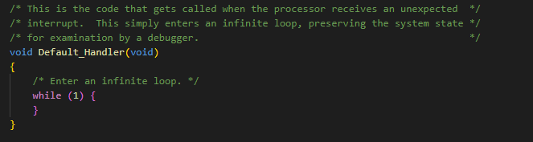
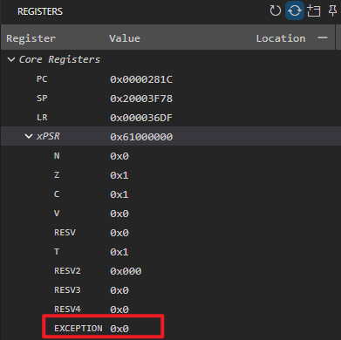
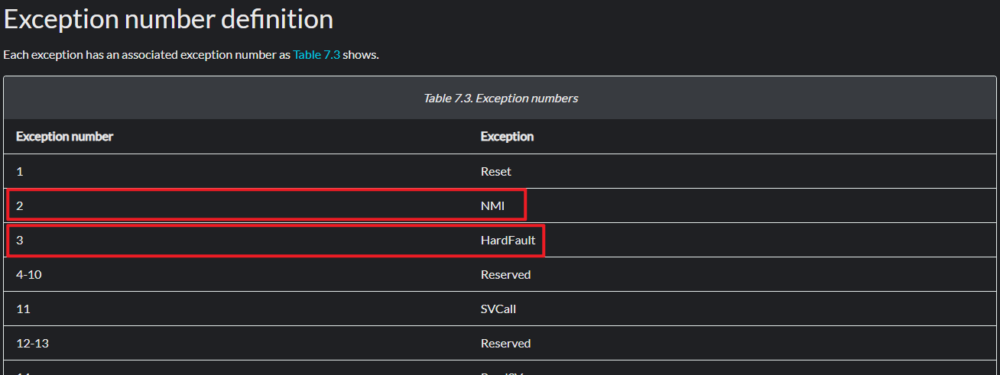
3. Default Handler
If program is seen block in Default_Handler(), then it mostly caused be a Hardfault or NMI exception.
Check the EXCEPTION field in xPSR register to see which exception is triggered.
  See ARMv6-M Architecture Reference Manual for detials
4

Slide 5
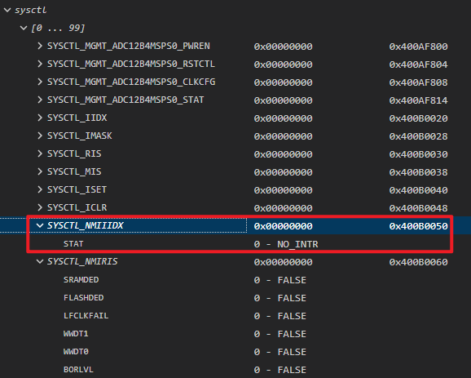
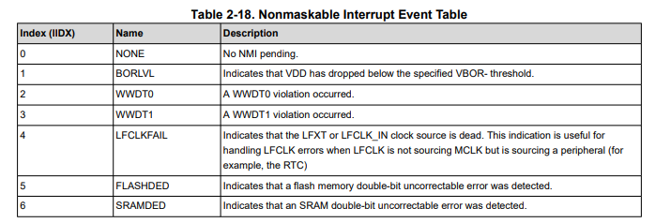
Check NMI Causes
Check SYSCTL.NMIIIDX register to see current pending NMI interrupt:
SRAMDED or FLASHDED : Further check SYSCTL.DEDERRADDR register to check the error address.
LFCLKFAIL: Check external LFXT work states. Try to change the crystal capacitor to make sure crystal successfully startup.
BORLVL: Check VDD power supply waveform during MCU working. Make sure LDO has large enough output current for MCU working.
  See Nonmaskable Interrupt Event Table in MSPM0 G-Series 80-MHz Microcontrollers Technical Reference Manual (Rev. C) for details.
5

Slide 6
Hard Fault Causes
Hard fault is generally caused by address error on CPU access, or access protected memory region by MPU, such as :
Access flash or SRAM address which is invalid in this device.
Access flash or SRAM address which is not word aligned.
Access peripheral registers which is not supported in this device.
Access address which is protected by MPU.

Slide 7
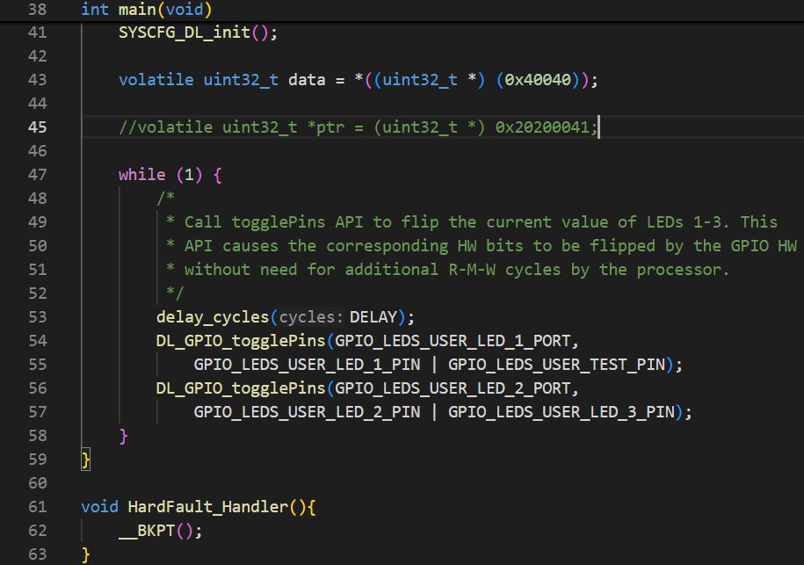
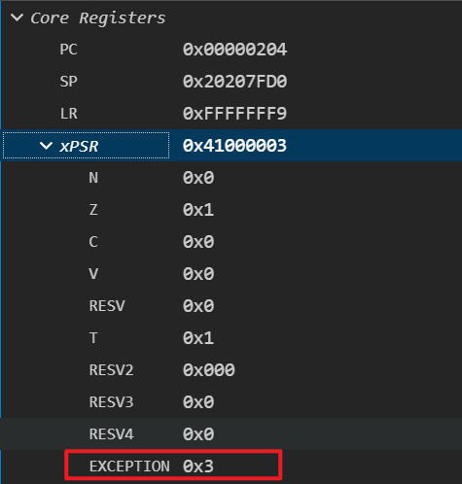
Debug with Hard Fault
Issue Phenomenon
The program is stall in HardFault_Handler().
If the HardFault_Handler() is not defined, it will enter Default_Handler(), which could be caused by NMI or Hard Fault.
For Hard Fault, if we check the xPSR register, the EXCEPTION field will be 0x3 for hard fault.
Hard Fault

Slide 8
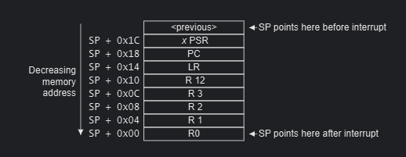
Debug with Hard Fault
When Hard Fault occurs, before CPU jump to hard fault handler, it will store current Core Register status, and push these registers value into Stack. So we could check the Stack content to get the PC value when Hard Fault occurs.
Please check Cortex-M0+ Devices Generic User Guide for the Exception entry and return flow.

Slide 9
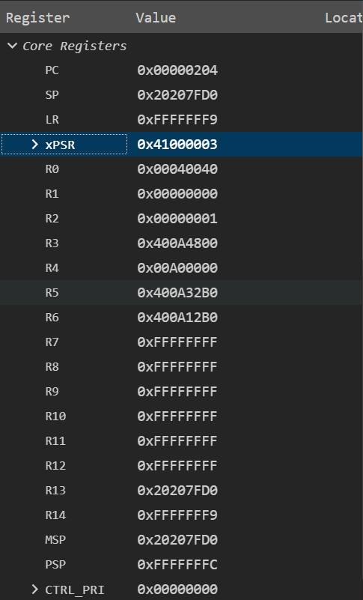
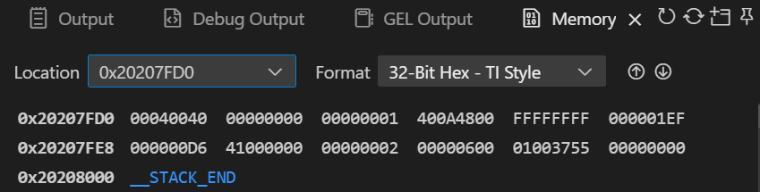
Debug with Hard Fault
There is an example for how to identify the PC when hard fault occur. By compare the Core Register content and Stack content, it shows the PC value when hard fault occur is 0x00D6.
And then we could check the 0x00D6 address to get the assembly instruction which causes hard fault.
PC value when Hard Fault occurs

Slide 10
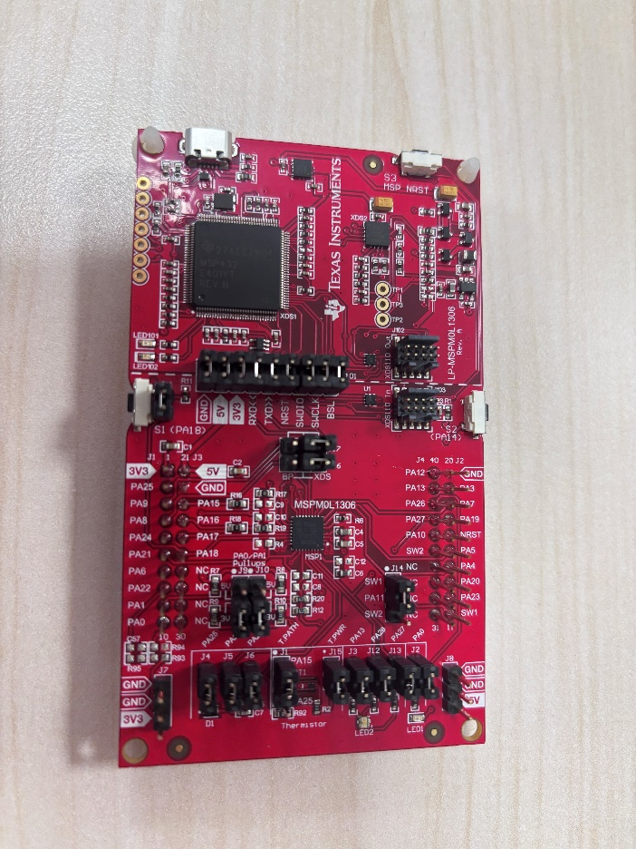
XDS110 Connection
GND
Customer Board
XDS110
3V3
SWDIO
SWCLK
Remove the Jumpers between XDS110 and MSPM0 board on launchpad.
Focus on the header pins on the XDS110 side (the highlighted part in yellow), connect SWDIO, SWCLK, 3V3 and GND with customer board debugger port.
MSPM0
10

