Slide 1
MSPM0 CSC Example Guide
TI MSP
May. 2025

Slide 2
CSC Example Quick Start Up
Resources
MSPM0 Security Boot User Guide
<mspm0_sdk_dir>/docs/english/middleware/boot_manager/doc_guide/doc_guide-srcs/customer_secure_users_guide.html
Mcuboot Open Source Document
mcuboot/docs/design.md at main · mcu-tools/mcuboot · GitHub
mcuboot/docs/imgtool.md at main · mcu-tools/mcuboot · GitHub

Slide 3
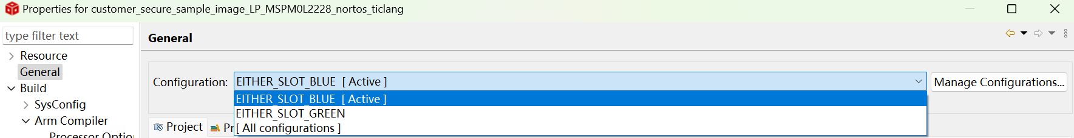
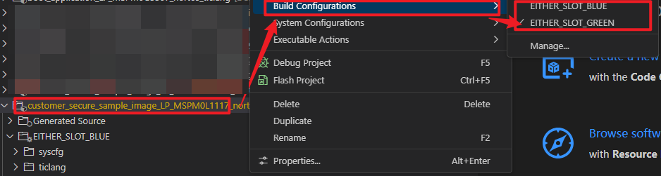
CSC Example Quick Start Up | L1117/L2228/G3519
Step By Step
Step1: Go into MSPM0 SDK install folder (such as C:\ti\mspm0_sdk_2_04_00_06)
Step2: Make sure python3.7 or newer version is installed and run below command in command line for necessary requirements. (for image signing and handling)
python -m pip install --user -r source/third_party/mcuboot/scripts/requirements.txt
Step3: Build <customer_secure_sample_image> example for GREEN or BLUE configuration in project property. (Active in ‘Manage Configuration’)
CCS 12.8.1 or before
CCS 20 or higher

Slide 4
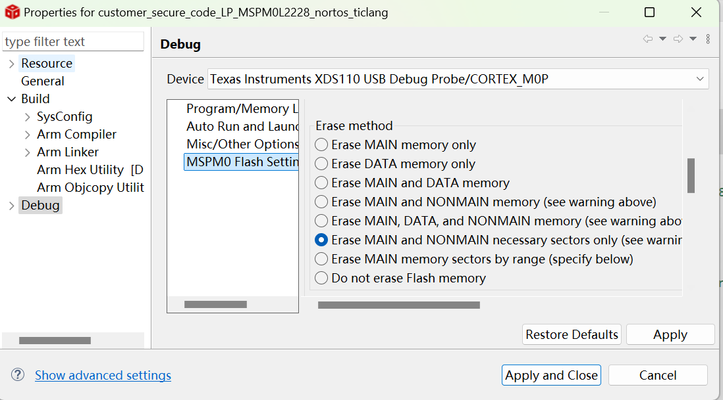
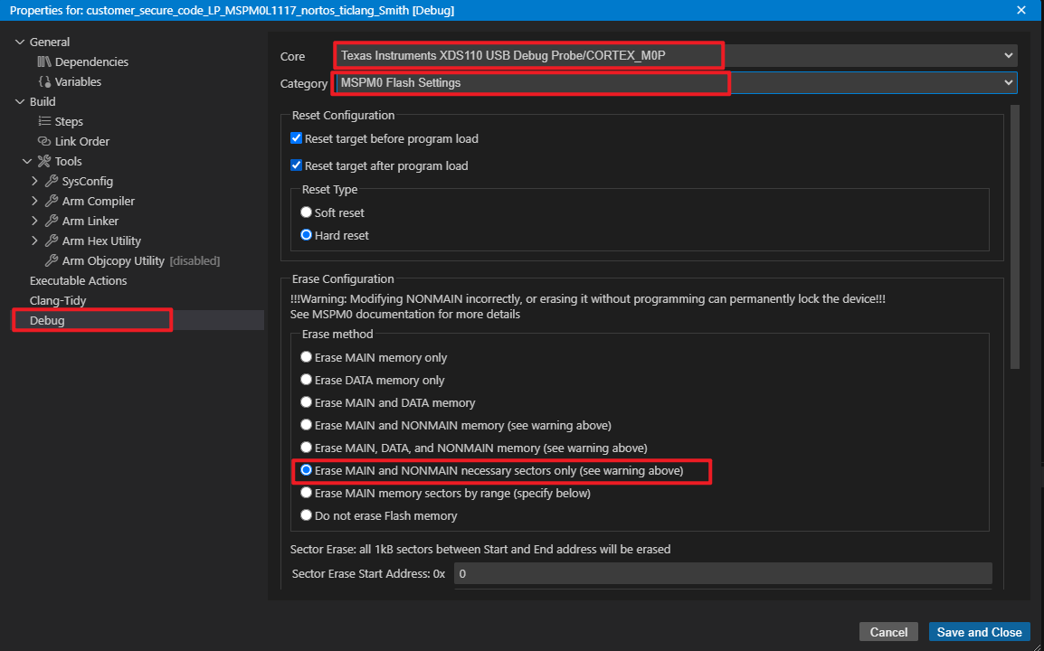
CSC Example Quick Start Up | L1117/L2228/G3519
Step By Step
Step4: Got to <customer_secure_code> example properties, and configure flash erase method.
CCS 12.8.1 or before
CCS 20 or higher

Slide 5
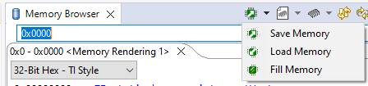
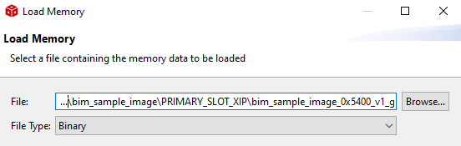
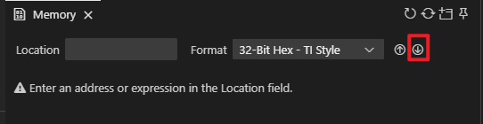
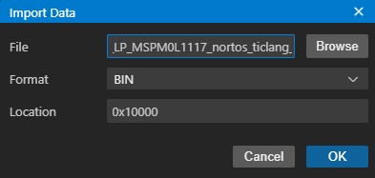
CSC Example Quick Start Up | L1117/L2228/G3519
Step By Step
Step5: Debug <customer_secure_code> example, stop before the program start running.
View – Memory Browser
Select Load Memory.
Load below three image to the flash from ccs workspace: (File Type: Binary)
\customer_secure_code_LP_MSPM0L2228_nortos_ticlang\Debug\customer_secure_code_LP_MSPM0L2228_nortos_ticlang-bank1-0x20000.bin – Start Address: 0x20000 (0x10000 for L1117, 0x40000 for G3519)
\customer_secure_sample_image_LP_MSPM0L2228_nortos_ticlang\EITHER_SLOT_BLUE\sample_image_signed_0x4800_v1_0_0_blue.bin – Start Address: 0x4800 (0x4800 for L1117 and G3519)
\customer_secure_sample_image_LP_MSPM0L2228_nortos_ticlang\EITHER_SLOT_GREEN\sample_image_signed_0x4800_v2_0_0_green.bin – Start Address: 0x24800 (0x14800 for L1117, 0x44800 for G3519)
CCS 12.8.1 or before
CCS 20 or higher

Slide 6
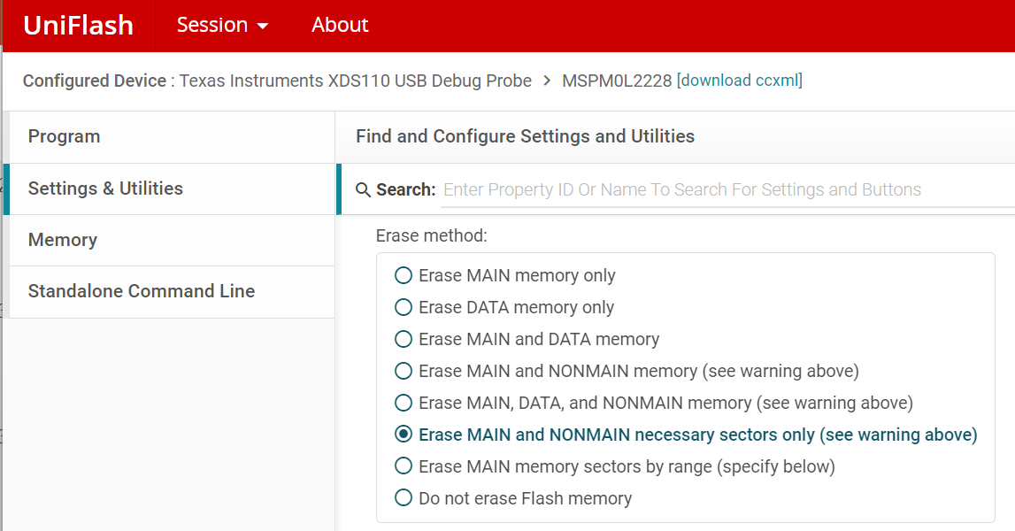
CSC Example Quick Start Up | L1117/L2228/G3519
Step By Step
Step6: Disconnect debug and reset device:
The RED LED on for 1-2s, representing for CSC execution stage.
Then the GREED LED flashing because a higher image version. (executed in Physical BANK1)
Step7: Image update - Open Uniflash, select MSPM0L2228/L1117/G3519 for correct device.
Configure Erase method (such as right image)
Load image (or higher version) in: \customer_secure_sample_image_LP_MSPM0L2228_nortos_ticlang\EITHER_SLOT_BLUE\ sample_image_signed_0x4800_v3_0_0_blue.txt
Reset device, the BLUE LED flashing after RED LED on for 1-2s.
Reset device again, the RED LED on for a quite short time (AES-CMAC fast image verification) and then BLUE LED flashing

