Slide 1
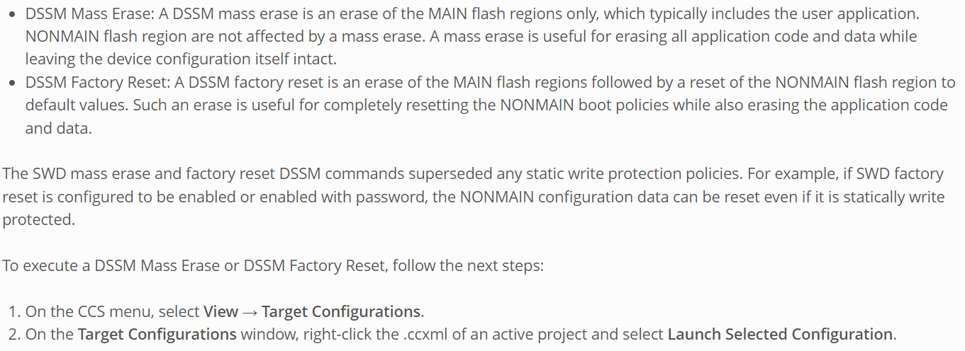
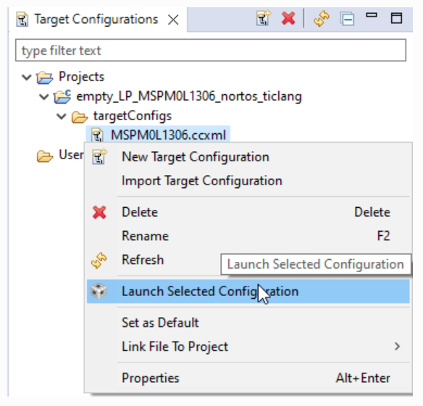
1. MSPM0 CCS Mass Erase & Factory Reset

Slide 2
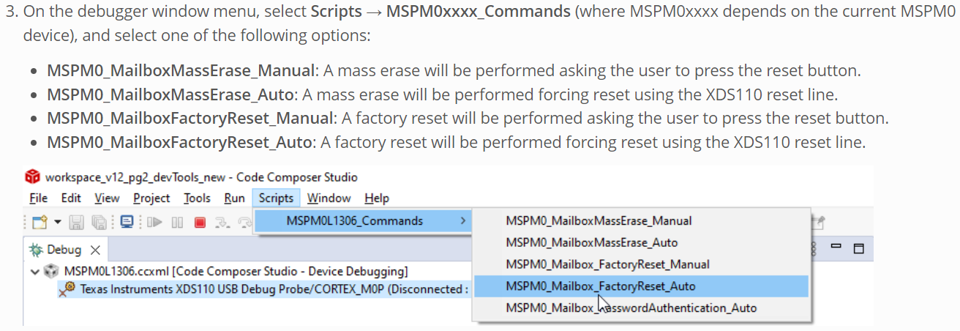

Slide 3
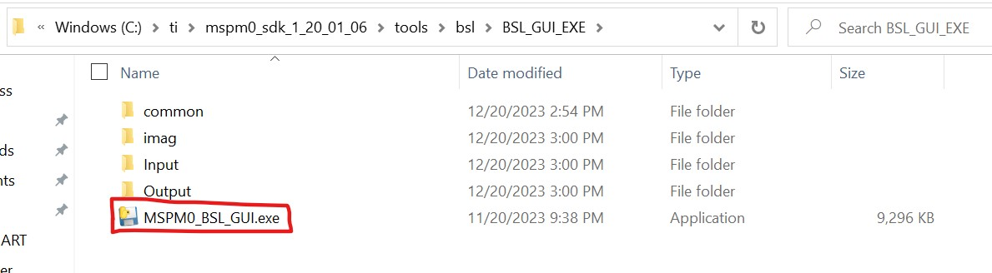
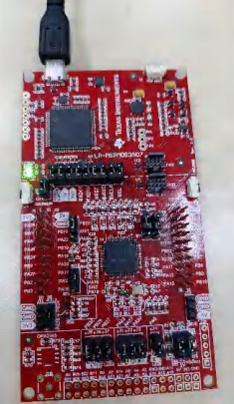
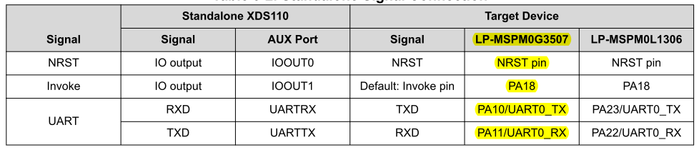
2. MSPM0 BSL Host Usage
Using MSPM0_BSL_GUI host to execute erase flash、firmware update
1. Open MSPM0_BSL_GUI host in the SDK
2. Connect the XDS110 and the chip via the UART interface
using the default pinout as follows:
The EVM board has been connected by default using jumpers.

Slide 4
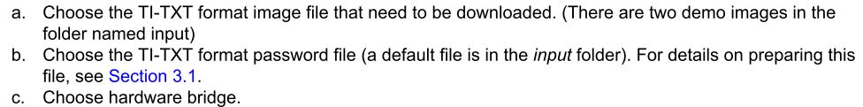

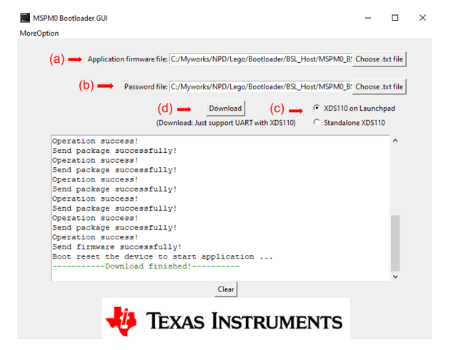


3. Follow these steps to configure the host computer interface:
Note that when using the standalone XDS110, please select "Standalone XDS110"
d. Download：
1. Set the chip's invoke pin to a high level (e.g., PA18, on the left button of the TI EVM board).
2. Then set the NRST pin to a low level.
3. After that, click the Download button. During the process, you can restore the invoke pin; it doesn't need to be kept high continuously.

