Slide 1
MSPM0 Hard Fault Debug
MSP Team
June, 2025

Slide 2
Hard Fault Causes
Hard fault is generally caused by address error on CPU access, or access protected memory region by MPU, such as :
Access flash or SRAM address which is invalid in this device.
Access flash or SRAM address which is not word aligned.
Access peripheral registers which is not supported in this device.
Access address which is protected by MPU.

Slide 3
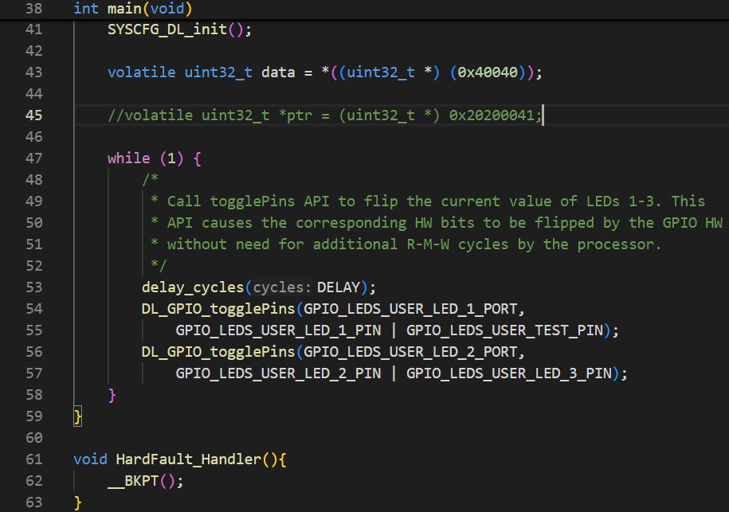
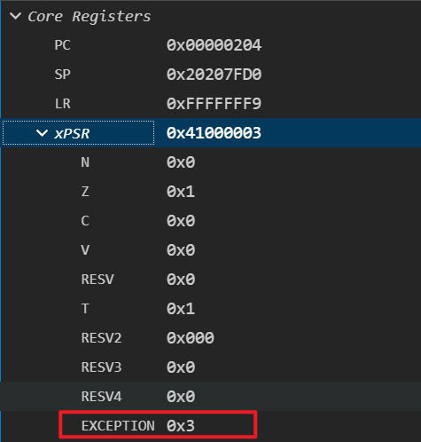
Debug with Hard Fault
Issue Phenomenon
The program is stall in HardFault_Handler().
If the HardFault_Handler() is not defined, it will enter Default_Handler(), which could be caused by NMI or Hard Fault.
For Hard Fault, if we check the xPSR register, the EXCEPTION field will be 0x3 for hard fault.
Hard Fault

Slide 4
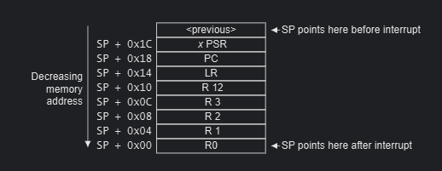
Debug with Hard Fault
When Hard Fault occurs, before CPU jump to hard fault handler, it will store current Core Register status, and push these registers value into Stack. So we could check the Stack content to get the PC value when Hard Fault occurs.
Please check Cortex-M0+ Devices Generic User Guide for the Exception entry and return flow.

Slide 5
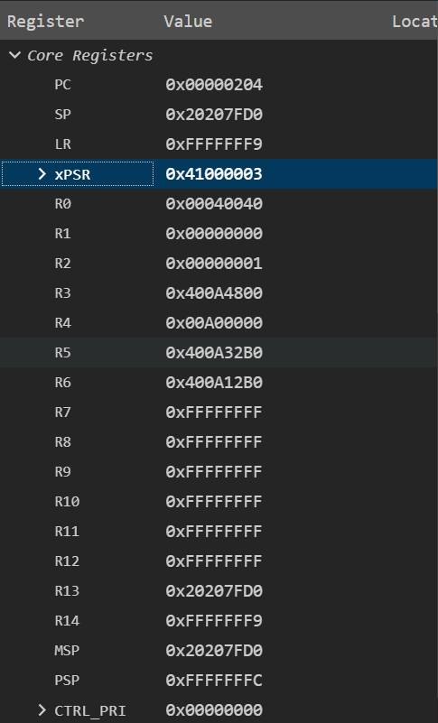
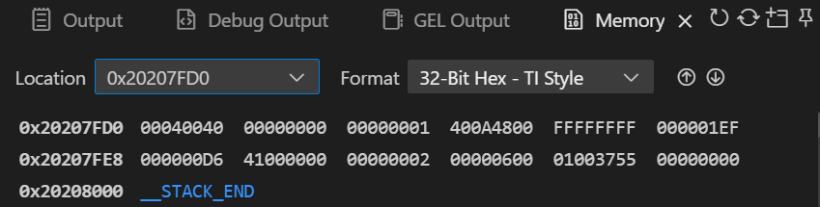
Debug with Hard Fault
There is a example for how to identify the PC when hard fault occur. By compare the Core Register content and Stack content, it shows the PC value when hard fault occur is 0x00D6.
And then we could check the 0x00D6 address to get the assembly instruction which causes hard fault.
PC value when Hard Fault occurs

