Slide 1
Unlock MSPM0
MSPM0 team

Slide 2
DSSM Mass Erase and Factory Reset
Solution 1: Using CCS
Step 1: Hardware connection: XDS110 with MSPM0 device
Step 3: In Target Configurations window, find your current MSPM0 project and expand the folders to find the .ccxml file:
Signals needed: VDD, GND, SWDIO, SWCLK, NRST
Step 2: Open Target Configurations

Slide 3
DSSM Mass Erase and Factory Reset
Solution 1: Using CCS
Step 4: Right-click the .ccxml file and click on Launch Selected Configuration
Step 5: Click on Scripts -> MSPM0G3507 Commands -> MSPM0_Mailbox_FacotryReset_Auto
Step 6:the Console will show the following:
Step 7: If that is not working, try force the device go into BSL and do the steps 2~6 above.
To force the device go into BSL mode, if you have not modified the default BSL invoke pin that is PA18 in NONMAIN Flash, you can pull high of PA18 before power up the device and keep it high. If you use the LaunchPad, you can just keep push the button S1 when connect the board to PC.

Slide 4
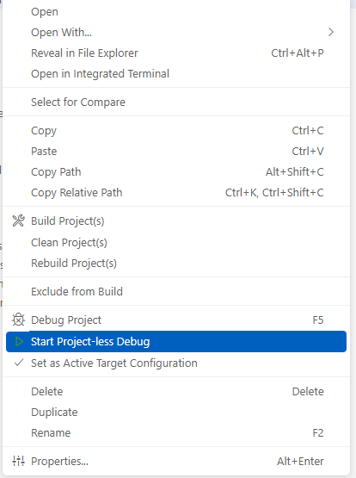
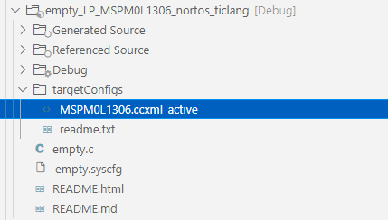
DSSM Mass Erase and Factory Reset
Solution 2: Using CCS Theia (CCS 20.0)
Step 1: Hardware connection: XDS110 with MSPM0 device
Step 3:Right-click the .ccxml file and click Start Project-less Debug
Signals needed: VDD, GND, SWDIO, SWCLK, NRST
Step 2: Find your current MSPM0 project and expand the targetConfigs folder to find the .ccxml file

Slide 5
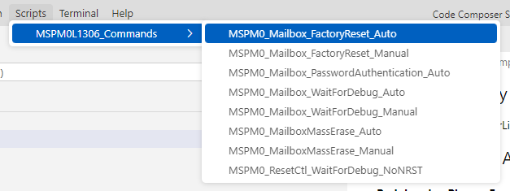
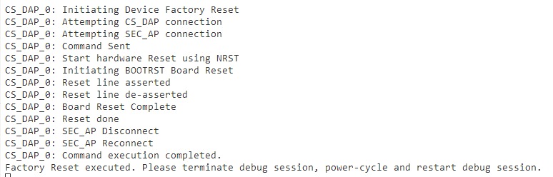
DSSM Mass Erase and Factory Reset
Solution 2: Using CCS Theia (CCS 20.0)
Step 4: Click on Scripts -> MSPM0L1306 Commands -> MSPM0_Mailbox_FacotryReset_Auto
Step 7: If that is not working, try force the device go into BSL and do the steps 2~5 above.
To force the device go into BSL mode, if you have not modified the default BSL invoke pin that is PA18 in NONMAIN Flash, you can pull high of PA18 before power up the device and keep it high. If you use the LaunchPad, you can just keep push the button S1 when connect the board to PC.
Step 5:the Console will show the following:

Slide 6
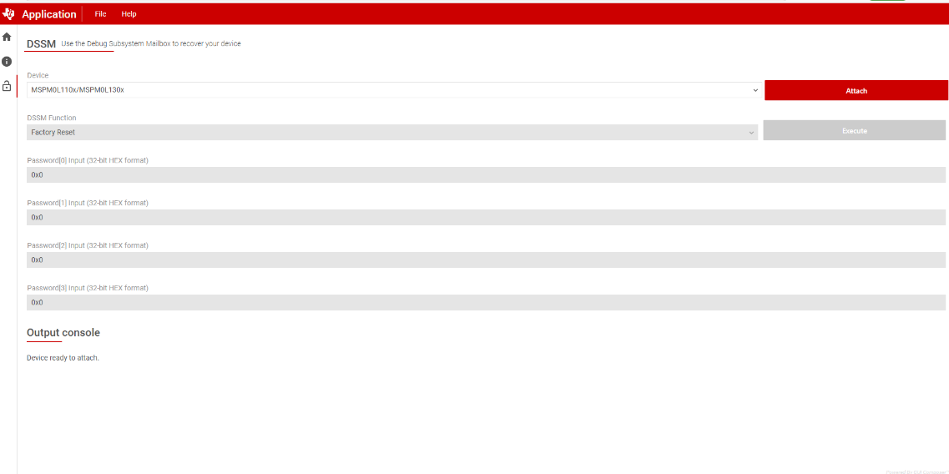
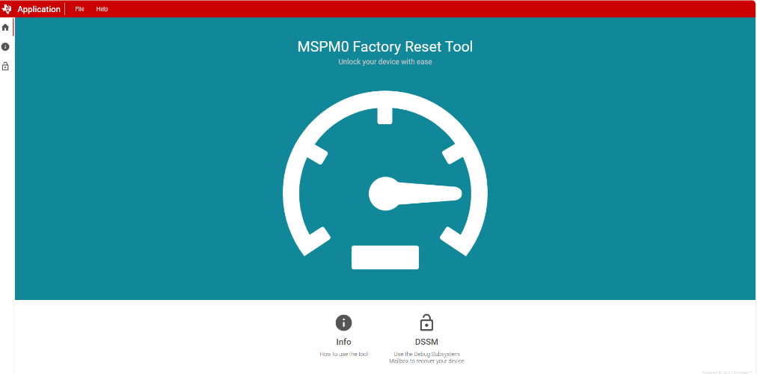
DSSM Mass Erase and Factory Reset
Solution 3: Using TI Online tool
MSPM0_Factory_Reset_Tool (ti.com)

Slide 7
DSSM Mass Erase and Factory Reset
Solution 4: Using Uniflash
Step 1: Download the latest version of Uniflash (> v 8.7.0)
Step 2:Do factory reset as below

Slide 8
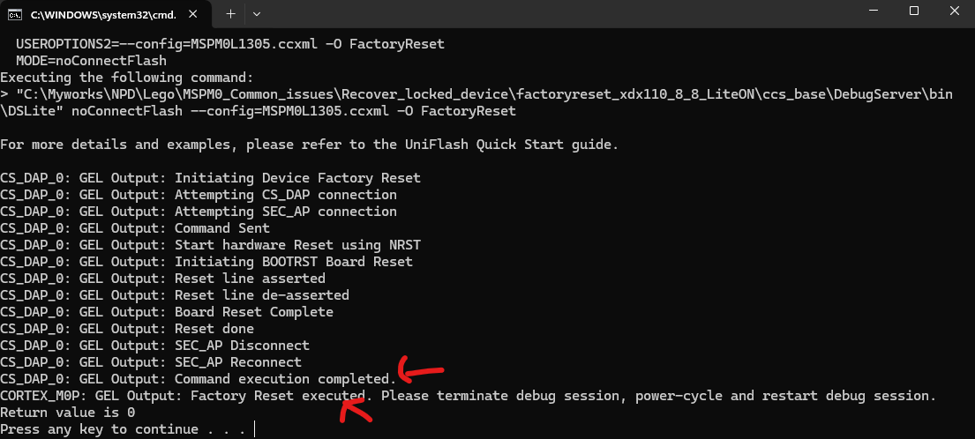
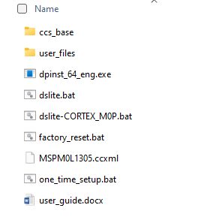

DSSM Mass Erase and Factory Reset
Solution 5: Using CommandLine based on XDS110
Step 1: Hardware connection: XDS110 with MSPM0 device
Step 3: If it is successful, it will show as below
Signals needed: VDD, GND, SWDIO, SWCLK, NRST
Step 2: Double click factory_reset.bat to do the factory reset

Slide 9
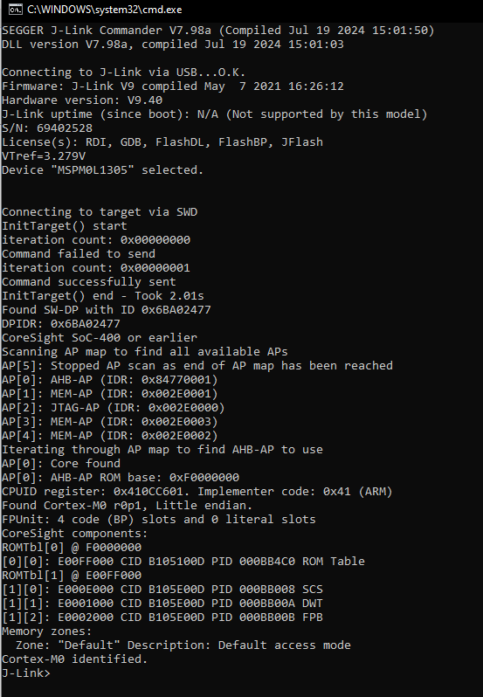
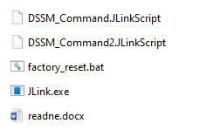

DSSM Mass Erase and Factory Reset
Solution 6: Using CommandLine based on J-Link
Step 1: Hardware connection: J-Link with MSPM0 device
Step 3: If it is successful, it will show as below
Signals needed: VDD, GND, SWDIO, SWCLK, NRST
Step 2: Open factory_reset.bat to modify the -device MSPM0L1305 to the device you test with, save and close it.
Step 3: Double click factory_reset.bat to do the factory reset.

Slide 10
Boot Diagnostic of MSPM0
MSPM0 team

Slide 11
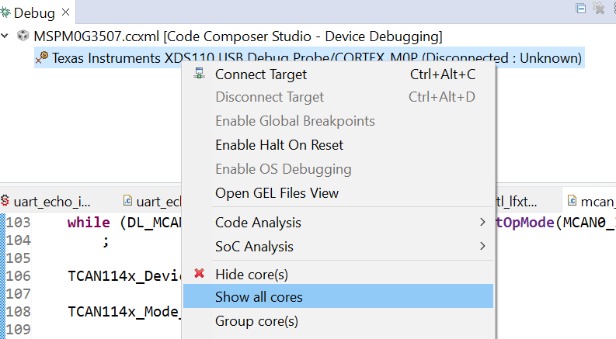
Boot Diagnostic based on CCS
Step 1: Close CCS first
Step 2: In CCS Path:
C:\ti\<ccsversion>\ccs\ccs_base\common\targetdb\Modules\AP\CFGAP.xml.
Add these two lines and save:
<register id="CFGAP_BOOTDIAG" offset="0x0010" width="32" page="121“
acronym="CFGAP_BOOTDIAG"/>
<register id="CFGAP_LIFECYCLE" offset="0x0014" width="32" page="121"
acronym="CFGAP_LIFECYCLE"/>
Step 3: Open CCS. Lauch Selected Configuration
Step 4: Show all cores

Slide 12
Boot Diagnostic based on CCS
Step 5: Right click on the CS_DAP_0 then click Connect Target
Step 6: If the CS_DAP_0 connect is successful. In the Expression window, type in CFGAP_BOOTDIAG and CFGAP_LIFECYCLE. Record the register value.

Slide 13
Boot Diagnostic based on CCS Theia (or version >20.0)
Step 1: Close CCS Theia (20.0) first
Step 2: In CCS Path:
C:\ti\<ccstheia version>\ccs\ccs_base\common\targetdb\Modules\AP\CFGAP.xml.
Add these two lines and save:
<register id="CFGAP_BOOTDIAG" offset="0x0010" width="32" page="121“
acronym="CFGAP_BOOTDIAG"/>
<register id="CFGAP_LIFECYCLE" offset="0x0014" width="32" page="121"
acronym="CFGAP_LIFECYCLE"/>
Step 3: Open CCS to an active project and open the targetConfigs folder

Slide 14
Boot Diagnostic based on CCS Theia (or version >20.0)
Step 4: Right-click the .ccxml file and select Start Project-less Debug
Step 5: Open watch window and add the symbol CFGAP_BOOTDIAG below
Step 6: Right click the THREADS and click show all cores

Slide 15
Boot Diagnostic based on CCS Theia (or version >20.0)
Step 7: Right-click the CS_DAP_0 and connect Target
Step 8: You will get the value of CFGAP_BOOTDIAG

