Slide 1
MibSPI communication for TMS570
Queries and Discussion with TI team
H C Trivedi

Slide 2
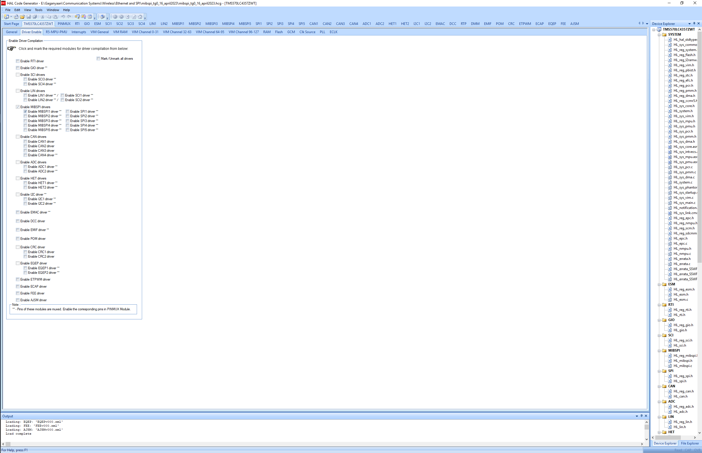
MibSPI Master :: HALCOGEN Configuration
On driver enable page, MibSPI1 has been selected.
Remaining drivers have been disabled.

Slide 3
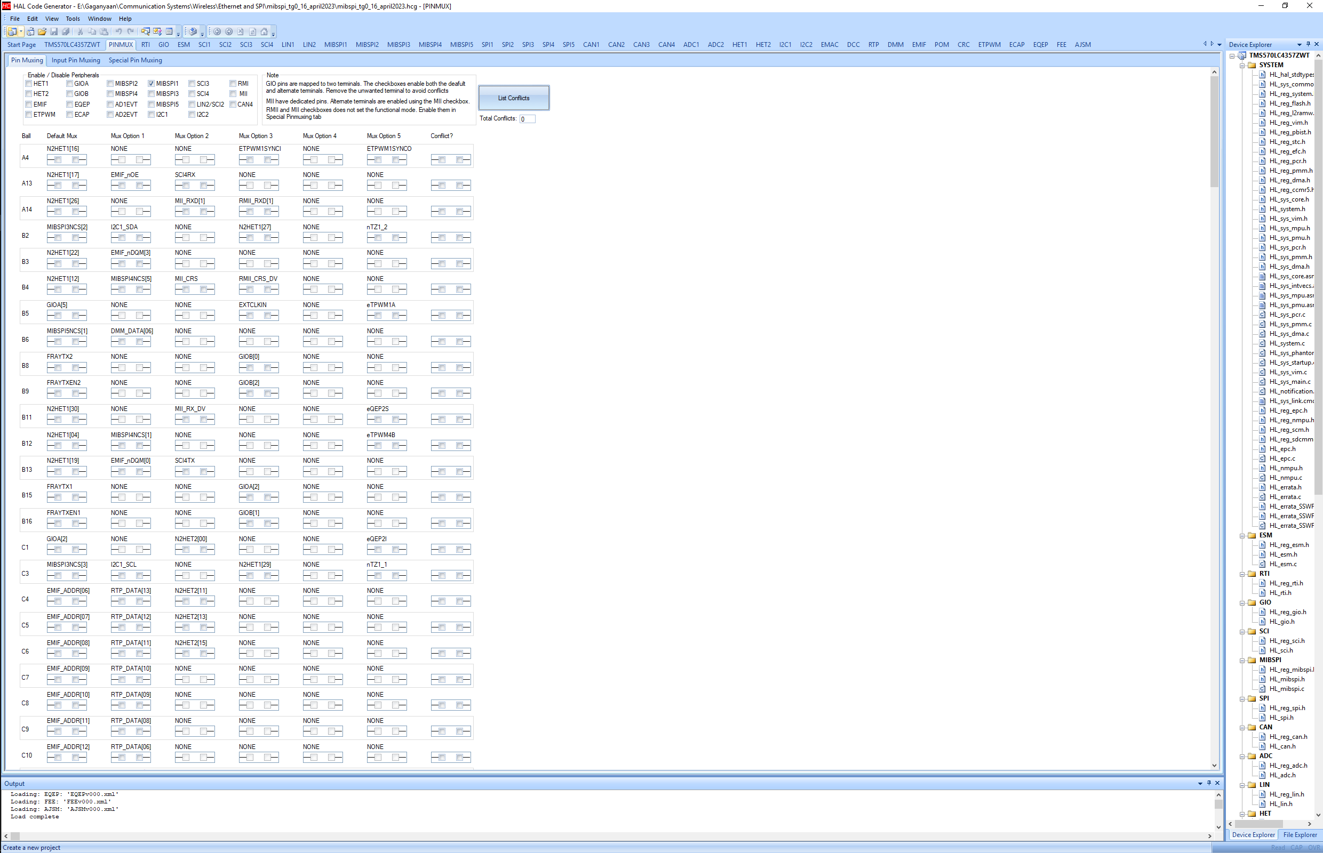
MibSPI Master :: HALCOGEN Configuration
Enable PinMux for MibSPI1 and remove all the conflicts.

Slide 4
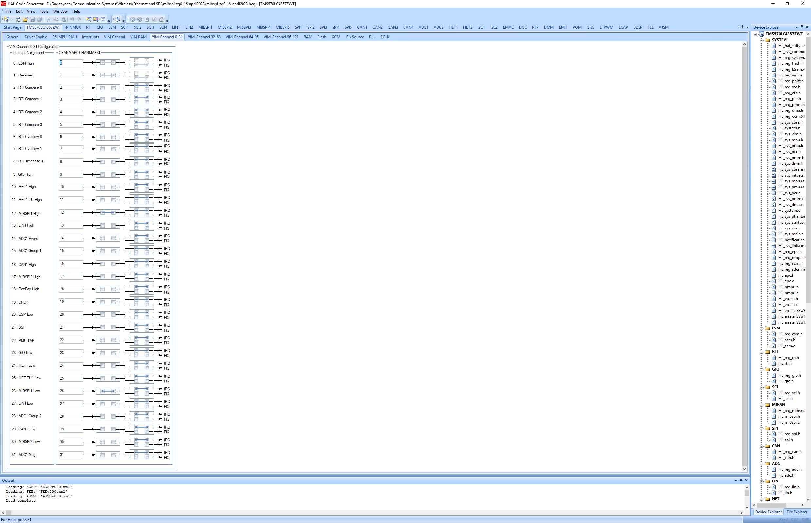
MibSPI Master :: HALCOGEN Configuration
Enable associated interrupts.

Slide 5
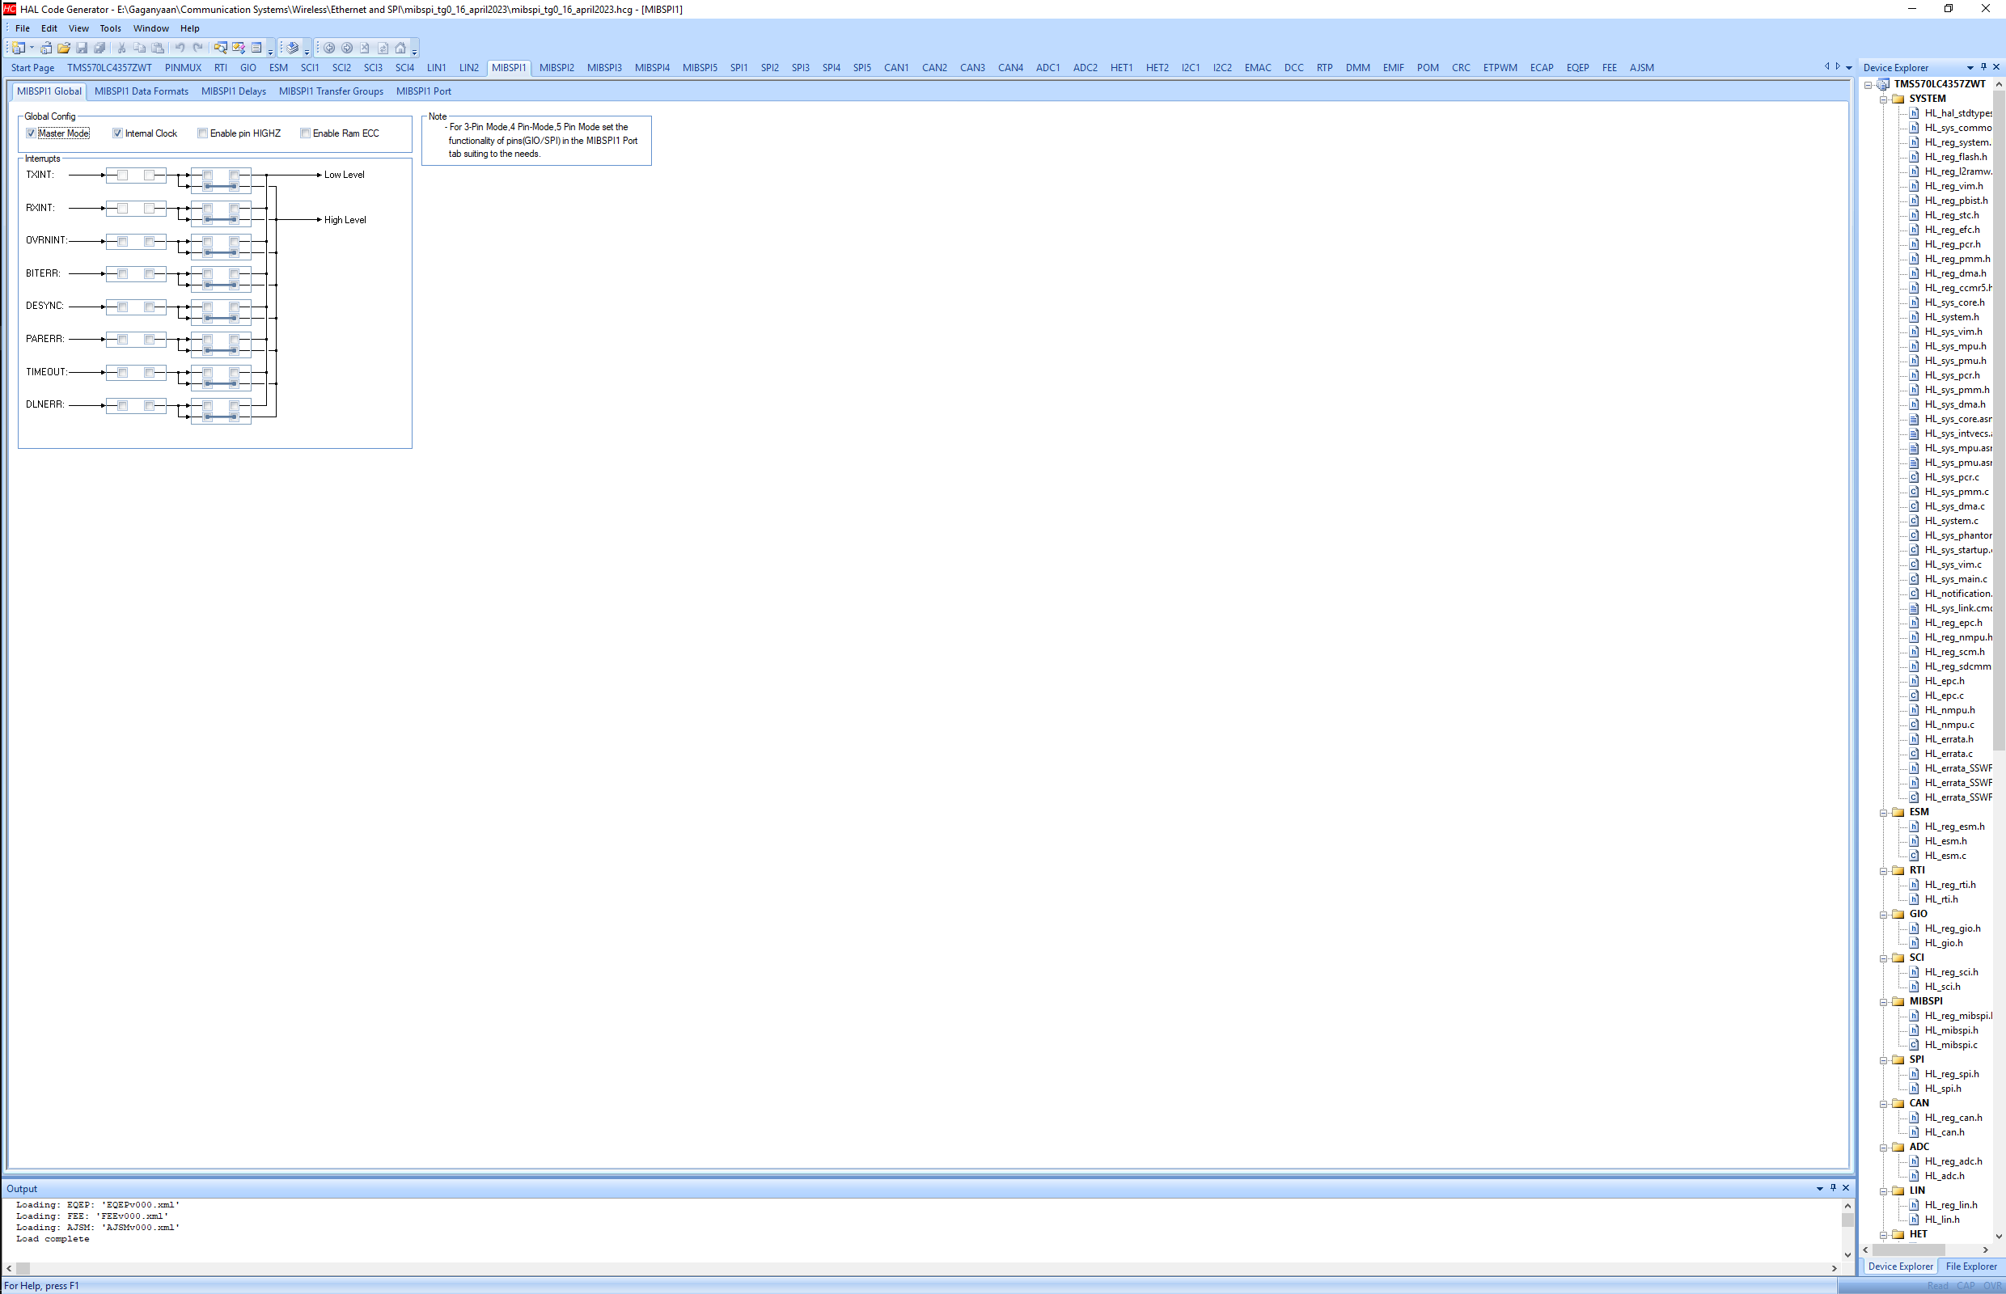
MibSPI Master :: HALCOGEN Configuration
Enable the checkbox for Master Mode and Internal Clock under MibSPI1 Global parameters.

Slide 6
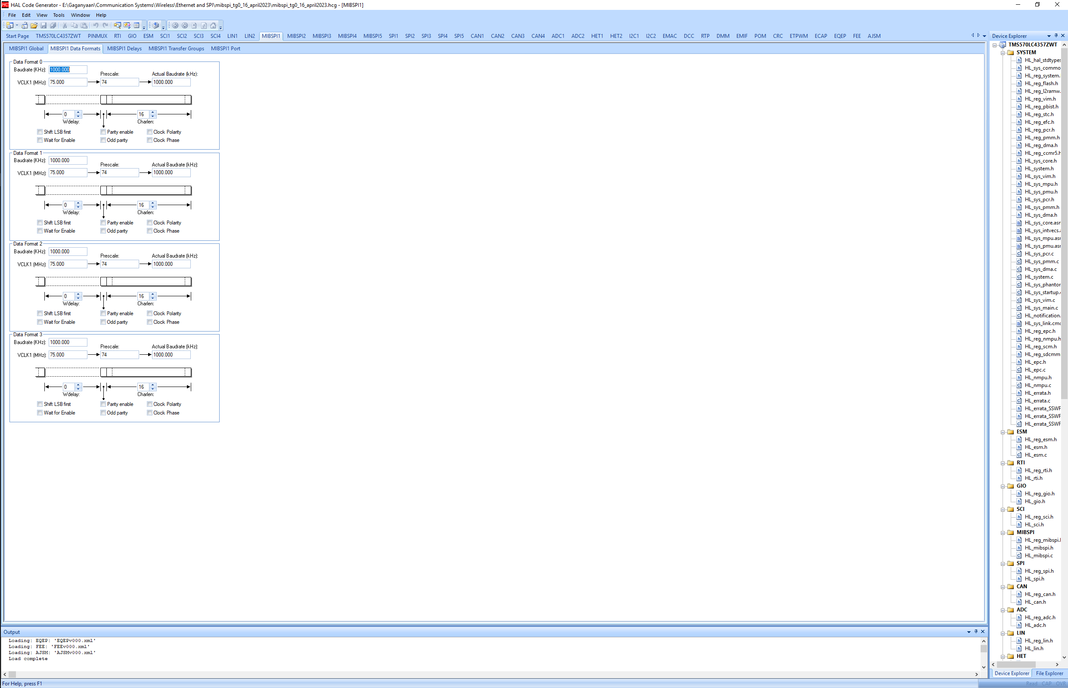
MibSPI Master :: HALCOGEN Configuration
Disable wait for enable as we are implementing 3 pin SPI interface.
Clock polarity and clock phase are disable for mode 0 SPI.

Slide 7
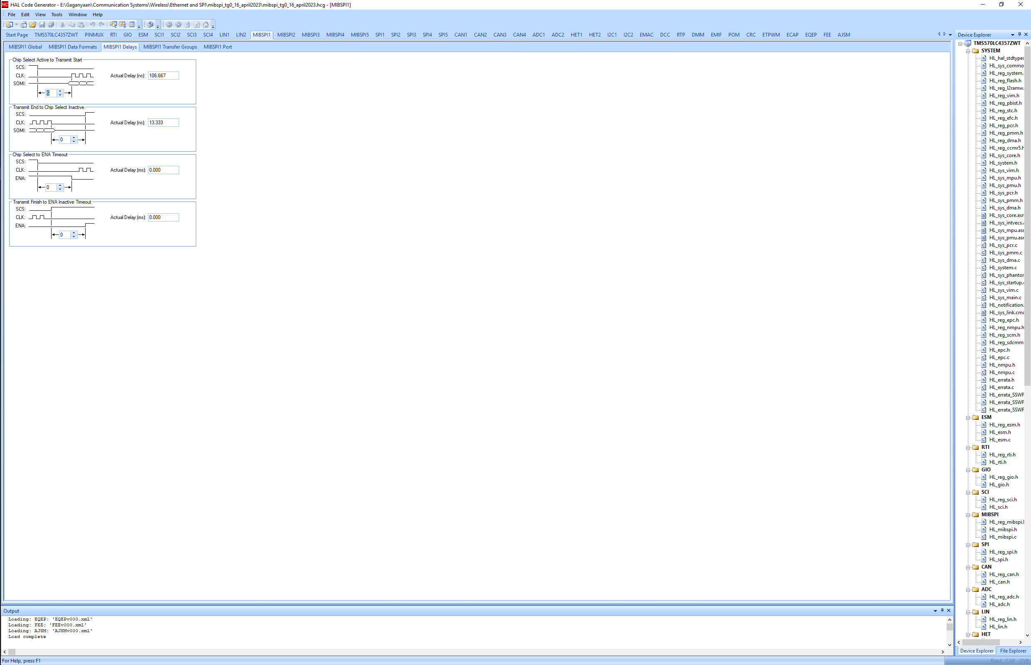
MibSPI Master :: HALCOGEN Configuration
Introduce 6 VCLK delays for master as specified in the TRM.

Slide 8
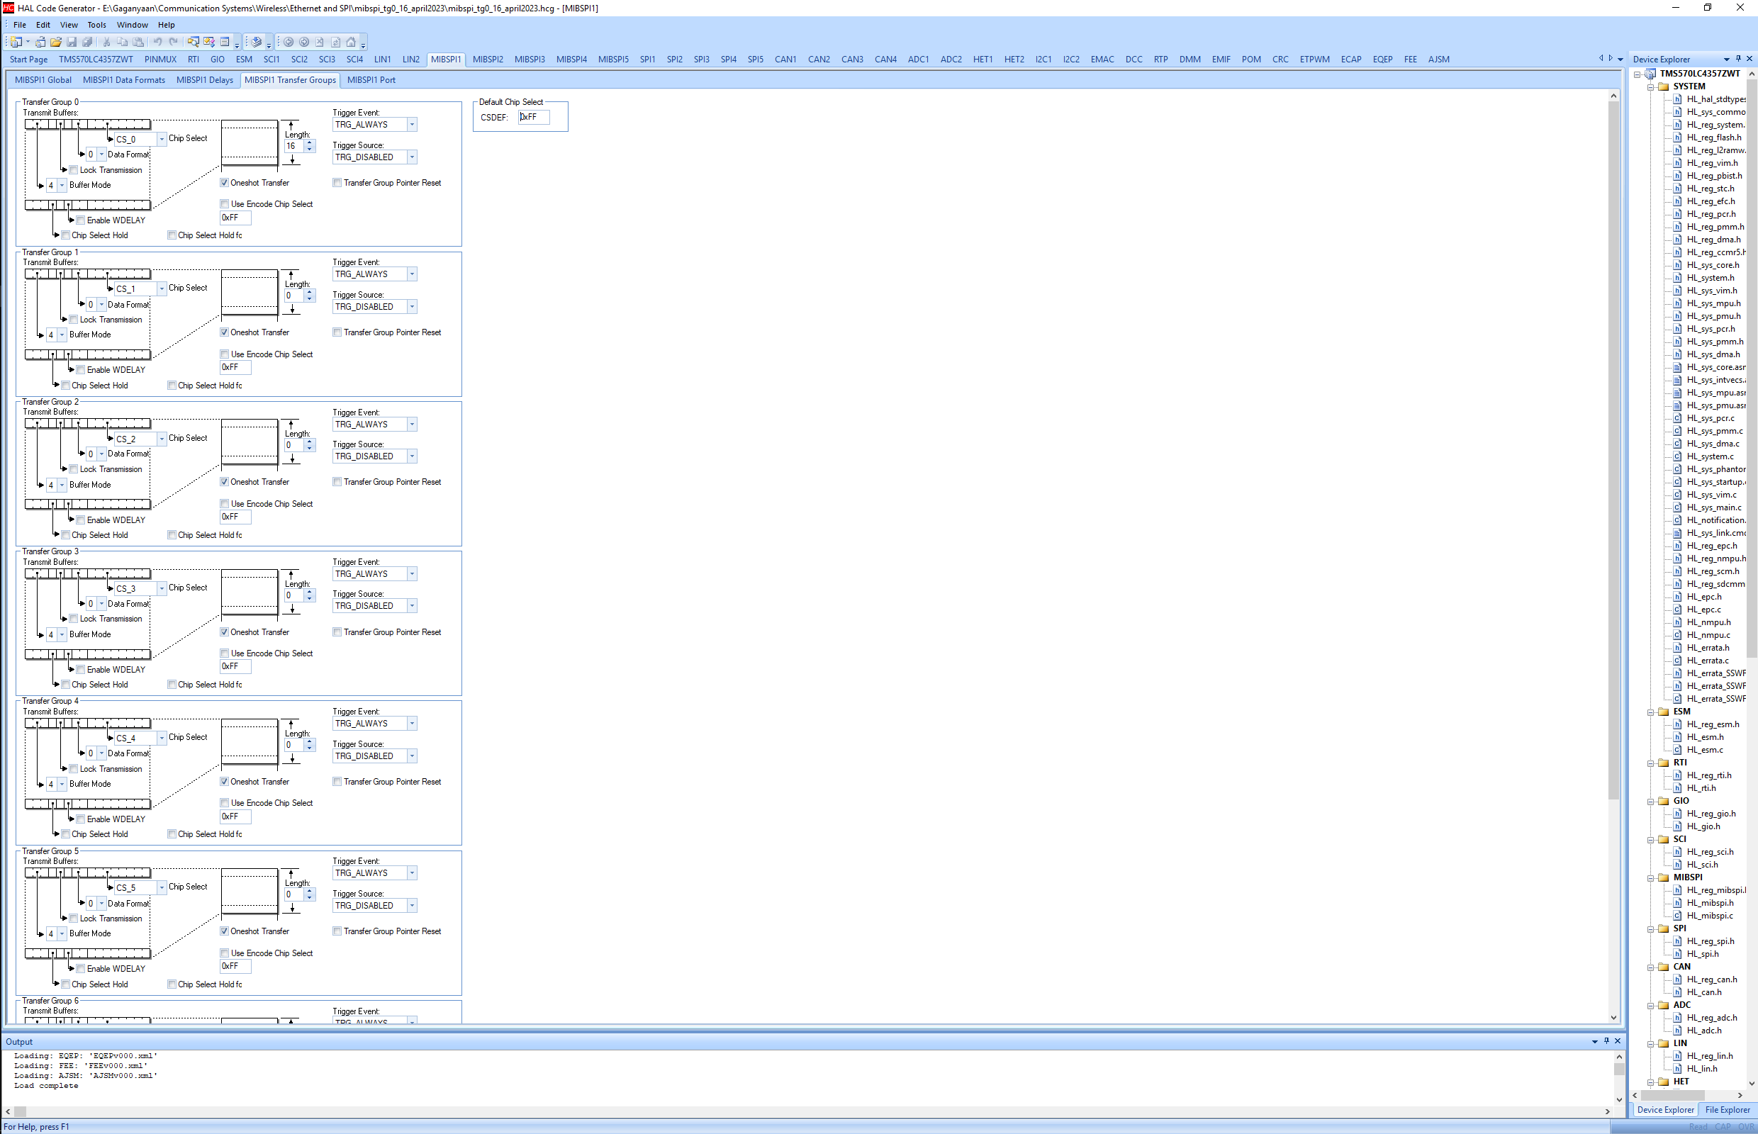
MibSPI Master :: HALCOGEN Configuration
Only TG0 is being used. Word length is kept 16 as of now.
Query: Chip Select is currently CS_0. when it shall be CS_None?

Slide 9
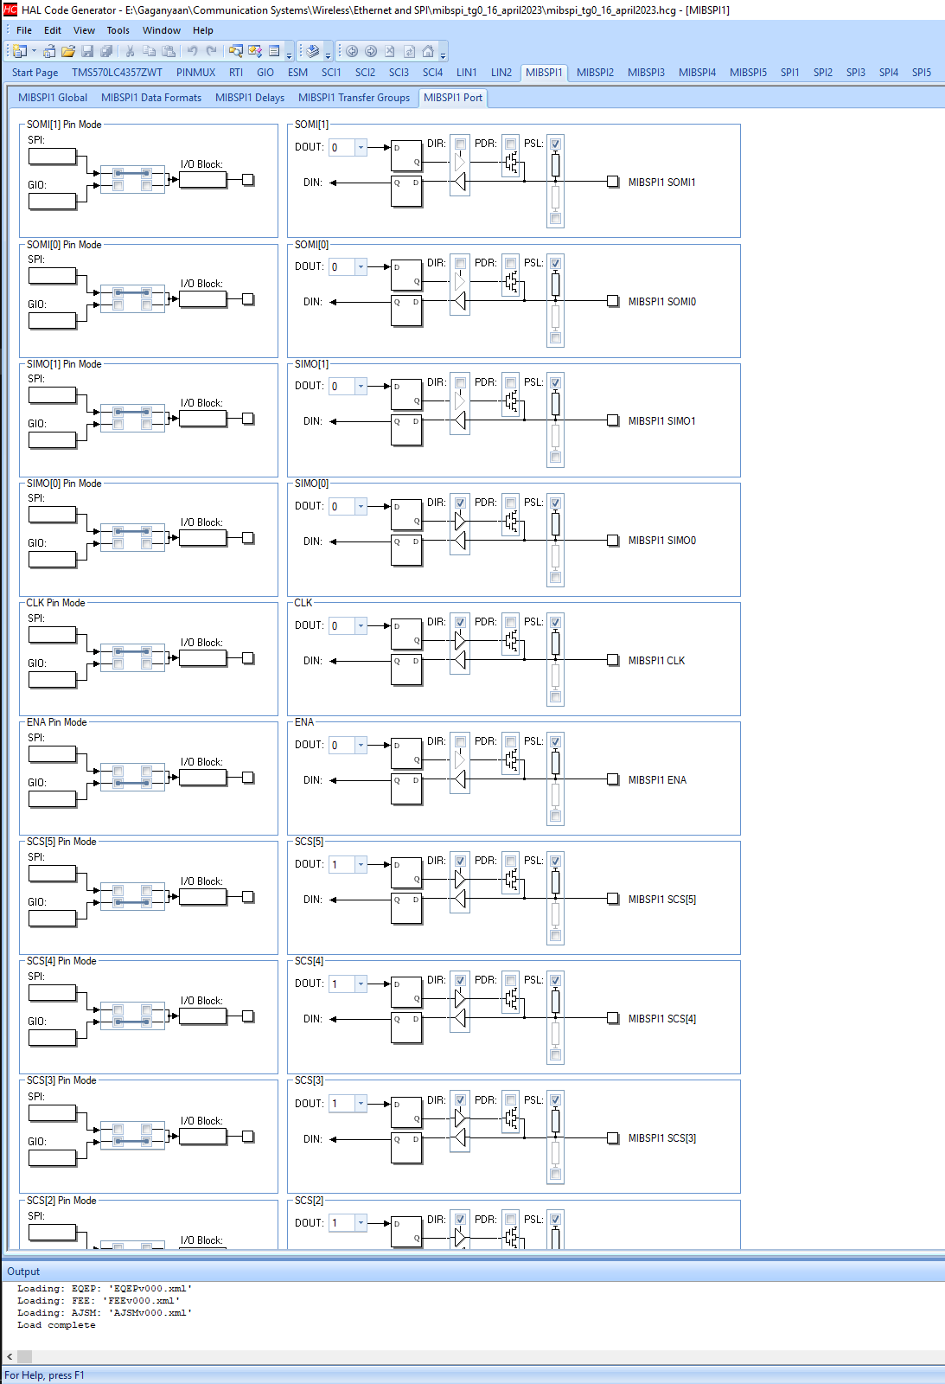

MibSPI Master :: HALCOGEN Configuration
SOMI[1] => GIO mode
SOMI[0] => SPI mode, data direction: Input
SIMO[1] => GIO Mode
SIMO[0] => SPI mode, data direction: Output
Clk Pin => SPI mode, data direction: Output
Ena Pin => GIO Mode
SCS[0] to SCS[5] => Pin Mode GIO

Slide 10
MibSPI Master :: Code
/* USER CODE BEGIN (0) */
/* USER CODE END */
/* Include Files */
#include "HL_sys_common.h"
/* USER CODE BEGIN (1) */
#include "HL_mibspi.h"
#define data_length 16
unsigned long counter1 = 0;
bool transmit_flag = 0;
uint16 tx_data[data_length] = {0,1,2,3,4,5,6,7,8,9,10,11,12,13,14,15};
uint16 rx_data[data_length] = {0};
/* USER CODE END */
/** @fn void main(void)
* @brief Application main function
* @note This function is empty by default.
*
* This function is called after startup.
* The user can use this function to implement the application.
*/
/* USER CODE BEGIN (2) */
/* USER CODE END */
int main(void)
{
/* USER CODE BEGIN (3) */
_enable_IRQ_interrupt_();
mibspiInit();
mibspiEnableGroupNotification(mibspiREG1, 0, 1);
while(1)
{
if(transmit_flag == 0)
{
mibspiSetData(mibspiREG1, 0, tx_data);
mibspiTransfer(mibspiREG1, 0);
transmit_flag=1;
}
}
while(1);
/* USER CODE END */
return 0;
}
/* USER CODE BEGIN (4) */
void mibspiGroupNotification(mibspiBASE_t *mibspi, uint32 group)
{
printf("\n Transfer %d completed!!", counter1);
counter1++;
transmit_flag = 0;
}
/* USER CODE END */
This concludes MibSPI Master configuration.
The code runs properly and SPI data and Clock are visible on oscilloscope.

Slide 11
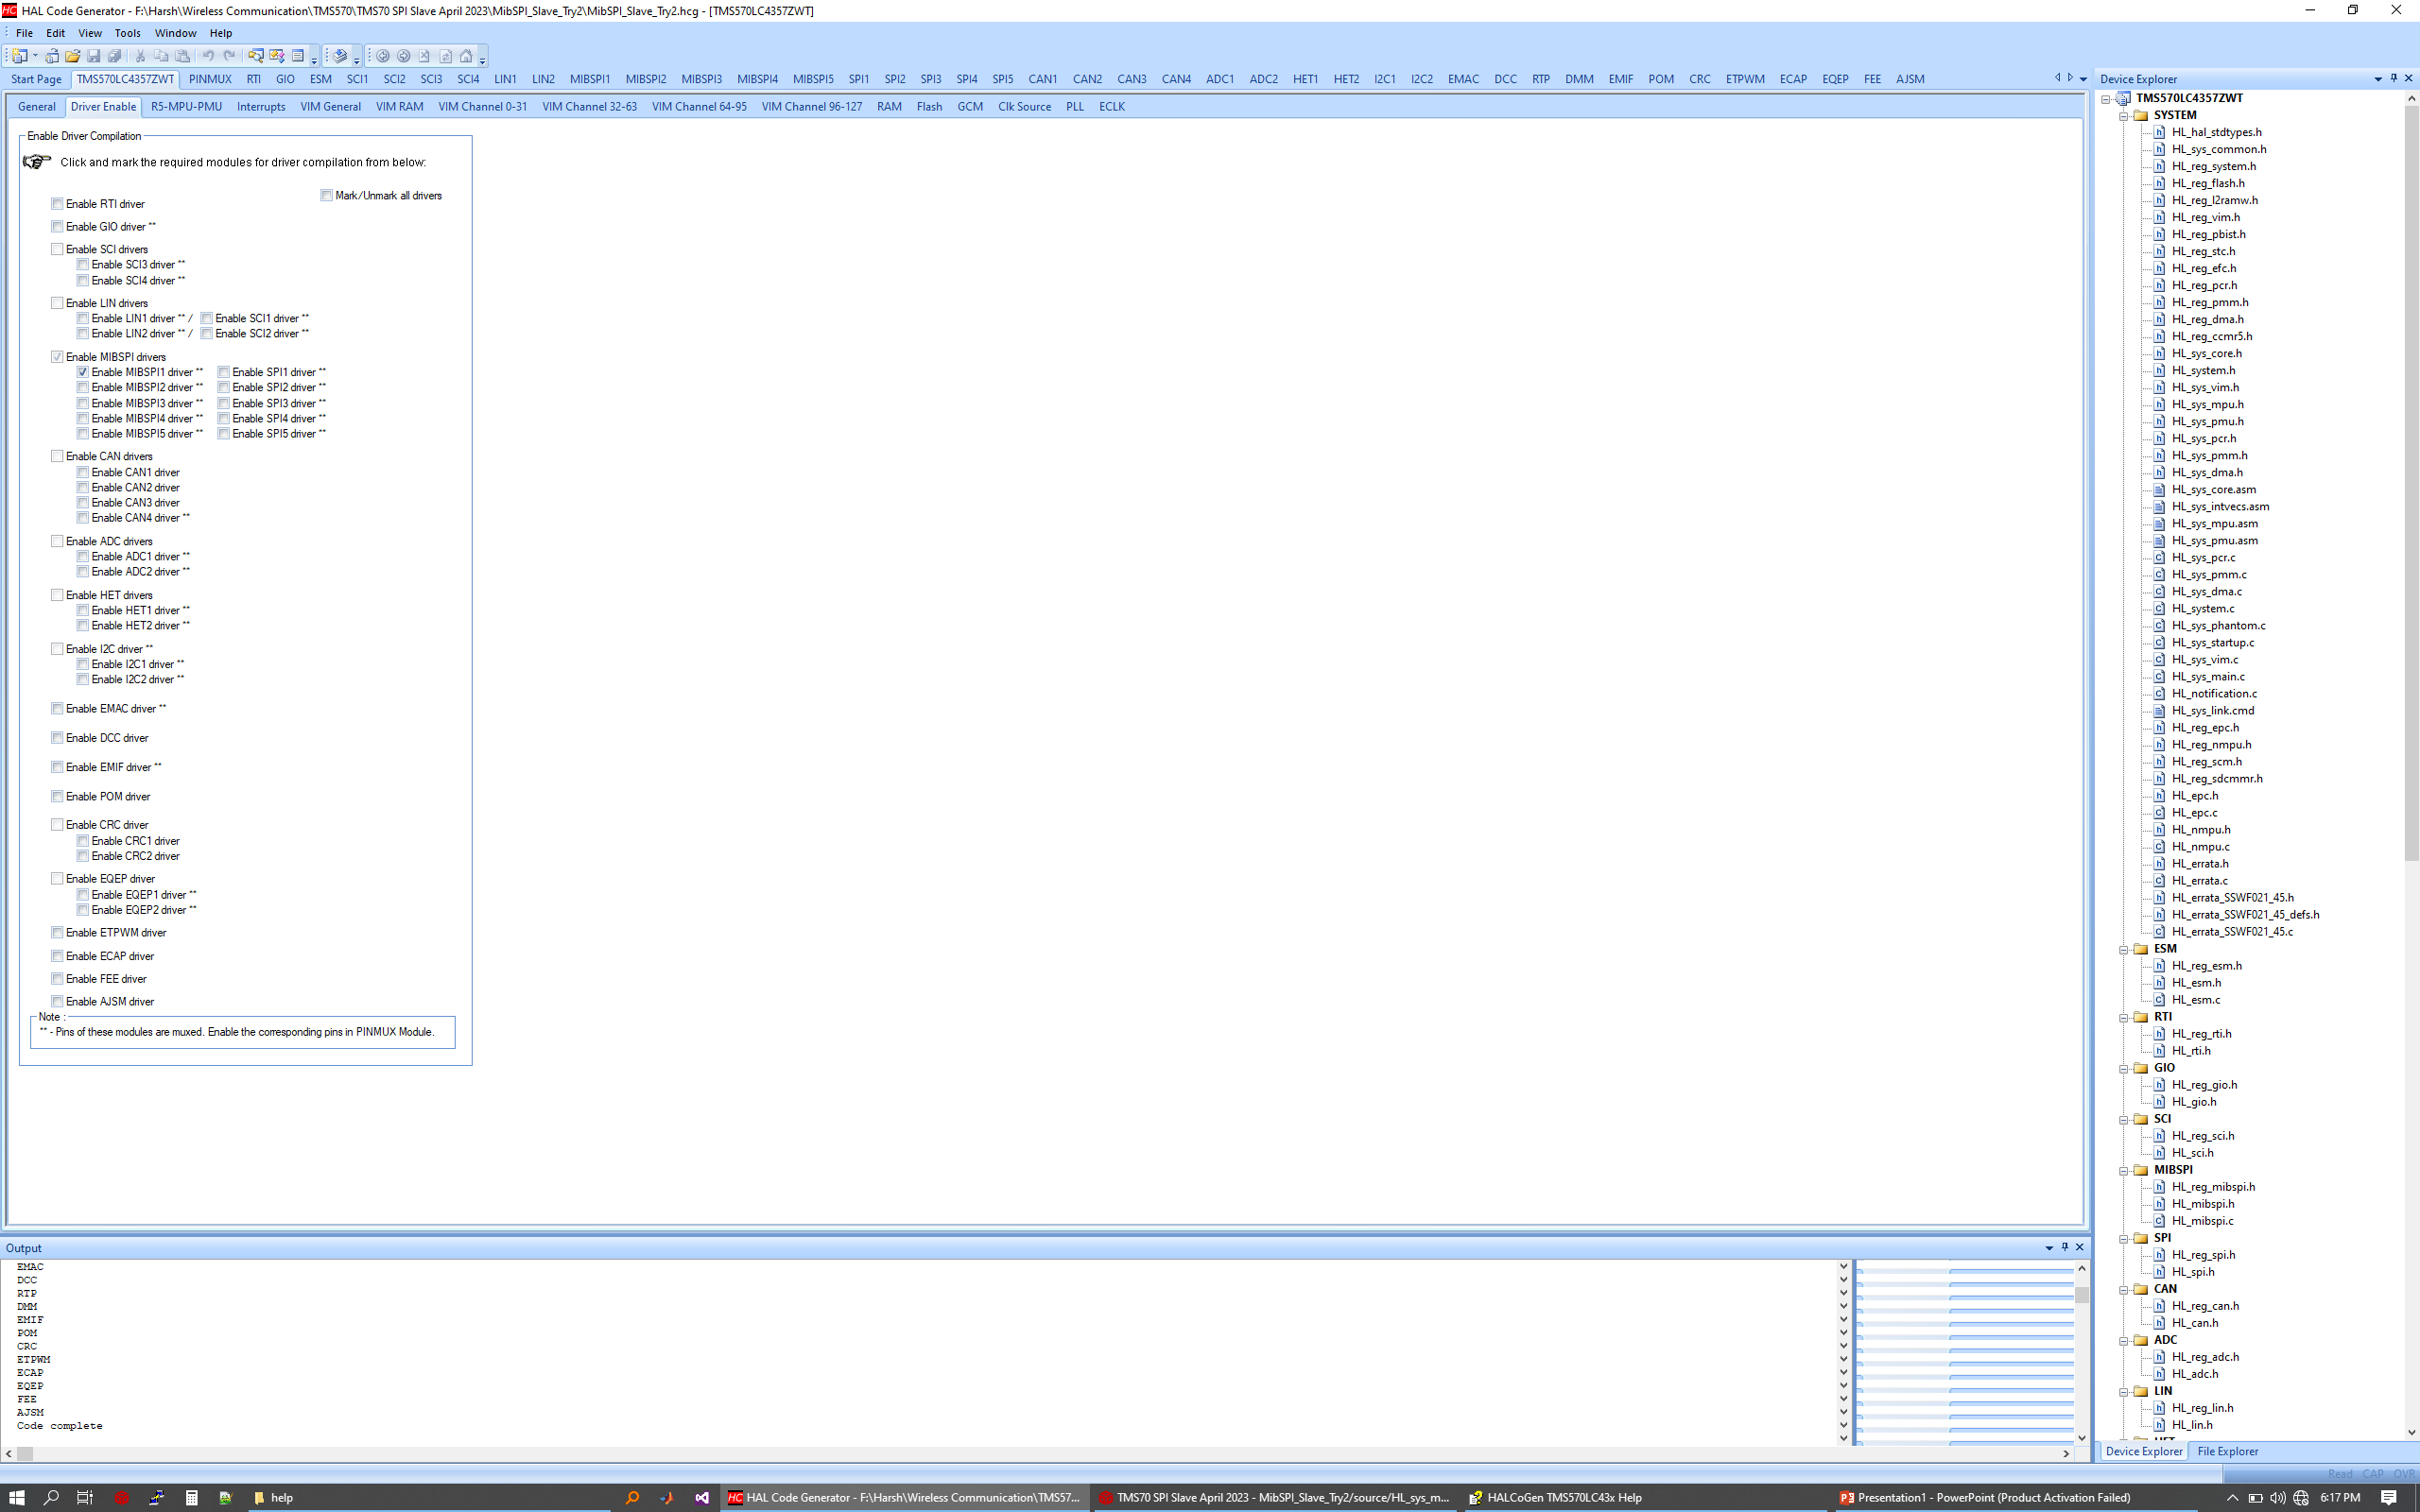
MibSPI Slave :: HALCOGEN Configuration
On driver enable page, MibSPI1 has been selected.
Remaining drivers have been disabled.

Slide 12
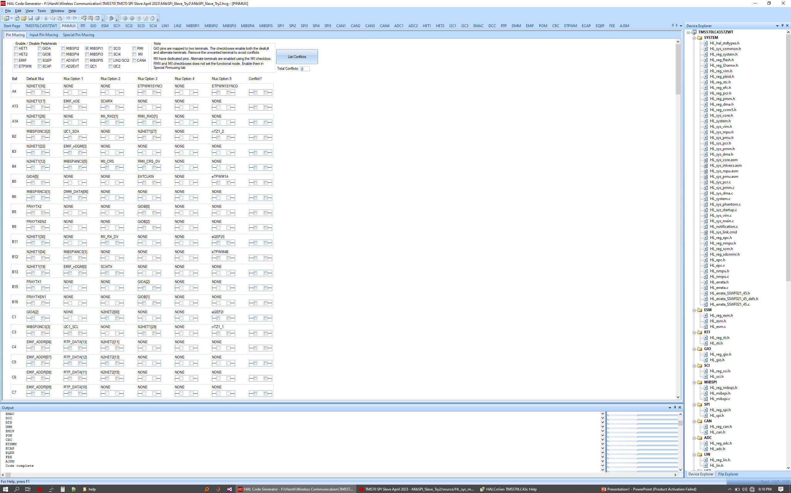
MibSPI Slave :: HALCOGEN Configuration
Enable PinMux for MibSPI1 and remove all the conflicts.

Slide 13
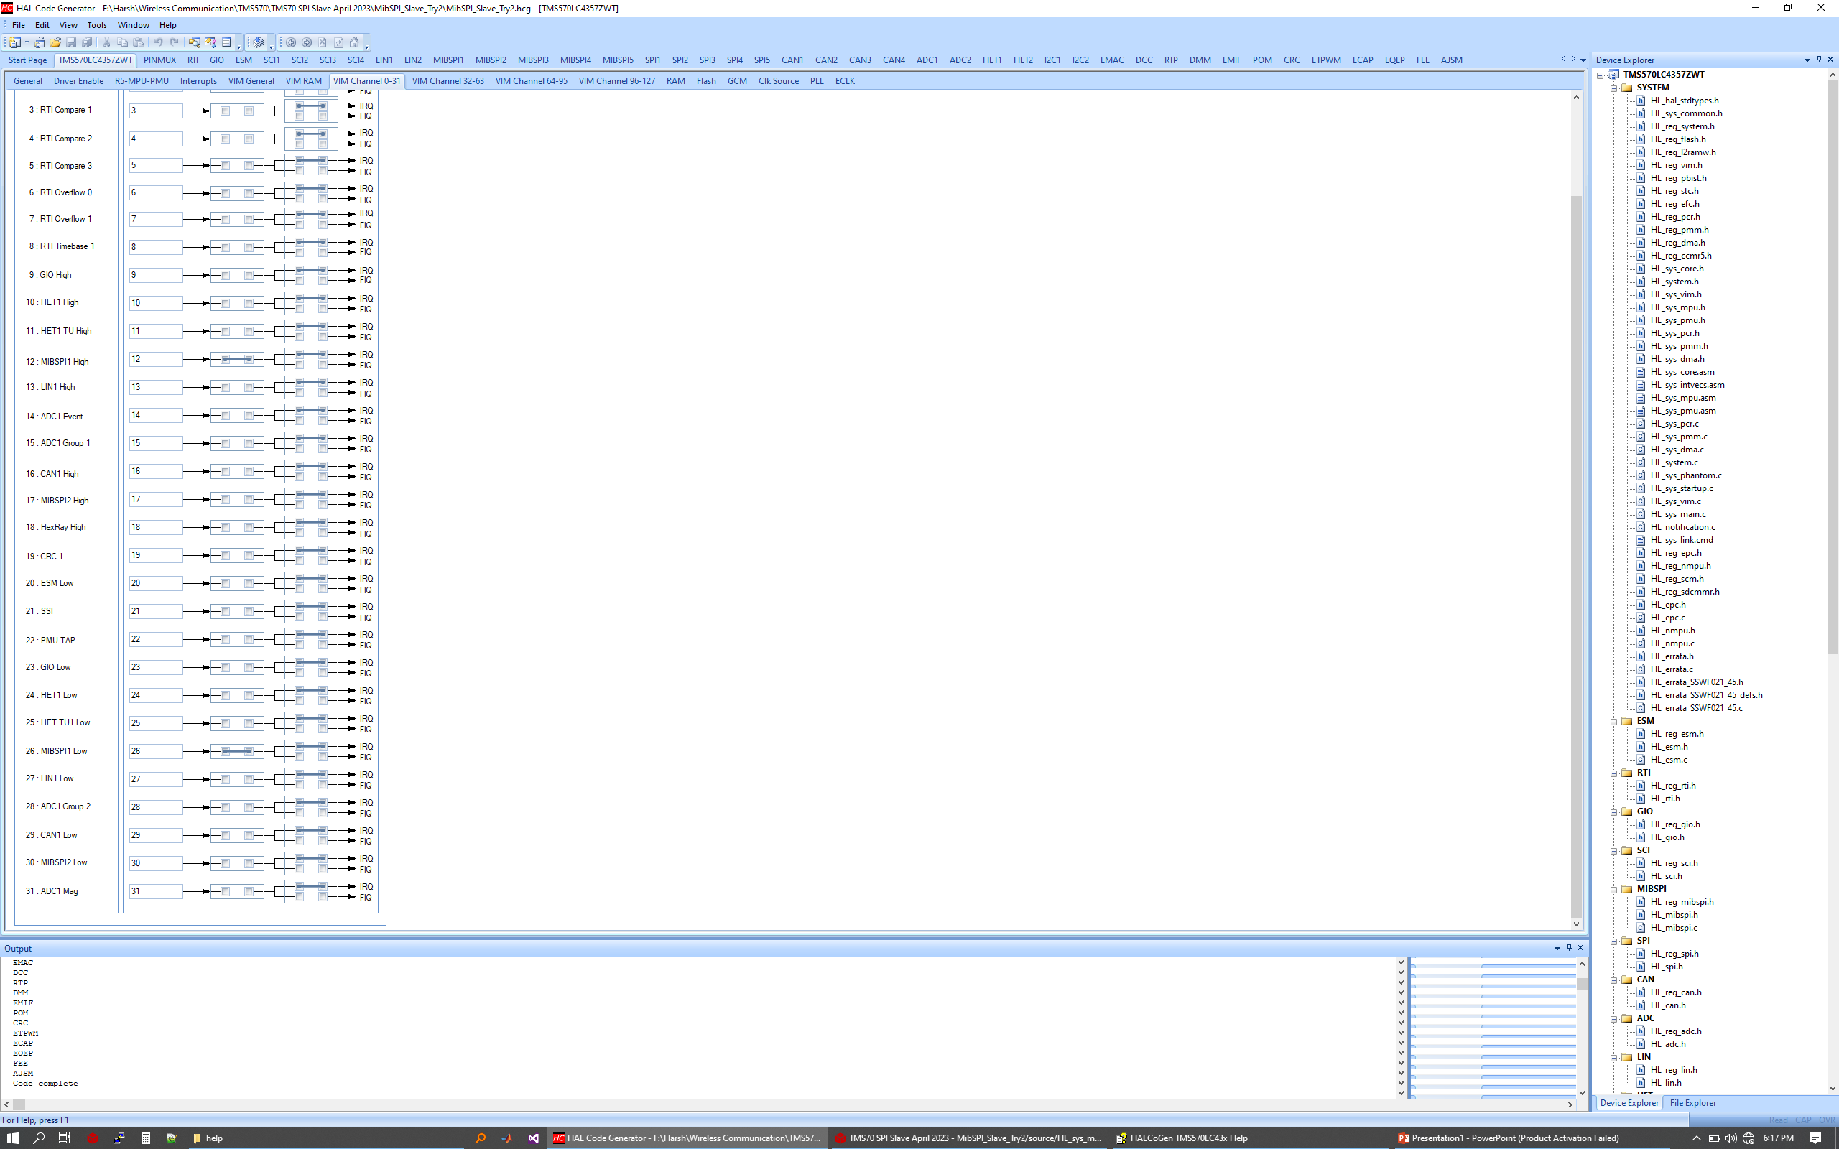
MibSPI Slave :: HALCOGEN Configuration
Enable associated interrupts.

Slide 14
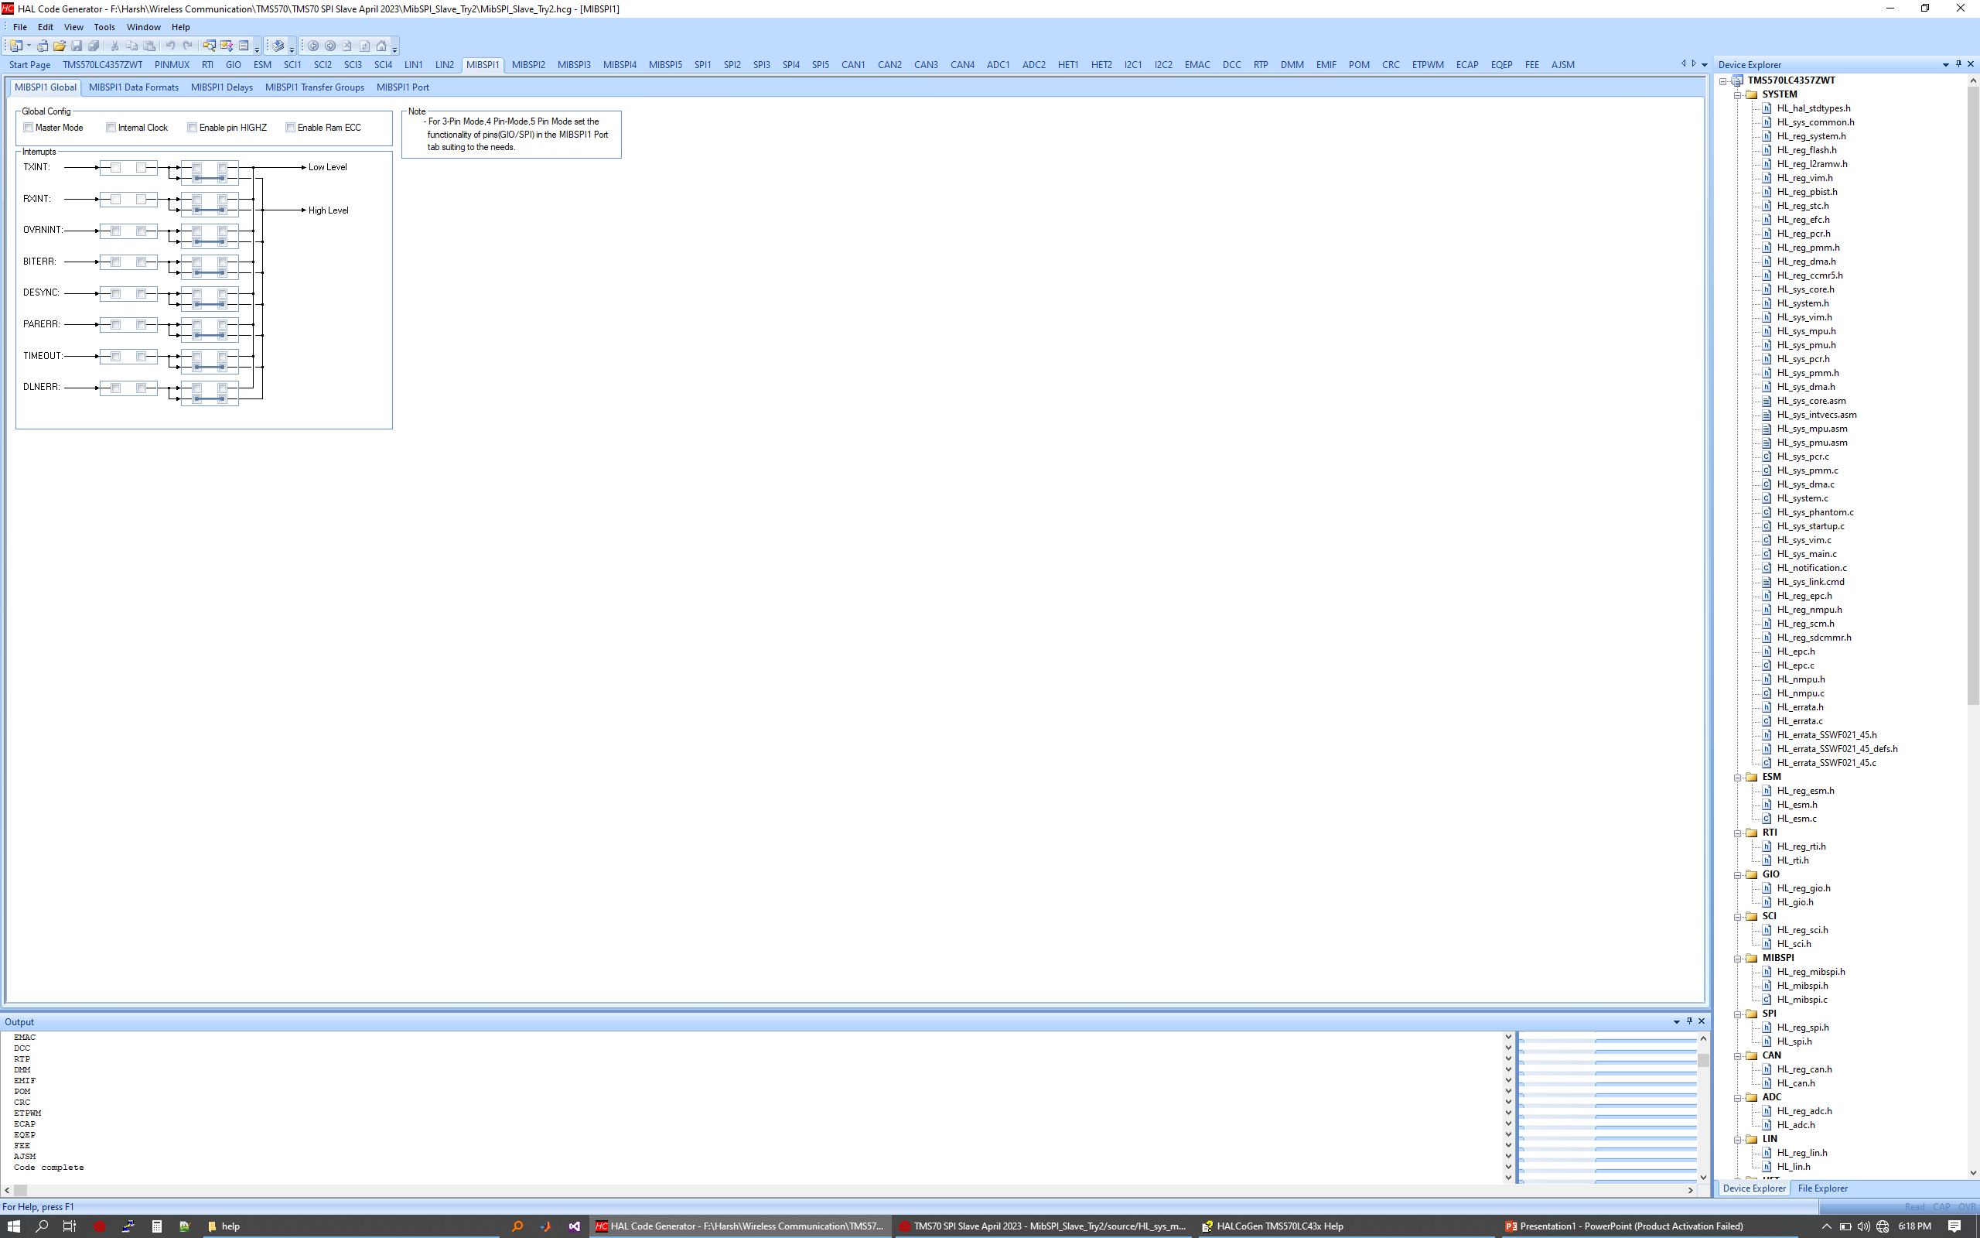
MibSPI Slave :: HALCOGEN Configuration
Disable the checkbox for Master Mode and Internal Clock under MibSPI1 Global parameters.

Slide 15
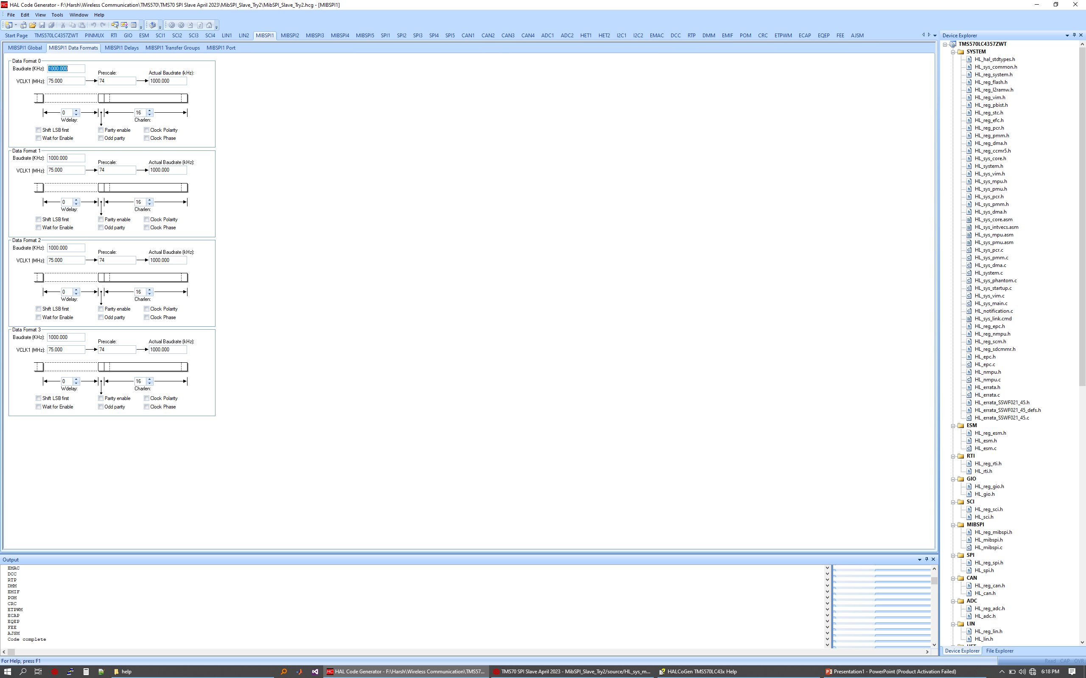
MibSPI Slave :: HALCOGEN Configuration
Disable wait for enable as we are implementing 3 pin SPI interface.
Clock polarity and clock phase are disable for mode 0 SPI.

Slide 16
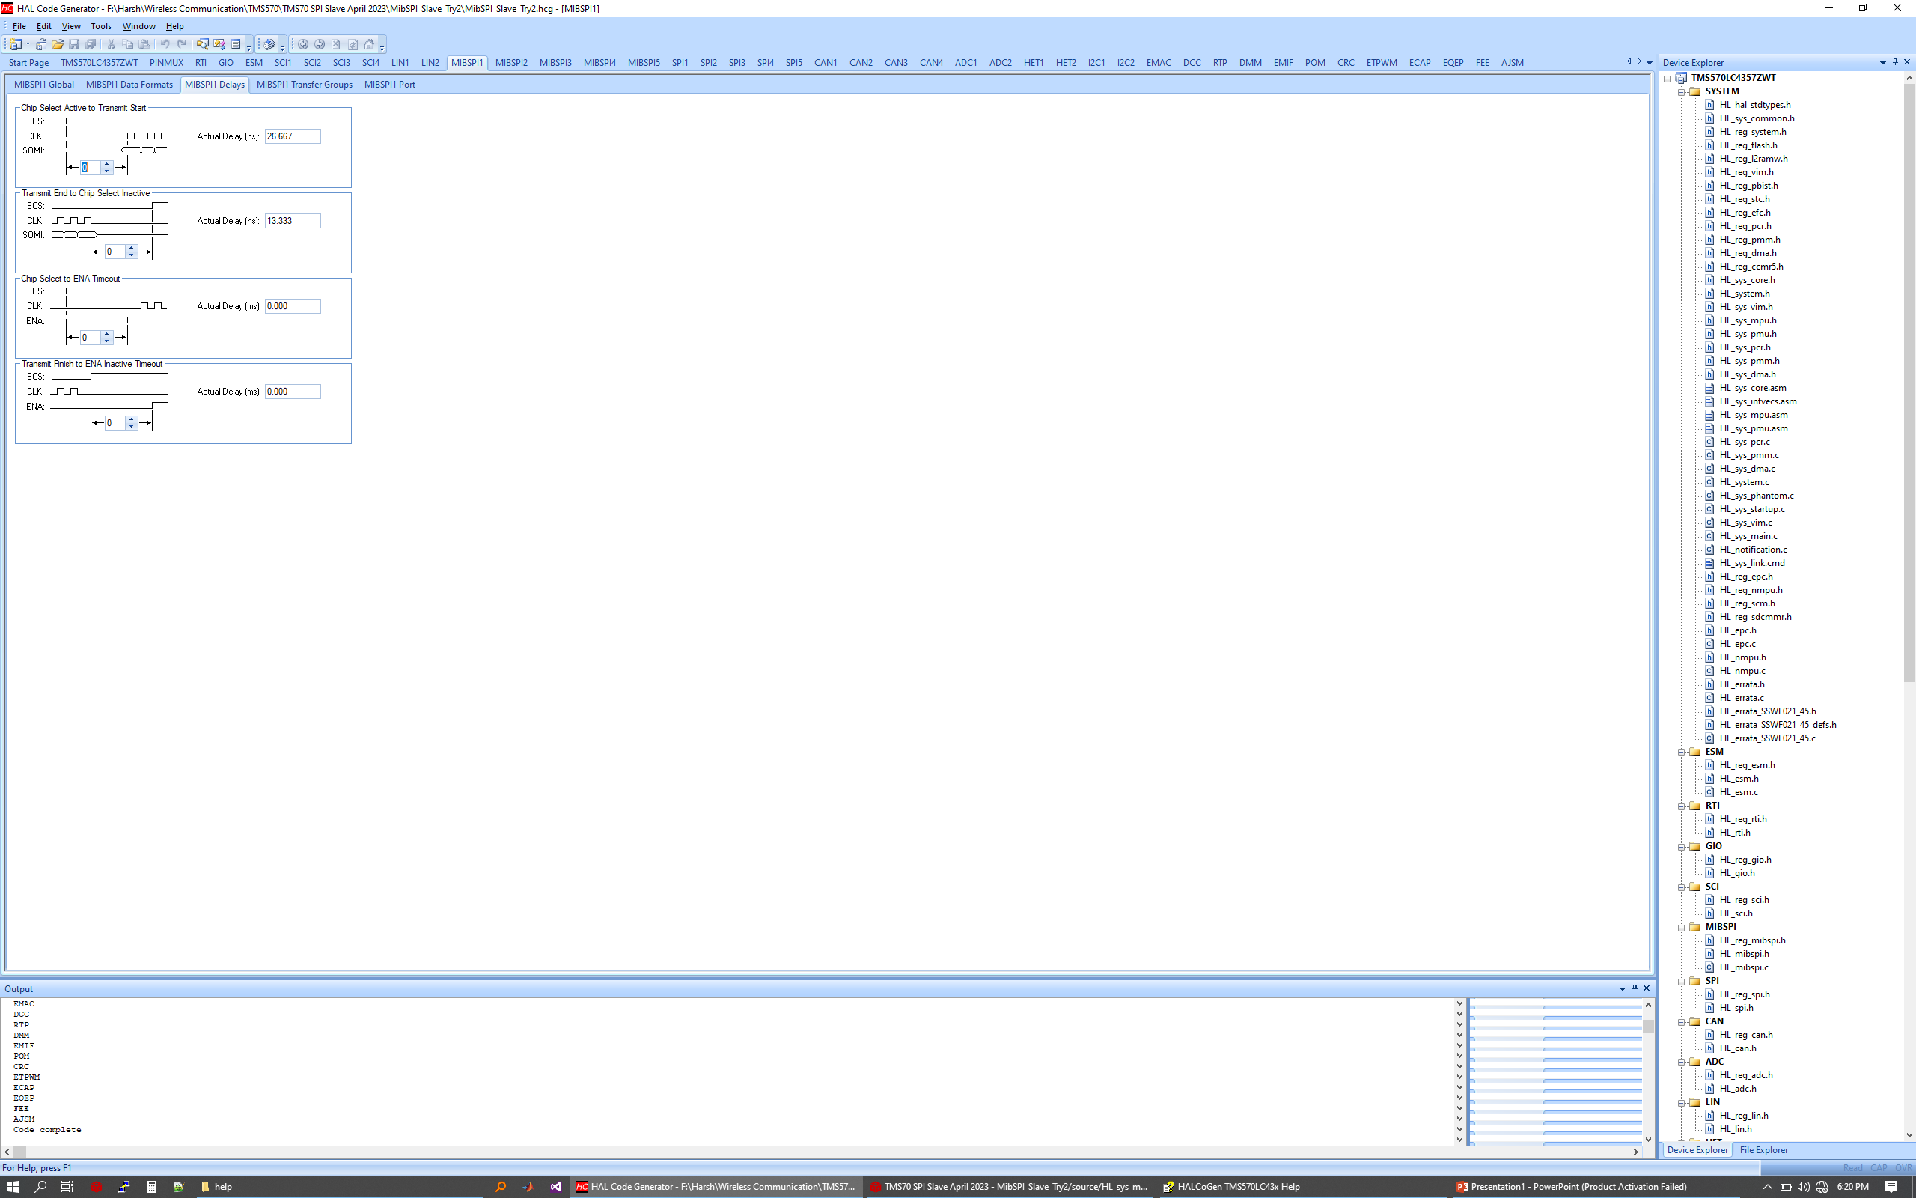
MibSPI Slave :: HALCOGEN Configuration
Introduce 6 VCLK delays for master as specified in the TRM.

Slide 17
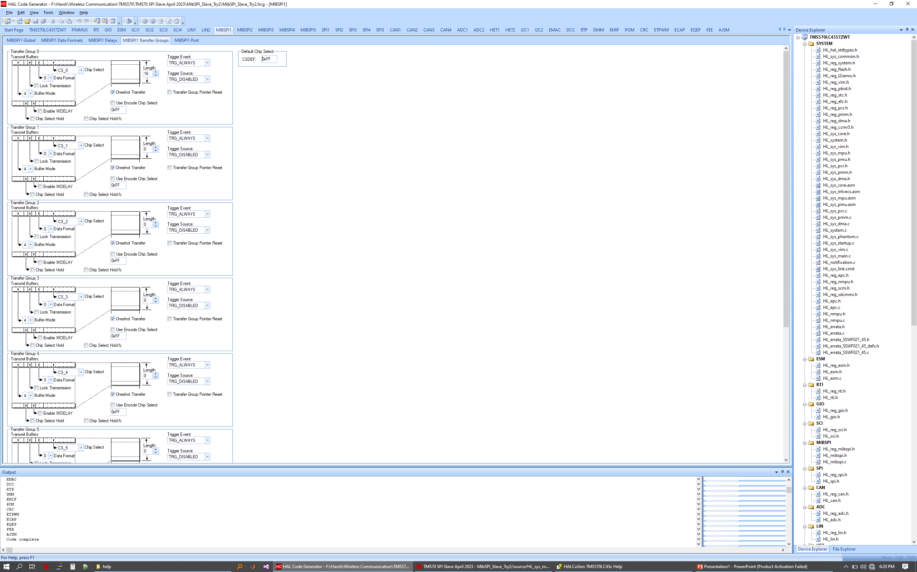
MibSPI Slave :: HALCOGEN Configuration
Only TG0 is being used. Word length is kept 16 as of now.
Query: Chip Select is currently CS_0. when it shall be CS_None?

Slide 18
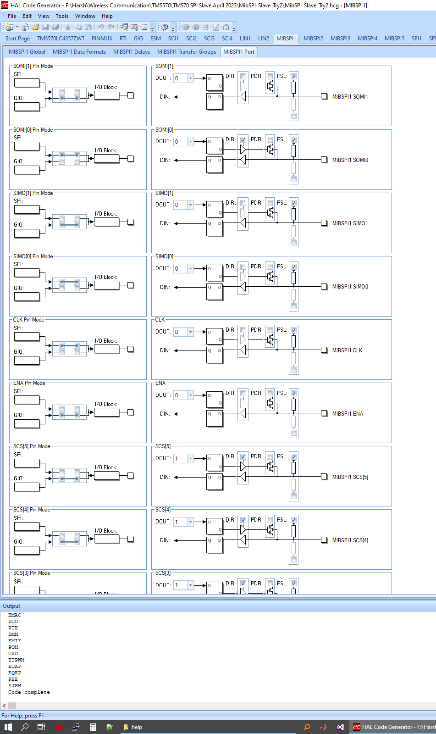
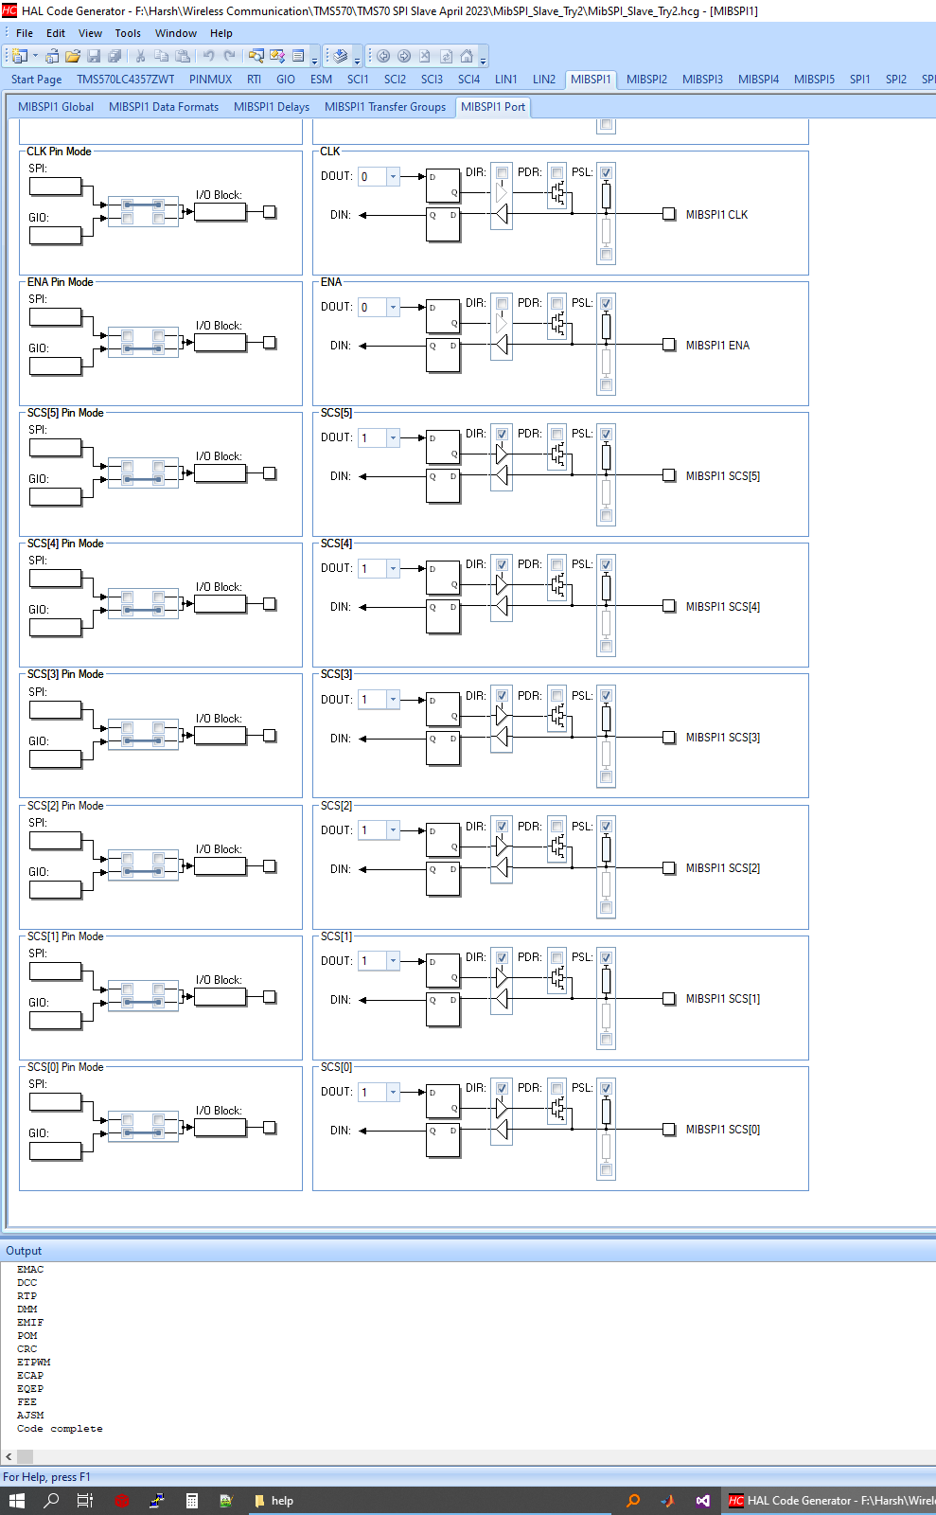
MibSPI Slave :: HALCOGEN Configuration
SOMI[1] => GIO mode
SOMI[0] => SPI mode, data direction: Output
SIMO[1] => GIO Mode
SIMO[0] => SPI mode, data direction: Input
Clk Pin => SPI mode, data direction: Input
Ena Pin => GIO Mode
SCS[0] to SCS[5] => Pin Mode GIO

Slide 19
MibSPI Slave :: Code
/* USER CODE BEGIN (0) */
/* USER CODE END */
/* Include Files */
#include "HL_sys_common.h"
/* USER CODE BEGIN (1) */
#include "HL_system.h"
#include "HL_mibspi.h"
#include "HL_sys_core.h"
#define data_length 16
uint16 rx_data[data_length] = {0};
unsigned long counter1 = 0;
/* USER CODE END */
/** @fn void main(void)
* @brief Application main function
* @note This function is empty by default.
*
* This function is called after startup.
* The user can use this function to implement the application.
*/
/* USER CODE BEGIN (2) */
/* USER CODE END */
int main(void)
{
/* USER CODE BEGIN (3) */
_enable_IRQ_interrupt_();
mibspiInit();
mibspiEnableGroupNotification(mibspiREG1, 0, 1);
while(1)
{
{
mibspiTransfer(mibspiREG1, 0);
}
}
/* USER CODE END */
return 0;
}
/* USER CODE BEGIN (4) */
void mibspiGroupNotification(mibspiBASE_t *mibspi, uint32 group)
{
uint16 *data;
data = &rx_data[0];
mibspiGetData(mibspi, group, data);
}
/* USER CODE END */
This concludes MibSPI Slave configuration.
The data is not being received by SPI Slave.

Slide 20
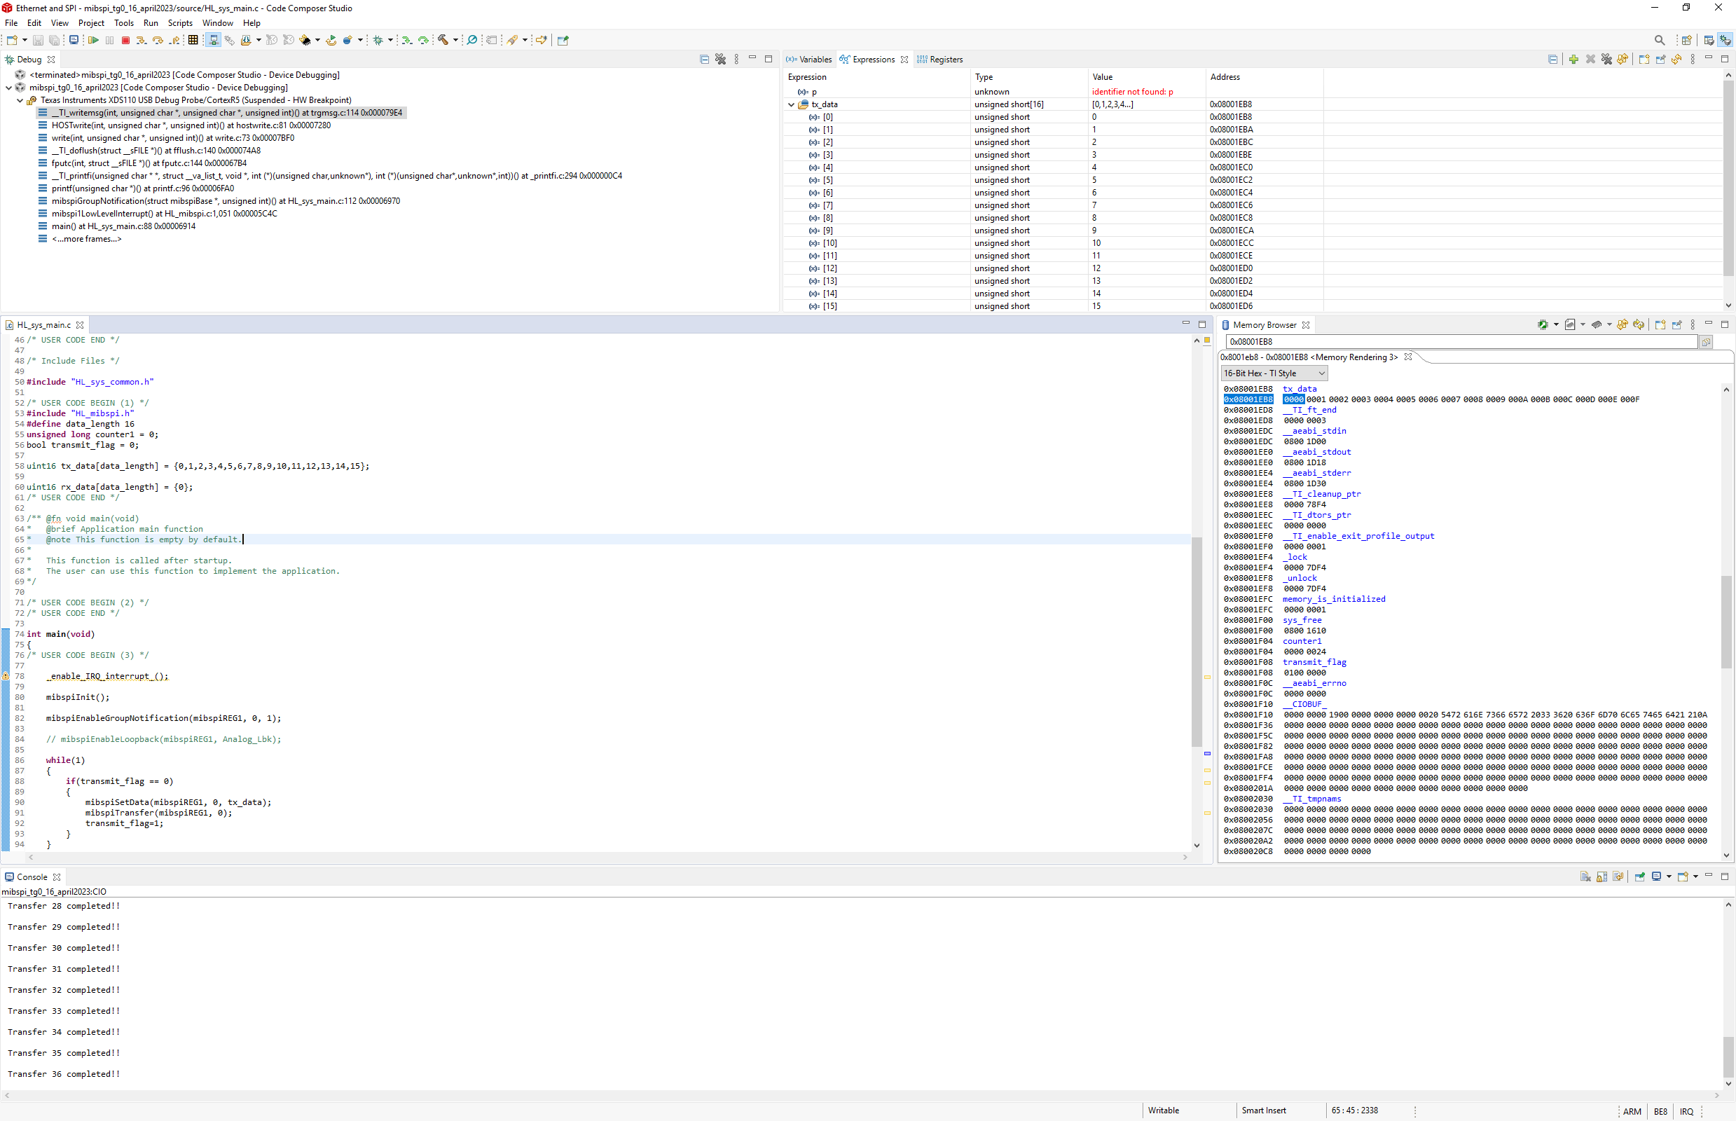
MibSPI Master :: CCS View

Slide 21
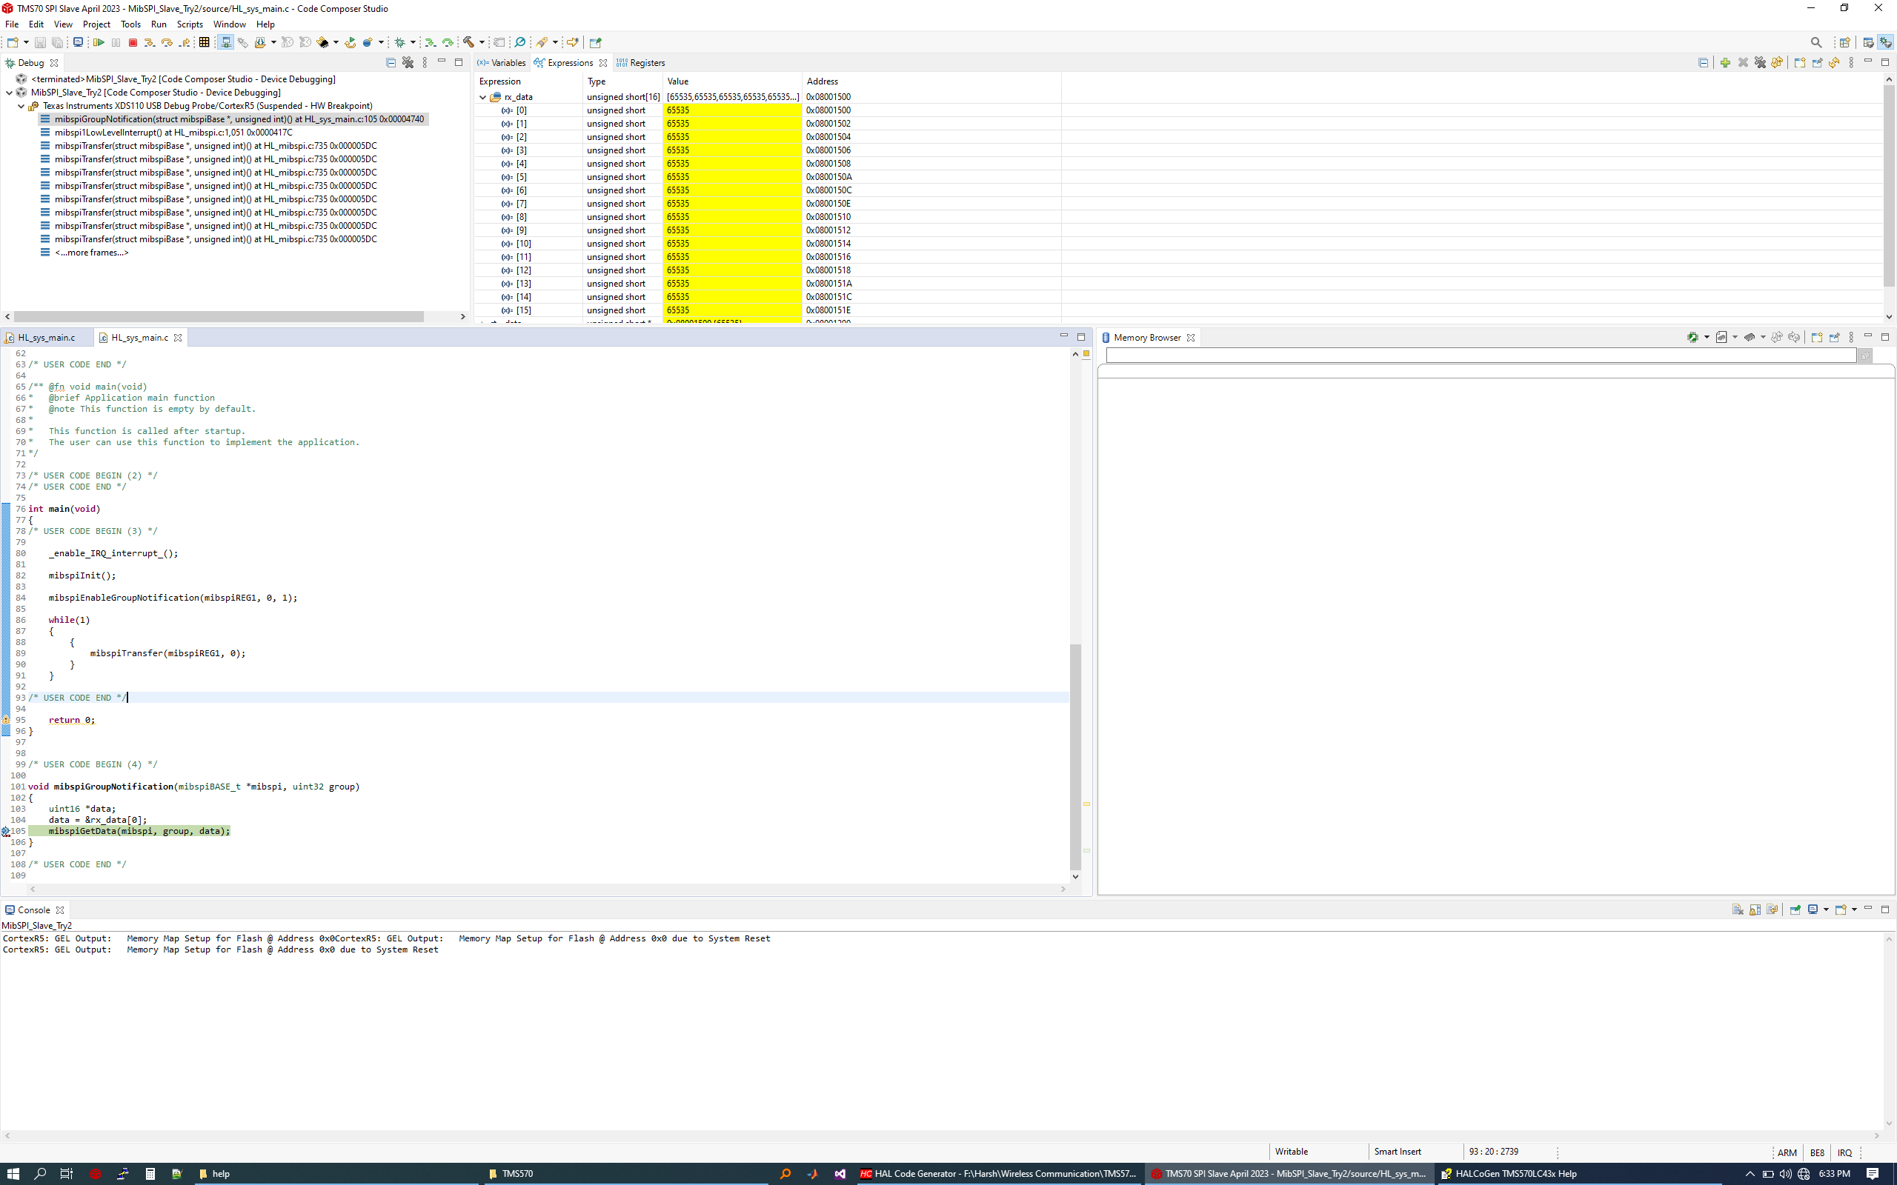
MibSPI Slave :: CCS View

