Slide 1
Program Jump Guide

Slide 2
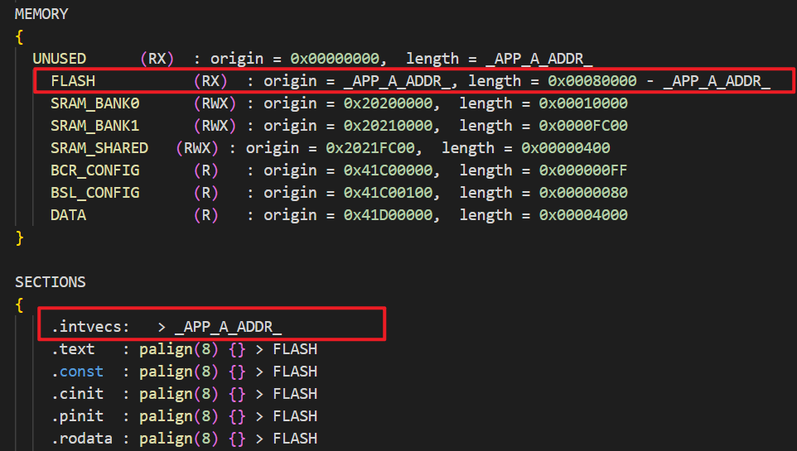
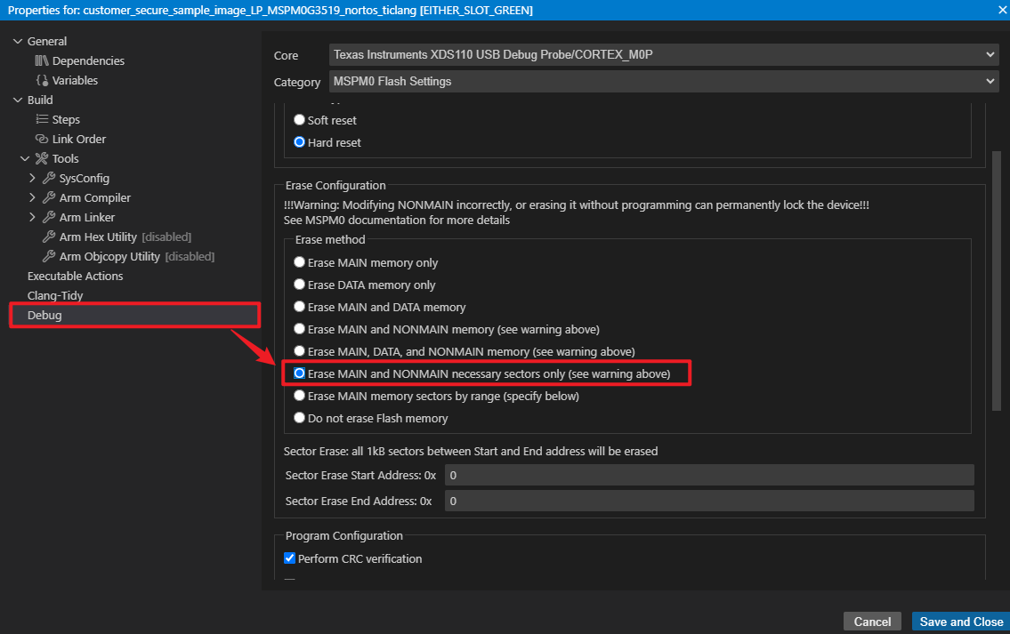
Before Jump
There are two program for a jump example
One is in the boot region: start at 0x0000 address
Another is the application image: start at _APP_A_ADDR_ address
  Make sure the .cmd file of app image is built from this address

Slide 3
uint32_t * vector_table_backup;
static void start_app(uint32_t *vector_table)
{
/* The following code resets the SP to the value specified in the
* provided vector table, and then the Reset Handler is invoked.
*
* Per ARM Cortex specification:
*
* ARM Cortex VTOR
*
*
* Offset Vector
*
* 0x00000000 ++++++++++++++++++++++++++
* | Initial SP value |
* 0x00000004 ++++++++++++++++++++++++++
* | Reset |
* 0x00000008 ++++++++++++++++++++++++++
* | NMI |
* ++++++++++++++++++++++++++
* | . |
* | . |
* | . |
*
* */
/* Back up of vector_table to avoid being changed because of SP update */
vector_table_backup = vector_table;
/* Set the Reset Vector to the new vector table (Will be reset to 0x000) */
SCB->VTOR = (uint32_t) vector_table;
/* Reset the SP with the value stored at vector_table[0] */
__asm volatile(
"LDR R3,[%[vectab],#0x0] \n"
"MOV SP, R3 \n" ::[vectab] "r"(vector_table));
/* Jump to the Reset Handler address at vector_table[1] */
((void (*)(void))(*(vector_table_backup + 1)))();
}
Program Jump Function
uint32_t * vector_table_backup;
static void start_app(uint32_t *vector_table)
{
/* The following code resets the SP to the value specified in the
* provided vector table, and then the Reset Handler is invoked.
*
* Per ARM Cortex specification:
*
* ARM Cortex VTOR
*
*
* Offset Vector
*
* 0x00000000 ++++++++++++++++++++++++++
* | Initial SP value |
* 0x00000004 ++++++++++++++++++++++++++
* | Reset |
* 0x00000008 ++++++++++++++++++++++++++
* | NMI |
* ++++++++++++++++++++++++++
* | . |
* | . |
* | . |
*
* */
/* Back up of vector_table to avoid being changed because of SP update */
vector_table_backup = vector_table;
/* Set the Reset Vector to the new vector table (Will be reset to 0x000) */
SCB->VTOR = (uint32_t) vector_table;
/* Reset the SP with the value stored at vector_table[0] */
__asm volatile(
"LDR R3,[%[vectab],#0x0] \n"
"MOV SP, R3 \n" ::[vectab] "r"(vector_table));
/* Jump to the Reset Handler address at vector_table[1] */
((void (*)(void))(*(vector_table_backup + 1)))();
}
This start_app() API could be used for program jump:
The API is used in boot image for jumping to application
The input vector_table is the start address of the application image _APP_A_ADDR_
This API achieves three functions:
Set the VTOR register to point to new image interrupt vector table start address
Reset SP with the “Initial SP value” in the new interrupt vector table.
Jump to the Reset Handler of the new image.

