Slide 1
Standalone XDS110 Password Debug Procedure
How to add a function: MSPM0_Mailbox_PasswordAuthentication_Manual

Slide 2
Method
Add a MSPM0_Mailbox_PasswordAuthentication_Manual function in .gel file

Slide 3
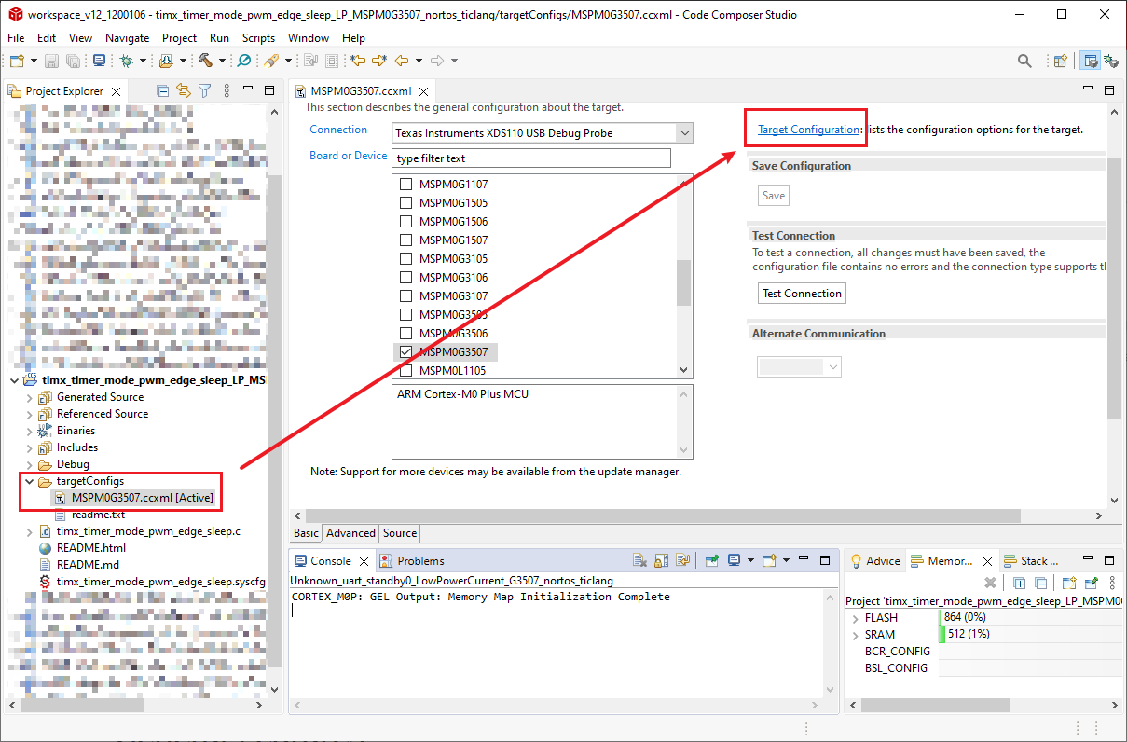
Step 1: Open Target Configuration
Open .ccxml file of your project.
Click Target Configuration.

Slide 4
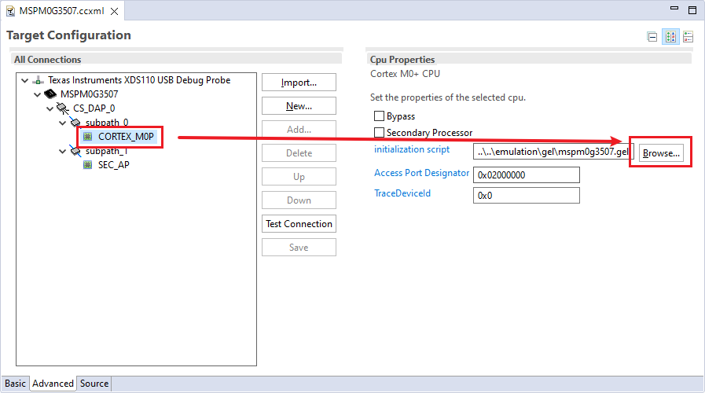
Step 2: Check .gel file name and open it
path to .gel file: C:\ti\ccs1250\ccs\ccs_base\emulation\gel
Open CORTEX_M0P
Remember you .gel file’s file name.
Open and Edit .gel file via file path.

Slide 5
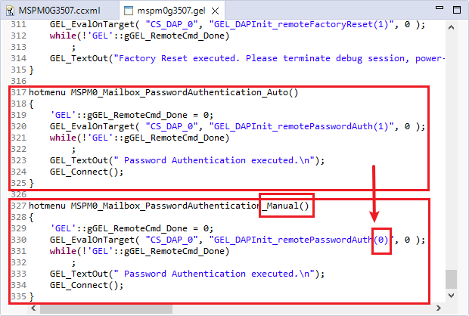
Step 3: Edit .gel file
Open .gel file
Copy and paste a new Password function.
Change the name to Manual and (1) to (0).

Slide 6
Step 4: Retry the Password Authentication Manual
Retry your Project’s Password Authentication procedure
Using MSPM0_Mailbox_PasswordAuthentication_Manual
During the procedure, need to press RESET button once.

