Slide 1
Which is the internal configuration of TM4C1290NCPDTI3R
・Type1
・Type2
TM4C1290NCPDTI3R
TM4C1290NCPDTI3R
Read Data Latch
Read Data Latch
PF0：SSI3_DATA1
PF0：SSI3_DATA1
D Q
CK
D Q
CK
PF3：SSI3_CLK
CLK GEN
PF3：SSI3_CLK
CLK GEN

Slide 2
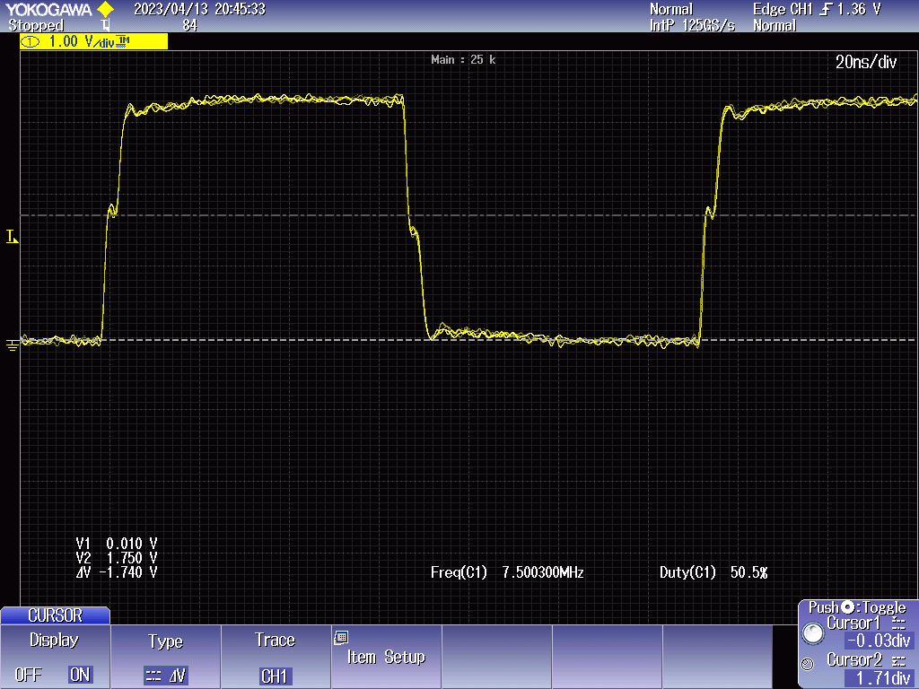
Stair step of SSI3_CLK

