Slide 1
Unlock MSPM0
MSPM0 team

Slide 2
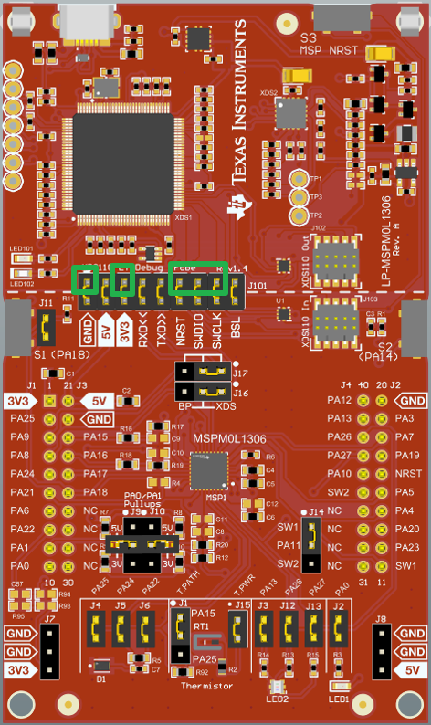
Method 0: Make device enter BSL
XDS110
Hardware connection (based on XDS110)
Step 0: Use a DuPont cable to connect the GND, DIO, and CLK on one side of the burner to the target board.
Step 1: Power down the MCU (unplug the power cord of the burner).
Step 2: Pull PA18 up. Press the PA18 button on Launchpad to ensure that the jumper cap is secure.
Step 3: Power on the MCU (plug in the power cord of the burner).
Step 5: Burn within 10 seconds without releasing PA18. No, look at method1.

Slide 3
Method 1: Force a DSSM Mass Erase/Factory reset
XDS110
Hardware connection (based on XDS110)
Step 1: Remove the jumper cap.
Step 2: Use a DuPont cable to connect the GND, 3.3V, DIO, CLK, and RST on one side of the burner to the target board. (If using launchpad, there is no need to do Step1,2).

Slide 4
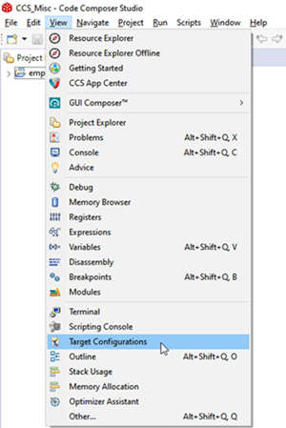
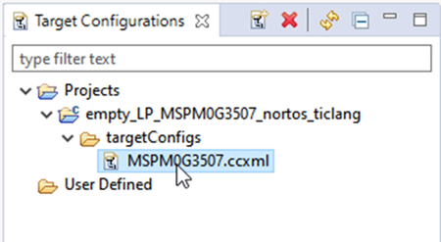
Method 1: Force a DSSM Mass Erase /Factory reset
Software steps（based on CCS）
  Step1: Open Target Configurations
  Step2: Find the ccxml file for the corresponding project

Slide 5
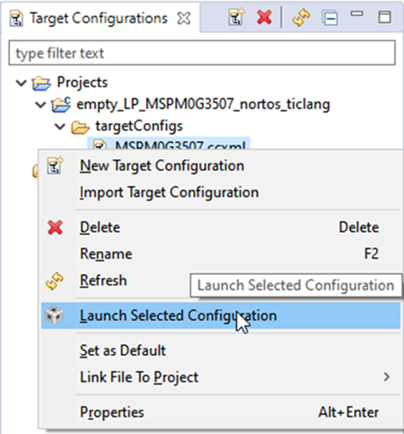
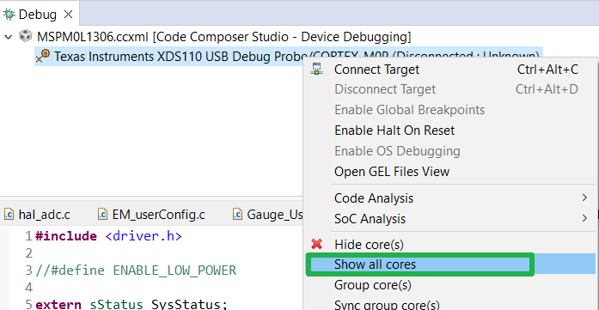
Method 1: Force a DSSM Mass Erase /Factory reset
Software steps（based on CCS）
  Step3: Click on launch
  Step4: Show all cores

Slide 6
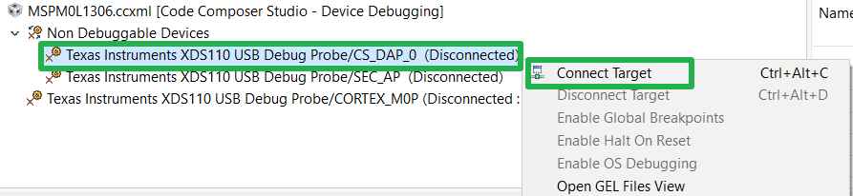
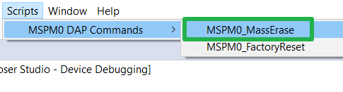
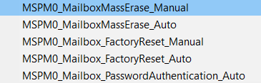
Method 1: Force a DSSM Mass Erase /Factory reset
Software steps（based on CCS）
  Step5: Connect DAP (If not work, please choose method2)
  Step6: Mass erase or a high level erase: FactoryReset
Auto: Means CCS will control the reset pin (Need to connect reset pin to debugger!).
Manual: Means users need to control the reset pin following instruction.

Slide 7
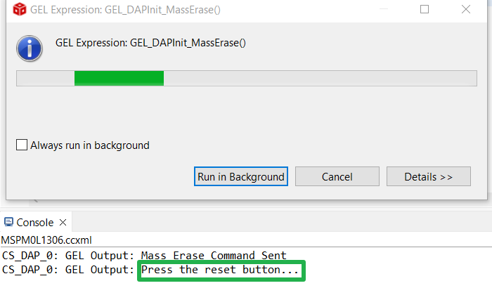
Method 1: Force a DSSM Mass Erase
Reset button
Software steps（based on CCS）
  Step7: if see this on Console interface, press the reset button of XDS110.

Slide 8
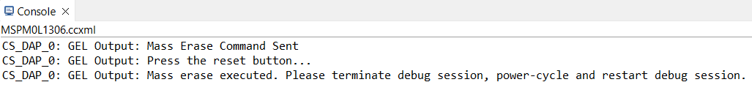


Method 1: Force a DSSM Mass Erase
Software steps（based on CCS）
  Step8: Console prompts, click pause, click debug, and burn the code again.

Slide 9
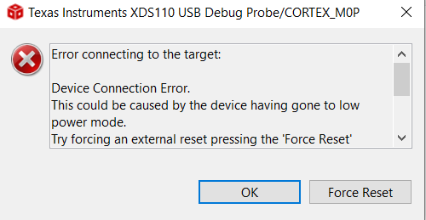
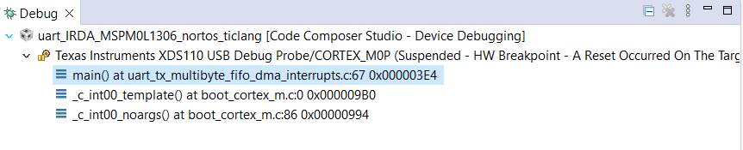
Method 1: Force a DSSM Mass Erase
Software steps（based on CCS）
  Step9: If this error occurs, select Force Reset while ensuring a reset connection. Successfully connected.

Slide 10

Method 2: BSL unlock
XDS110
Hardware connection (based on XDS110)
Step 1: Remove the jumper cap.
Step 2: Use a DuPont cable to connect the GND, 3.3V, RXD, TXD, RST, and BSL on one side of the burner to the target board. If using launchpad, a jumper needs to be used to connect RXD and TXD.
 | TXD | RXD | BSL
L1306 | PA23 | PA22 | PA18
G3507 | PA10 | PA11 | PA18

Slide 11
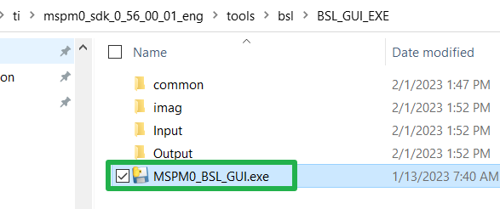
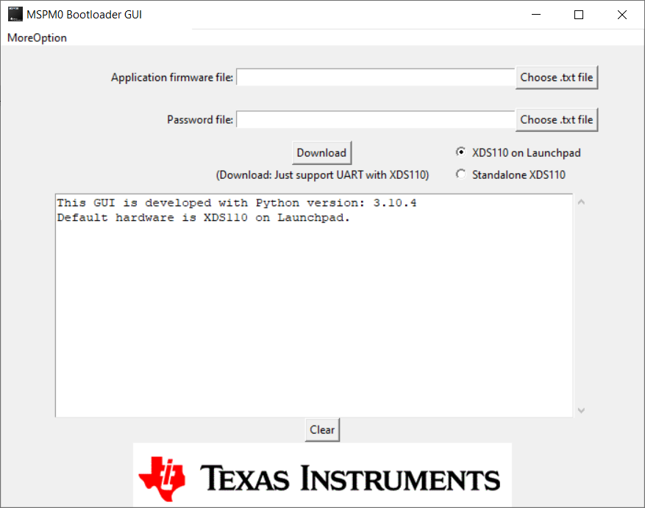
Method 2: BSL unlock
Software steps（based on CCS）
  Step1: Download MSPM0 SDK
  Step2: Open this software

Slide 12
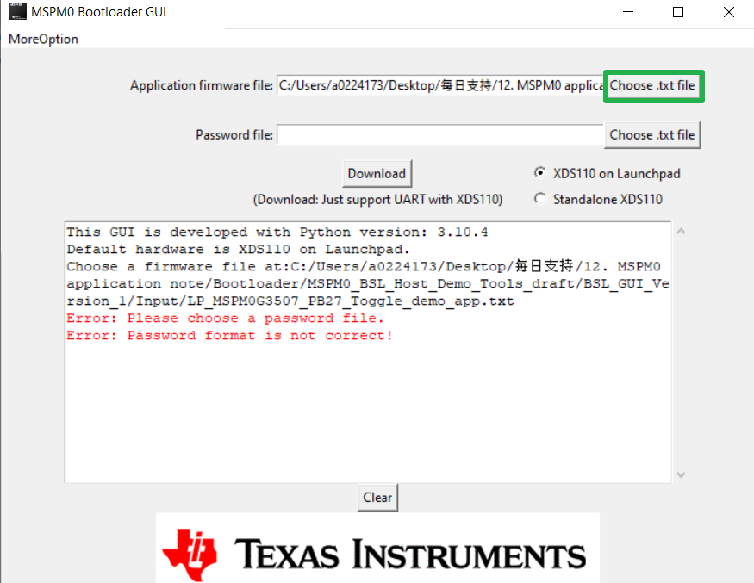
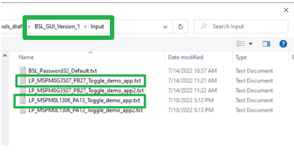
Method 2: BSL unlock
Software steps（based on CCS）
  Step3: Select the corresponding software firmware based on the chip used (in the input folder)

Slide 13
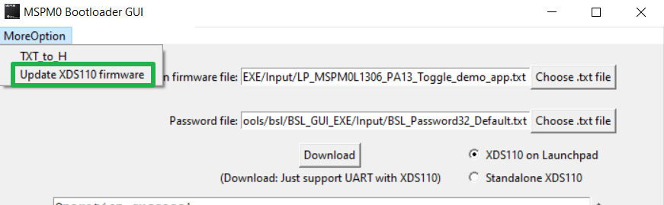
Method 2: BSL unlock
Software steps（based on CCS）
  Step4: Update XDS110 firmware

Slide 14
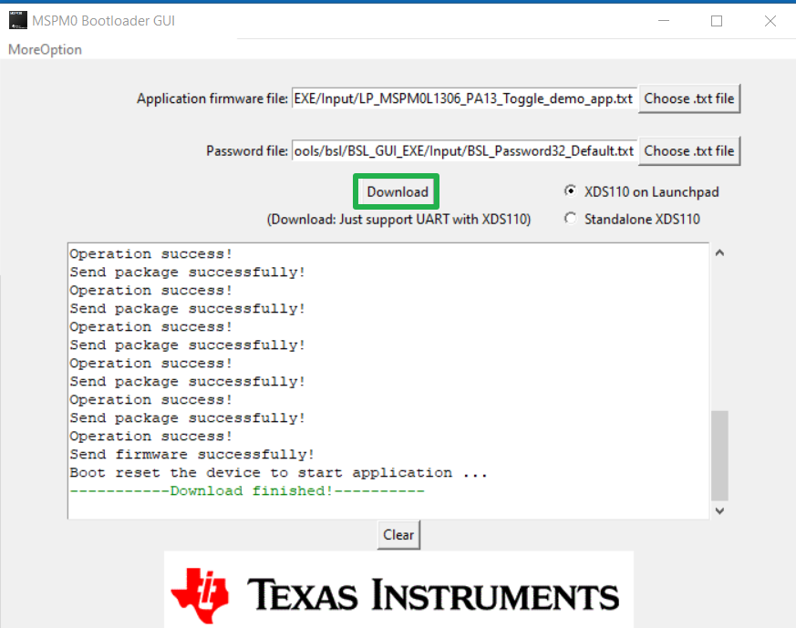
Method 2: BSL unlock
Software steps（based on CCS）
  Step5: Download firmware and unlock device

