Slide 1
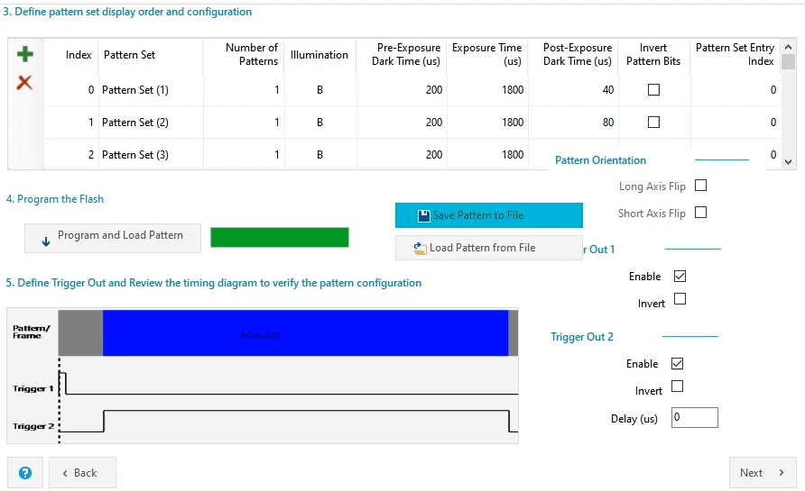
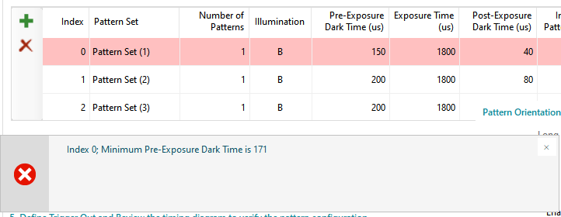
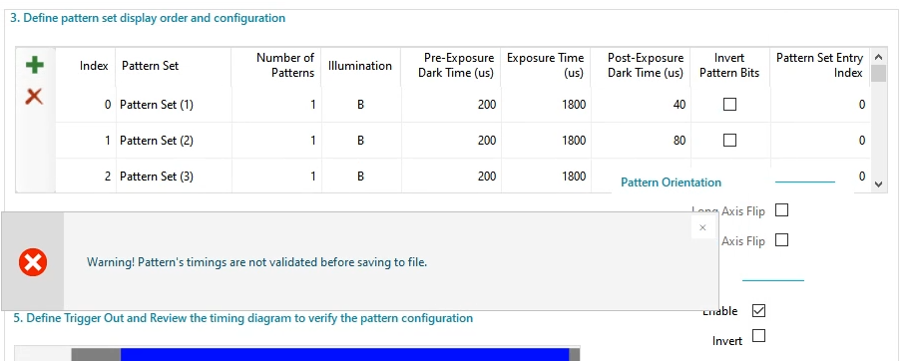
Save Pattern to file
<Figure-1: Incorrect timing value>
Download and operation is ok without Figure 1 message

