Slide 1
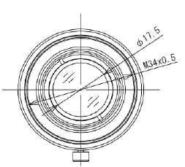
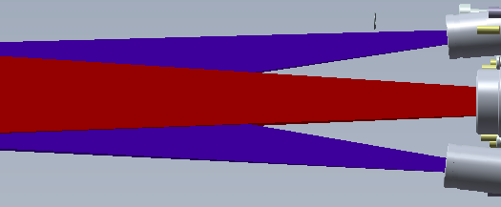
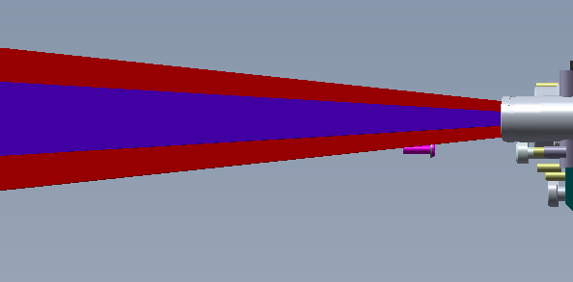
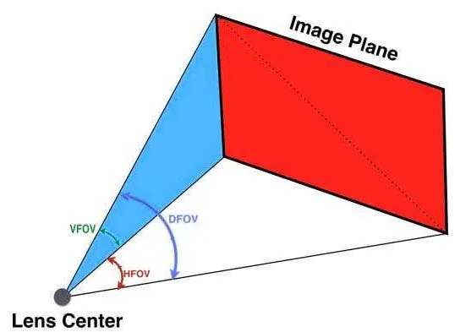
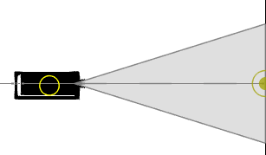
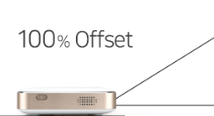
DLP3010EVM-LC Optical path
Need to check interference between optical path and components such as housing.
Working distance vs Area simulation
<Right Camera – Optical Path>
<Example-Camera Lens>
<Beam Projector – Optical Path>
<Left Camera – Optical Path>
<Example - Top view, Our intraoral scanner>
<Example - Side view- Our intraoral scanner >
① ?
Top View
②?
Side View
<DLP3010EVM-LC>
Can draw 3d optical path using D/H/V angle view

Slide 2
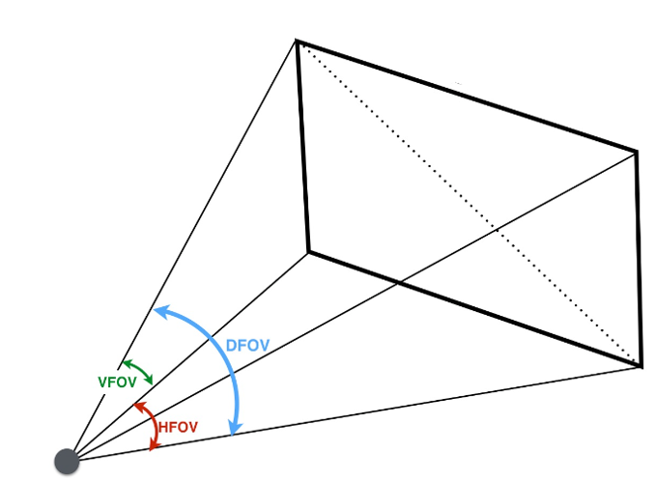
DLP3010EVM-LC Optical path
Beam projector
VFOV=Vertical Angle
HFOV=Horizontal Angle
DFOV=Diagonal Angle

