Slide 1
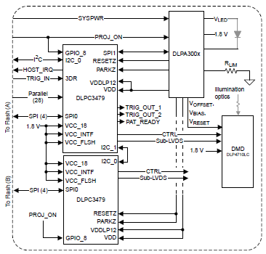



Beam Operation Condition and Scenario
User
GUI on PC
Operation Conditions
Download various pattern sets in Internal Mode in advance.
-. The number of images and exposure time for each pattern set are different .
Display the pattern set selected by the user.
Do not change the capture mode ( or pattern set configuration) while the beam pattern is operating.
To change the pattern set, stop the beam operation first.
PC interface
Controller
The exposure time and pattern configuration were arbitrarily set for explanatory purposes.
I2C
Pattern_set#1 Exposure time : 5000[us]
Pattern_set#2 Exposure time : 4000[us]
Pattern_set#3 Exposure time : 3000[us]
Pattern_set#3 Exposure time : 25000[us]
Flash Memory of Master DLPC
Flash Memory of Slave DLPC

Slide 2
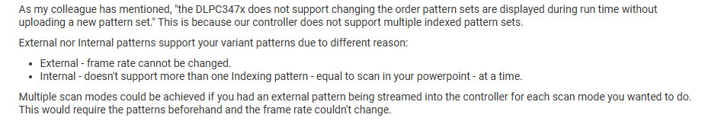
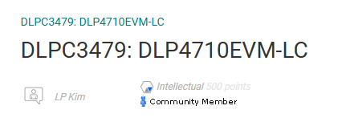
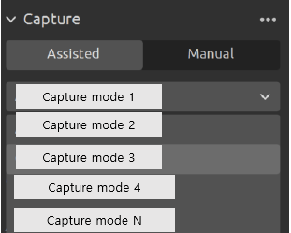

<Question-1> In Internal Pattern mode, it seems that Multi Pattern set mode is possible when not in operation.
Are operation scenarios 1 and 2 possible in Internal Pattern mode?
I would like to display the corresponding Internal Pattern configuration based on the Capture mode selected by the user, just like in the example GUI. The pattern configuration for each Capture mode is different.
<Question-2> If operation scenarios 1 and 2 are possible,
Is there a delay between the initial pattern set and the next pattern set during the display operation?
<Question-3> If operation scenarios 1 and 2 are possible,
Can a similar test be performed on the TI GUI and EVM?
<Example – GUI >

Slide 3
Beam Operation Condition and Scenario
Example of scenario 1
-. Conditions : All pattern sets have been downloaded to the external flash memory
Due to the DLPC initialization time, the PROJ_ON signal is changed from
Low to High and remains High thereafter.
A.1) Select “User capture mode #1 on Customizing GUI “ – Not TI GUI
A.2) The pattern set corresponding to capture Mode #1 is pre-loaded from the external
memory to the DLPC internal memory.
A.3) Pattern display operation execution
A.4) Pattern_set #1 Display → Pattern_set#2 Display
A.5) Operation Complete
A.6) Pattern display operation execution
A.7) Pattern_set #1 Display → Pattern_set#2 Display
A.8) Operation Complete
A.N) Display stop execution
B.1) Select “User capture mode #1 on Customizing GUI “ – Not TI GUI
B.2) The pattern set corresponding to capture Mode #2 is pre-loaded from the external
memory to the DLPC internal memory.
B.3) Pattern display operation execution
B.4) Pattern_set #1 Display → Pattern_set#2 Display → Pattern_set#3 Display
B.5) Operation Complete
B.6) Pattern display operation execution
B.7) Pattern_set #1 Display → Pattern_set#2 Display → Pattern_set#3 Display
B.8) Operation Complete
B.N) Display stop execution
Pattern_set#1 Exposure time : 5000[us]
Pattern_set#2 Exposure time : 4000[us]
<Capture mode #1_ pattern set configuration>
Repetitive action
Pattern_set#1 Exposure time : 5000[us]
Pattern_set#2 Exposure time : 4000[us]
Pattern_set#3 Exposure time : 3000[us]
<Capture mode #2_ pattern set configuration>
Pattern_set#1 Exposure time : 5000[us]
Pattern_set#3 Exposure time : 25000[us]
<Capture mode #3_ pattern set configuration>

Slide 4
Beam Operation Condition and Scenario
Example of scenario 1
-. Conditions : All pattern sets have been downloaded to the external flash memory
Due to the DLPC initialization time, the PROJ_ON signal is changed from
Low to High and remains High thereafter.
C.1) Select “User capture mode #3 on Customizing GUI “ – Not TI GUI
C.2) The pattern set corresponding to capture Mode # is pre-loaded from the external
memory to the DLPC internal memory.
C.3) Pattern display operation execution
C.4) Pattern_set #1 Display → Pattern_set#3 Display
C.5) Operation Complete
C.6) Pattern display operation execution
C.7) Pattern_set #1 Display → Pattern_set#3 Display
C.8) Operation Complete
C.N) Display stop execution
Pattern_set#1 Exposure time : 5000[us]
Pattern_set#2 Exposure time : 4000[us]
<Capture mode #1_ pattern set configuration>
Repetitive action
Pattern_set#1 Exposure time : 5000[us]
Pattern_set#2 Exposure time : 4000[us]
Pattern_set#3 Exposure time : 3000[us]
<Capture mode #2_ pattern set configuration>
Pattern_set#1 Exposure time : 5000[us]
Pattern_set#3 Exposure time : 25000[us]
<Capture mode #3_ pattern set configuration>

Slide 5
Beam Operation Condition and Scenario
Example of scenario 2
-. Conditions : All pattern sets have been downloaded to the external flash memory
Due to the DLPC initialization time, the PROJ_ON signal is changed from
Low to High and remains High thereafter.
A.1) Select “User capture mode #1 on Customizing GUI “ – Not TI GUI
A.2) The pattern set corresponding to capture Mode #1 is pre-loaded from the external
memory to the DLPC internal memory.
A.3) Pattern display operation execution
A.4) Pattern_set #2 Display → Pattern_set#1 Display
A.5) Operation Complete
A.6) Pattern display operation execution
A.7) Pattern_set #1 Display → Pattern_set#2 Display
A.8) Operation Complete
A.N) Display stop execution
B.1) Select “User capture mode #1 on Customizing GUI “ – Not TI GUI
B.2) The pattern set corresponding to capture Mode #2 is pre-loaded from the external
memory to the DLPC internal memory.
B.3) Pattern display operation execution
B.4) Pattern_set #1 Display → Pattern_set#3 Display → Pattern_set#2 Display
B.5) Operation Complete
B.6) Pattern display operation execution
B.7) Pattern_set #1 Display → Pattern_set#3 Display → Pattern_set#2 Display
B.8) Operation Complete
B.N) Display stop execution
Pattern_set#2 Exposure time : 4000[us]
Pattern_set#1 Exposure time : 5000[us]
<Capture mode #1_ pattern set configuration>
Repetitive action
Pattern_set#1 Exposure time : 5000[us]
Pattern_set#3 Exposure time : 3000[us]
Pattern_set#2 Exposure time : 4000[us]
<Capture mode #2_ pattern set configuration>
Pattern_set#3 Exposure time : 25000[us]
Pattern_set#1 Exposure time : 5000[us]
<Capture mode #3_ pattern set configuration>
The pattern set index is not in sequential order.

Slide 6
Beam Operation Condition and Scenario
Example of scenario 2
-. Conditions : All pattern sets have been downloaded to the external flash memory
Due to the DLPC initialization time, the PROJ_ON signal is changed from
Low to High and remains High thereafter.
C.1) Select “User capture mode #3 on Customizing GUI “ – Not TI GUI
C.2) The pattern set corresponding to capture Mode # is pre-loaded from the external
memory to the DLPC internal memory.
C.3) Pattern display operation execution
C.4) Pattern_set #2 Display → Pattern_set#1 Display
C.5) Operation Complete
C.6) Pattern display operation execution
C.7) Pattern_set #3 Display → Pattern_set#1 Display
C.8) Operation Complete
C.N) Display stop execution
Pattern_set#1 Exposure time : 5000[us]
Pattern_set#2 Exposure time : 4000[us]
<Capture mode #1_ pattern set configuration>
Repetitive action
Pattern_set#1 Exposure time : 5000[us]
Pattern_set#2 Exposure time : 4000[us]
Pattern_set#3 Exposure time : 3000[us]
<Capture mode #2_ pattern set configuration>
Pattern_set#1 Exposure time : 5000[us]
The pattern set index is not in sequential order.
Pattern_set#3 Exposure time : 25000[us]
<Capture mode #3_ pattern set configuration>

