Slide 1
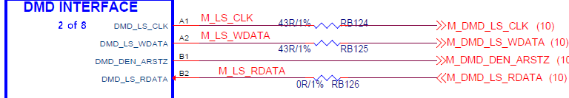
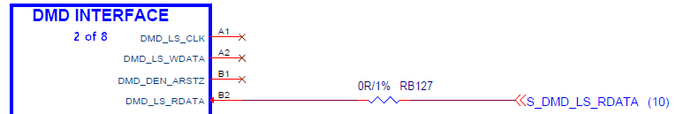
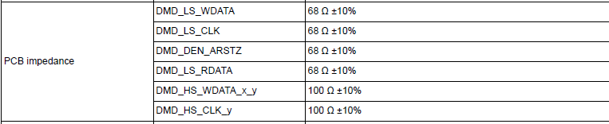
Master
Slave

Slide 2
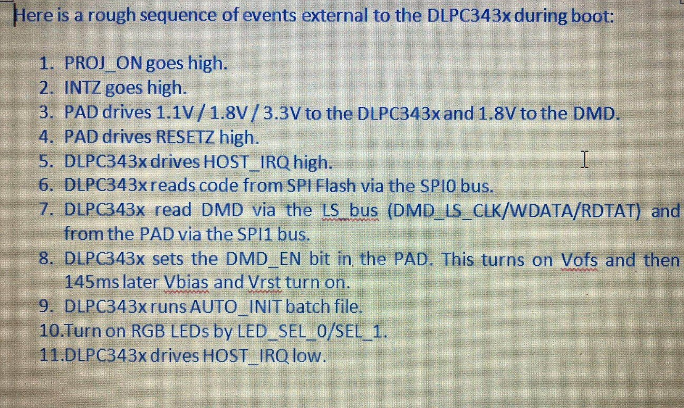

Slide 3
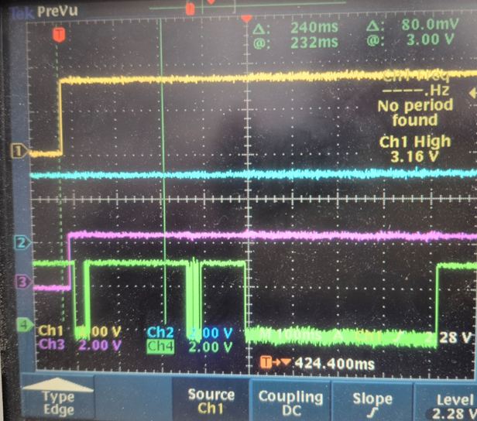
CH1: PROJ_ON
CH2: HOST_IRQ
CH3: RESETZ
[A]
[B]
[C]
CH4: SPI1Pin_CS
<DLPC3010EVM_with Beam Engine>
[A] 30[ms] , [B]36[ms] [C]424[ms]

Slide 4
