Slide 1
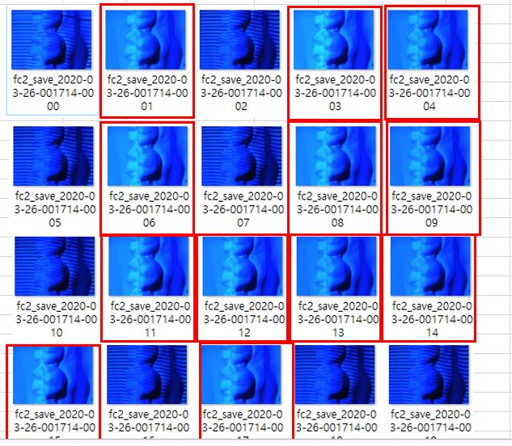
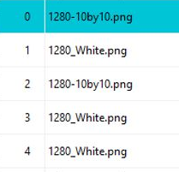
Test Condition = Pattern Set(1)
Pattern Set(1)=5 Patterns
Pattern Set
1 Cycle
OK
OK
How to control the camera mode to capture the OK examples?

Slide 2
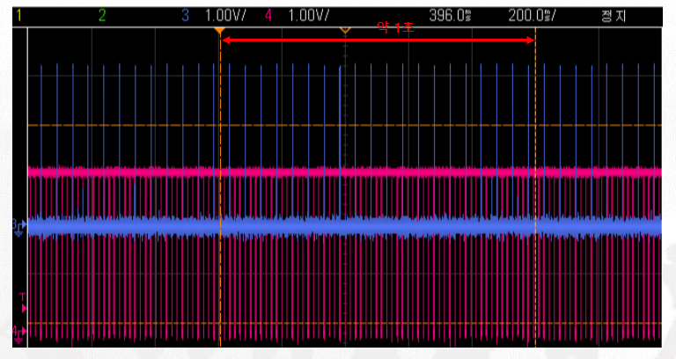
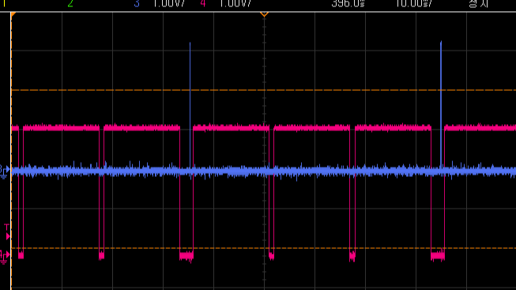
Test Condition = Pattern Set(1)
Pattern Set(1)=3 Patterns
②
③
①
I want to capture each capture during patter set(1).
How to set camera Trigger Mode using trigger2 of beam projection?

