Slide 1
DLP011-001 : DLPLCR70EVM (uses DLP7000 DMD) DLP011-002 : DLPLCR70UVEVM (uses DLP7000UV DMD) All other components are the same.

Slide 2
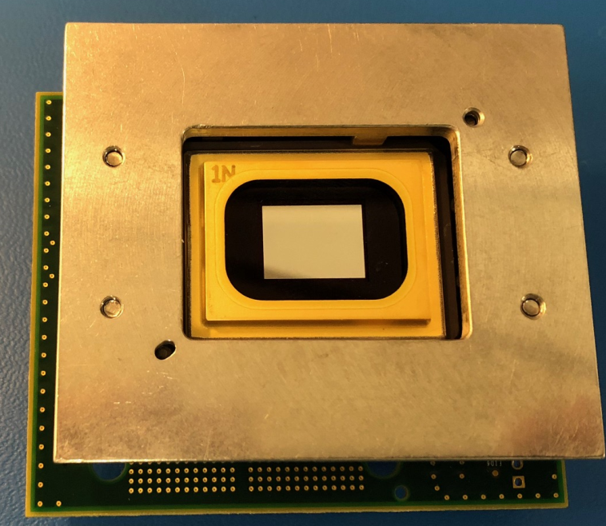
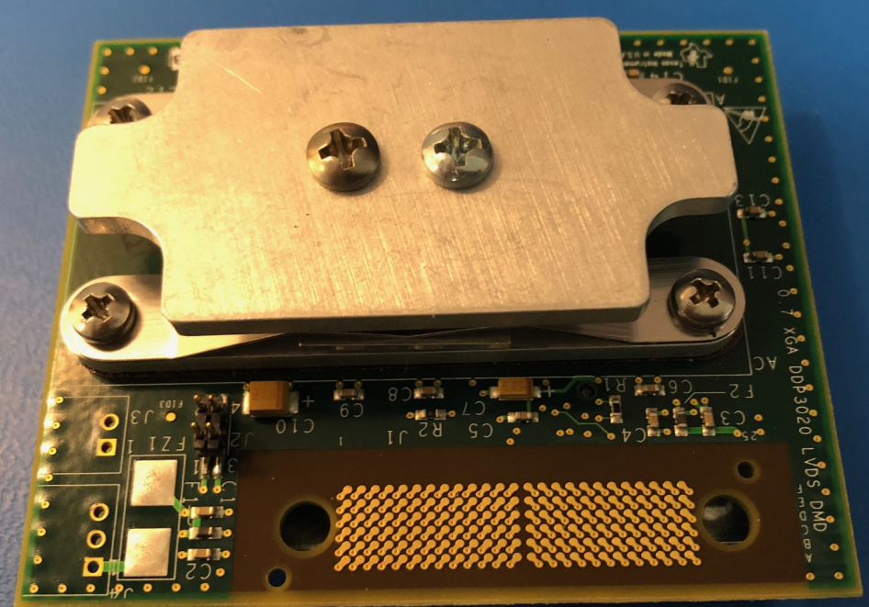
Assembly drawings and pictures
DLP011 Assembly (front)
DLP011 Assembly (back)

Slide 3
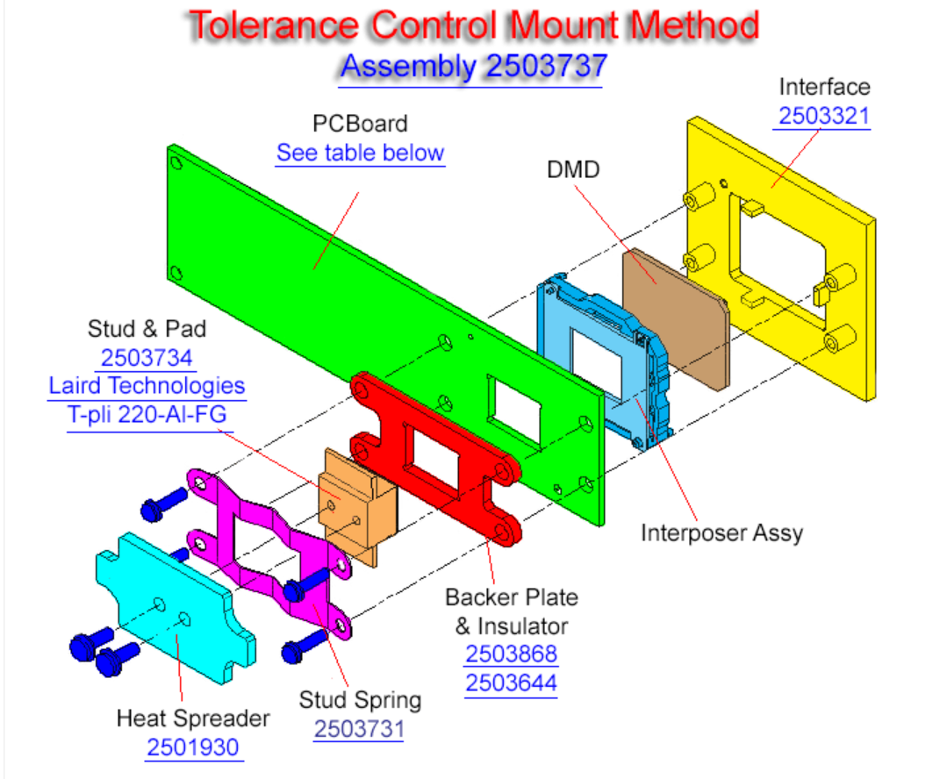
DLP011-00x Top Level Assy
DLP011-001 = DLP7000
DLP011-002 = DLP7000UV
DLP011 PCB
2
4ea. Screw, M3 x 0.5, x16mm, Pan Head
Torque to
3.0 +/- 1.0 IN-LB
2503000-0003
1
Apply Kapton Tape Insulator to side of backer plate mating to the board.
Apply thermal pad to surface of stud mating to DMD.
2ea. Screw, #6-32 UNC x .38”, Pan Head
Torque to 6.0 +/- 1.0 IN-LB

Slide 4
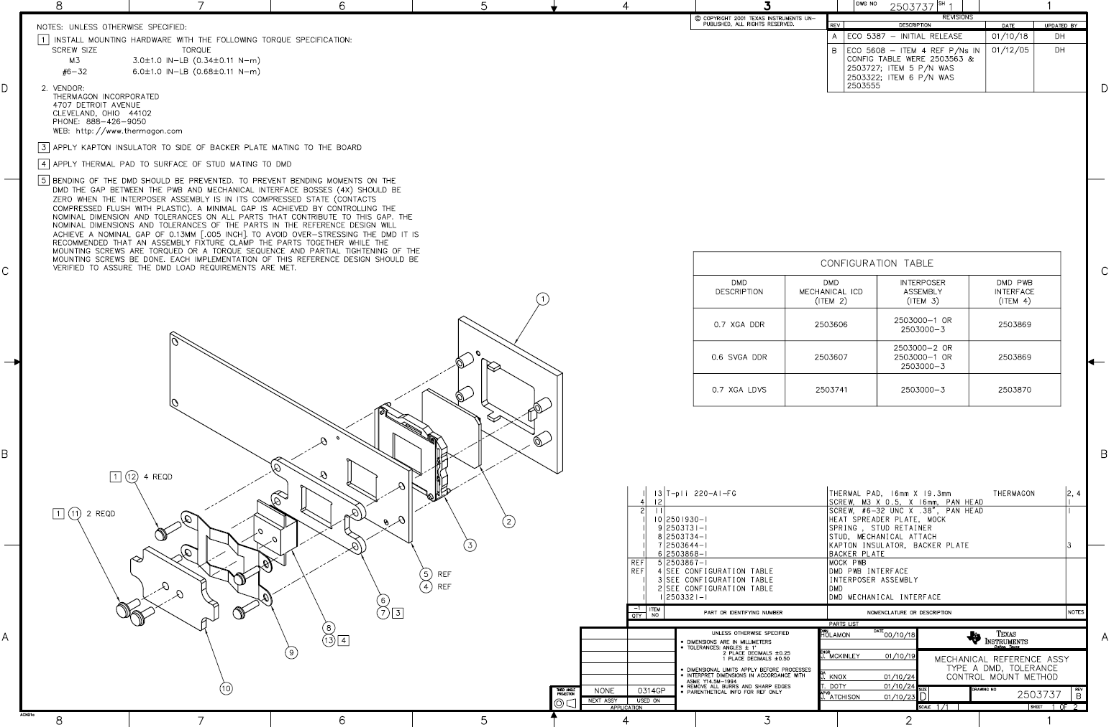
DLP011A
DLP011-001 = DLP7000
DLP011-002=DLP7000UV
2503000-0003
DLP011A

