Slide 1
DLPC120 Calibration
>>> Calibration Command Line Interface
Alex Chan

Slide 2
Introduction
In this training steps will be shown to run final iterative calibration in a production setting with the EVM/system
This guide assumes the user has already gone through flashing the system and generating temperature sweep calibration data
Ensure the project has all settings correctly configured and the project is saved
Ensure all equipment is plugged in and powered up and make sure no applications are still connected to the EVM/system such as other Control Programs

Slide 3
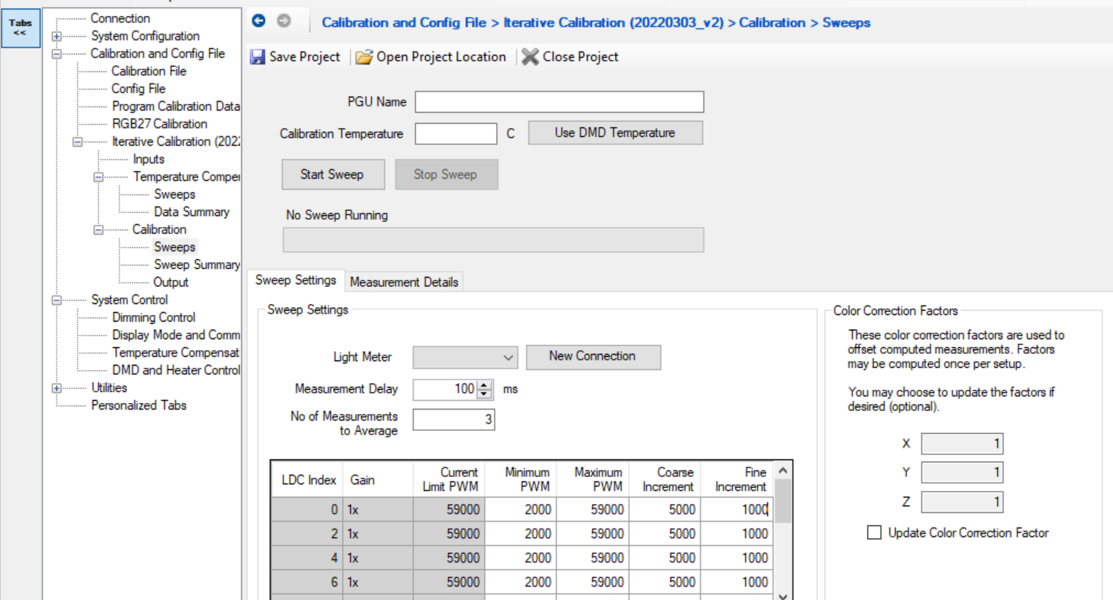
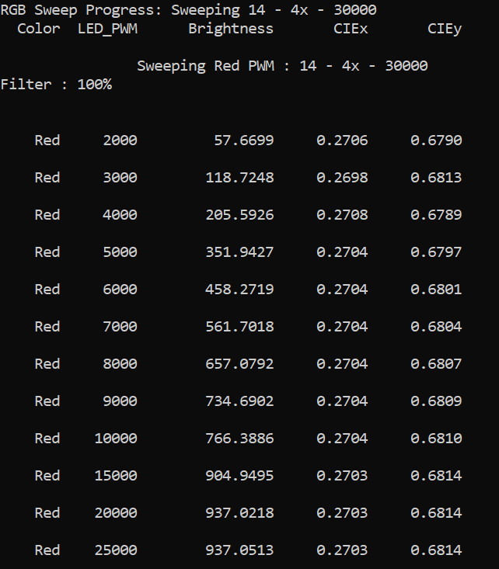
Sweep Settings: Fine/Coarse Increment Parameter
To speed up the calibration process a user can adjust the Fine and Coarse increment parameters. A starting point would be 1000 for Fine Increment and 5000 for Coarse Increment but a user can adjust for their specific use case

Slide 4
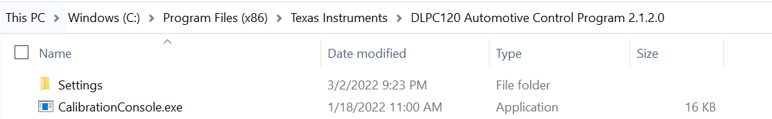
Step 1: Find the CalibrationConsole.exe file
Locate the CalibrationConsole.exe file and the directory path
Note that you will need to have installed a newer version of DLPC120 Control Program as older versions do not support Command Line Interface
For example this is the location of the folder for DLPC120 Control Program on a Windows Computer

Slide 5
Step 2: Find all supporting files
Ensure you have the following files ready and have all the directory paths
  Cal file
  Config file
  Project file
The following files will be provided for you so store them locally onto your computer and know the directory path
  Ca210 file – CA210.xml
  Cheetah file – Cheetah.xml

Slide 6
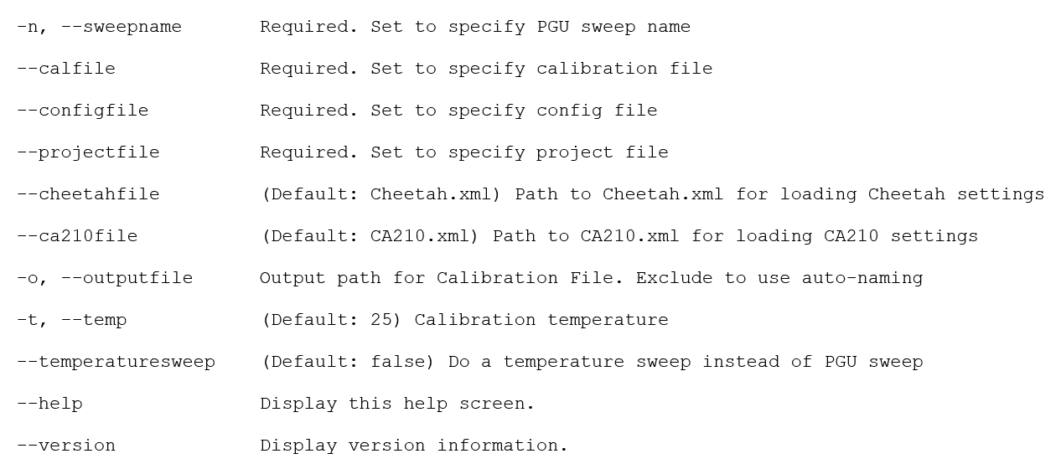
Explanation of Parameters
Here are all of the parameters to run the command line interface command

Slide 7
Step 3: Running the Command
There are two methods
  The user can type the command into a Windows Command Prompt
  The user can save the command created in Method 1 into a .bat file that can be executed by a user or called by a script

Slide 8
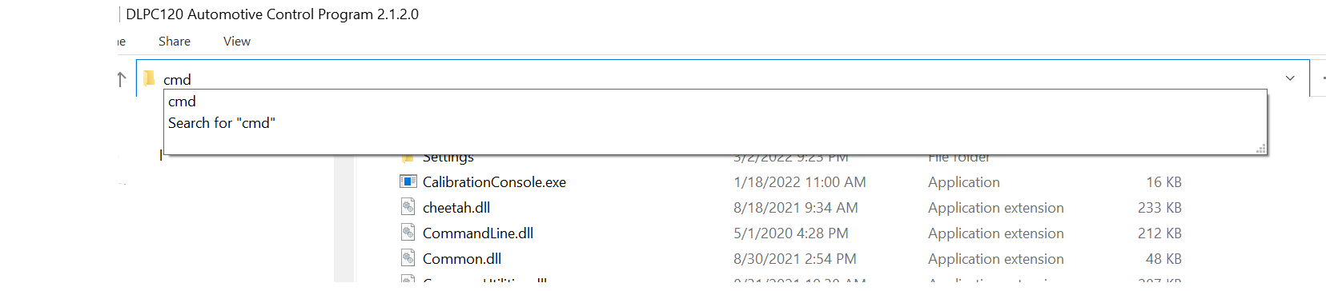
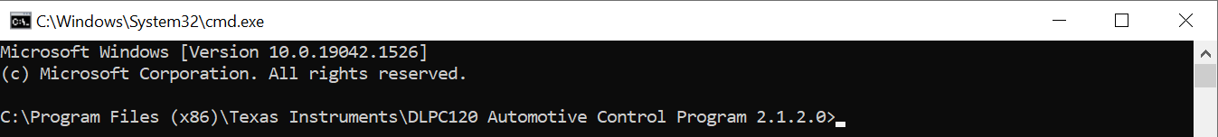
Method 1
Open up a Command Line Interface.
Go to the path of where the DLPC120 Automotive Control Program folder is and at the very top type “cmd”
This will open a Windows Command Terminal

Slide 9
Method 1 Continued
Type in the following command
  Note: If the user wants to call CalibrationConsole.exe remotely, the user will need to specify the path instead of using “.\” Anything highlighted in yellow is something the user needs to add. Note the spaces and this is all one single command.
.\CalibrationConsole.exe --sweepname [Name of Sweep] --calfile [Path and Name of calibration file] --configfile [Path and Name of config file] --projectfile [Path and Name of project file] --cheetahfile [Path of cheetah file]\Cheetah.xml --ca210file [Path of CA210.xml file]\CA210.xml –o [Cal Project location]\Output\[Name of output file].cal –t [temperature for example 25]

Slide 10
Method 1: Example Full Command
Here is an example of the command with proper syntax. You can copy and paste this command and edit it.
.\CalibrationConsole.exe --sweepname test_cli_sweepname3 --calfile .\cal_proj\DLP553030PGUQ1EVM_Ross_Ohio_Test_Build_v1 --configfile .\cal_proj\DLP553030PGUQ1EVM_Ross_Ohio_Test_Build_v1.cfg --projectfile .\cal_proj\dlpc120_calibration_ohio_setup.proj --cheetahfile .\Cheetah.xml --ca210file CA210.xml -o .\cal_proj\Output\test_cli_sweepname3.cal -t 25

Slide 11
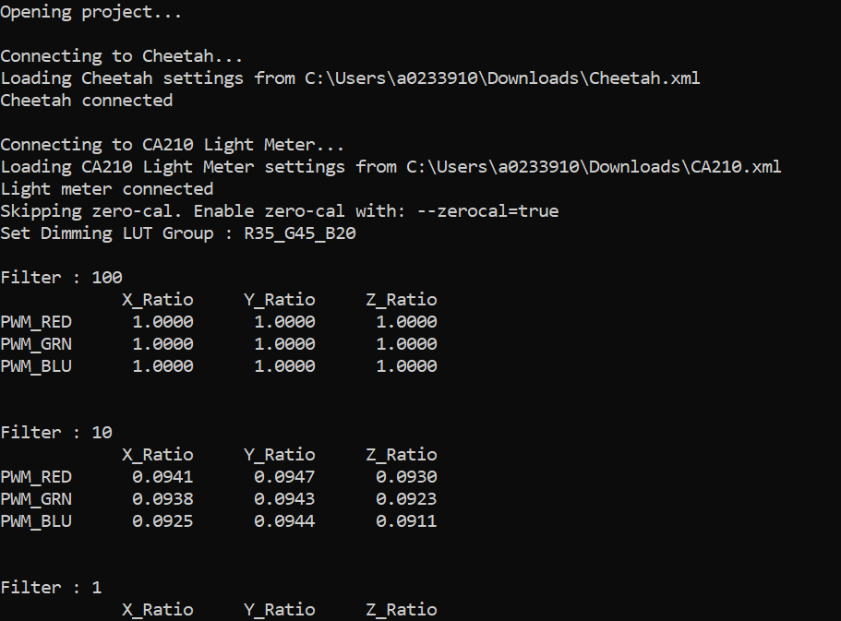
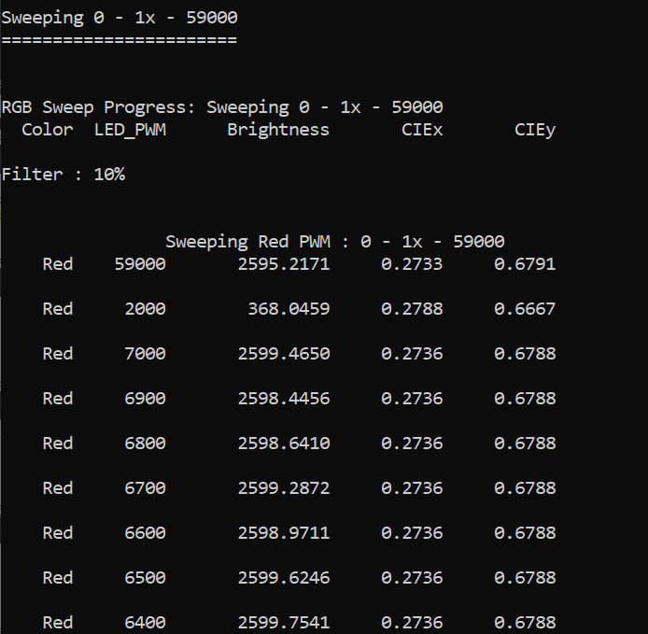
Method 1: Example Command Line
The following shows the beginning of the script once the user presses “Enter”
Notes:
.\CalibrationConsole.exe --sweepname test1 --calfile C:\Users\a0233910\Downloads\20220303_v2\20220303_v2\EVM_RevC_Starter_Cal_20180111_v3.cal --configfile C:\Users\a0233910\Downloads\20220303_v2\20220303_v2\Config0008_3DFDB5A3_20210714_test_v10.cfg --projectfile C:\Users\a0233910\Downloads\20220303_v2\20220303_v2\20220303_v2.proj --cheetahfile C:\Users\a0233910\Downloads\Cheetah.xml --ca210file C:\Users\a0233910\Downloads\CA210.xml -o C:\Users\a0233910\Downloads\20220303_v2\20220303_v2\Output\test1_out.cal -t 25

Slide 12
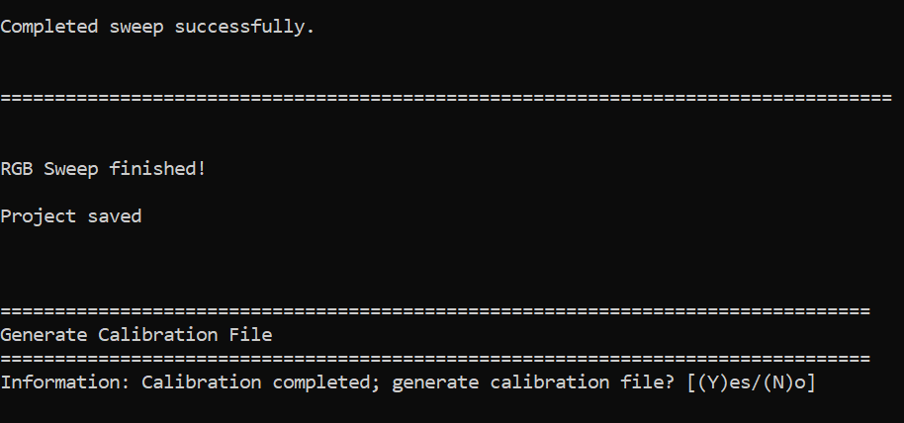
Method 1 Continued
At the end of the script you will see the following prompt and a prompt to generate the calibration file.

Slide 13
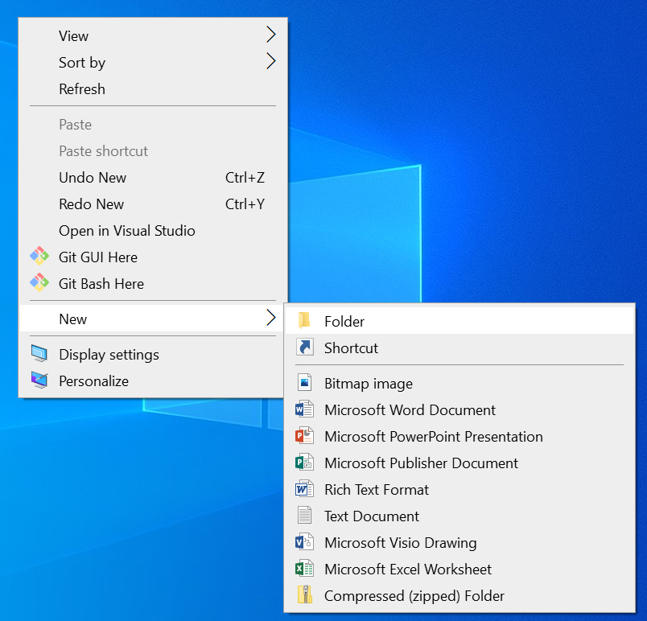
Method 2
Using the same command created from Method 2, a user can create a .bat file.
First open a blank text file

Slide 14
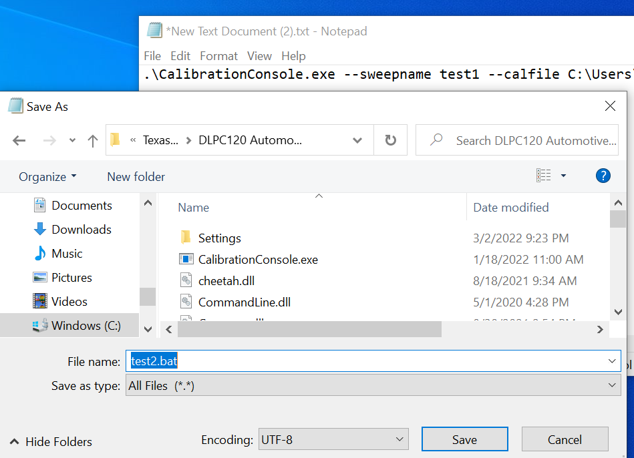
Method 2 Continued
Type in the command from Method 1 and then save as a .bat file exactly where your path references point to.
For example my command starts with .\CalibrationConsole.exe…because I was running the command from the DLPC120 Automotive Control Program folder so I want to save my .bat file in there.

Slide 15
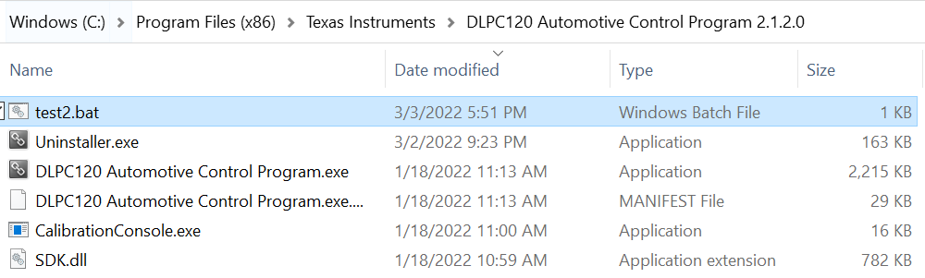
Method 2 Continued
I named my .bat file test2.bat and you can see it now located inside the DLPC120 Automotive Control Program. If you click the .bat file it will automatically launch the script

