Slide 1
DLPC230 Calibration Discoloration Debug
Alex Chan

Slide 2
Introduction
After the calibration routine has been completed and the user has generated the calibration file, it is important that the system be checked for any discoloration or issues.
If you set the Source image to an all white image and vary the dimming slider or use the horizontal gray ramp, there may be discoloration at certain settings.
This training will go over how to address discoloration in the brightness range after flashing the calibration file.

Slide 3
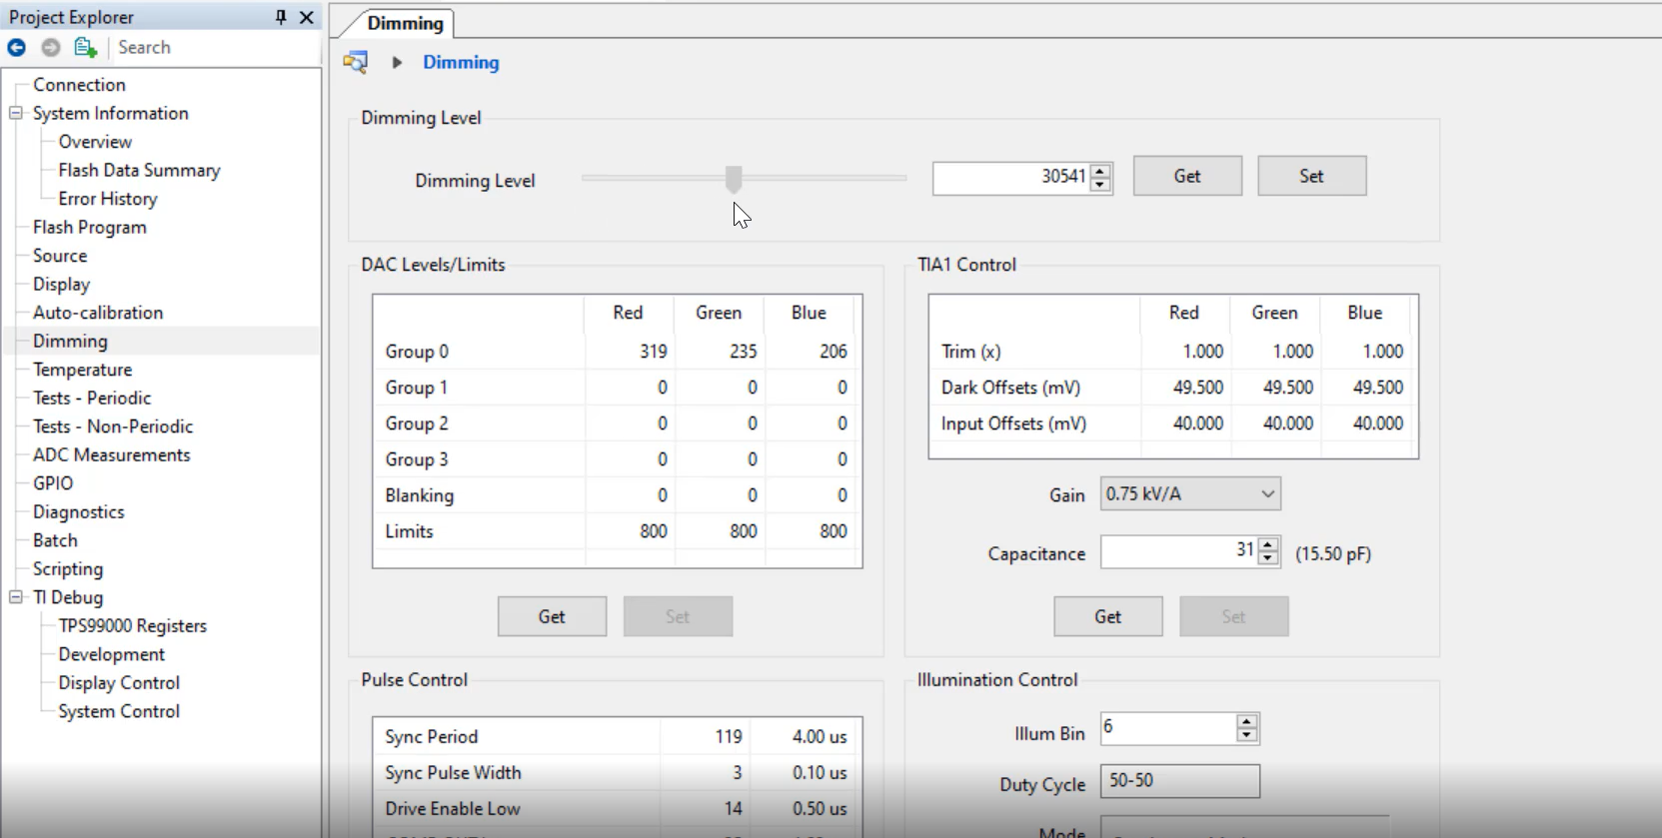
Discoloration Debug Step 1
First take note at what backlight level and settings the system is showing discoloration. Take note of the dimming level value, gain, illumination bin, duty cycle, and DAC levels. You can press the “Get” button in any of these boxes to get the current value. Another method is to check the generated calibration log file.

Slide 4
Discoloration Debug Step 2
In a real life debug example I noticed some discoloration at dimming level 44,000.
I checked the generated calibration log file to determine what coarse combination which was bin 6, gain of 6 kV/A and had current limits of 800, 800, 800

Slide 5
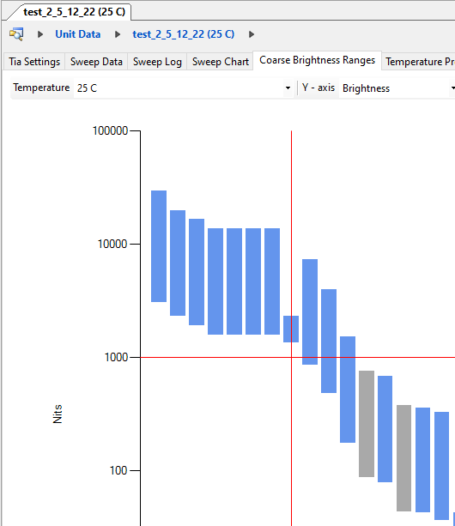
Discoloration Debug Step 3
Now I can go back to the unit sweep and check that specific coarse combination. Looking just at the coarse brightness range, I immediately noticed it was a very short bar that got picked in the final generated calibration file algorithm. This can lead to the calibration algorithm not having a lot of data to make optimal color point matching

Slide 6
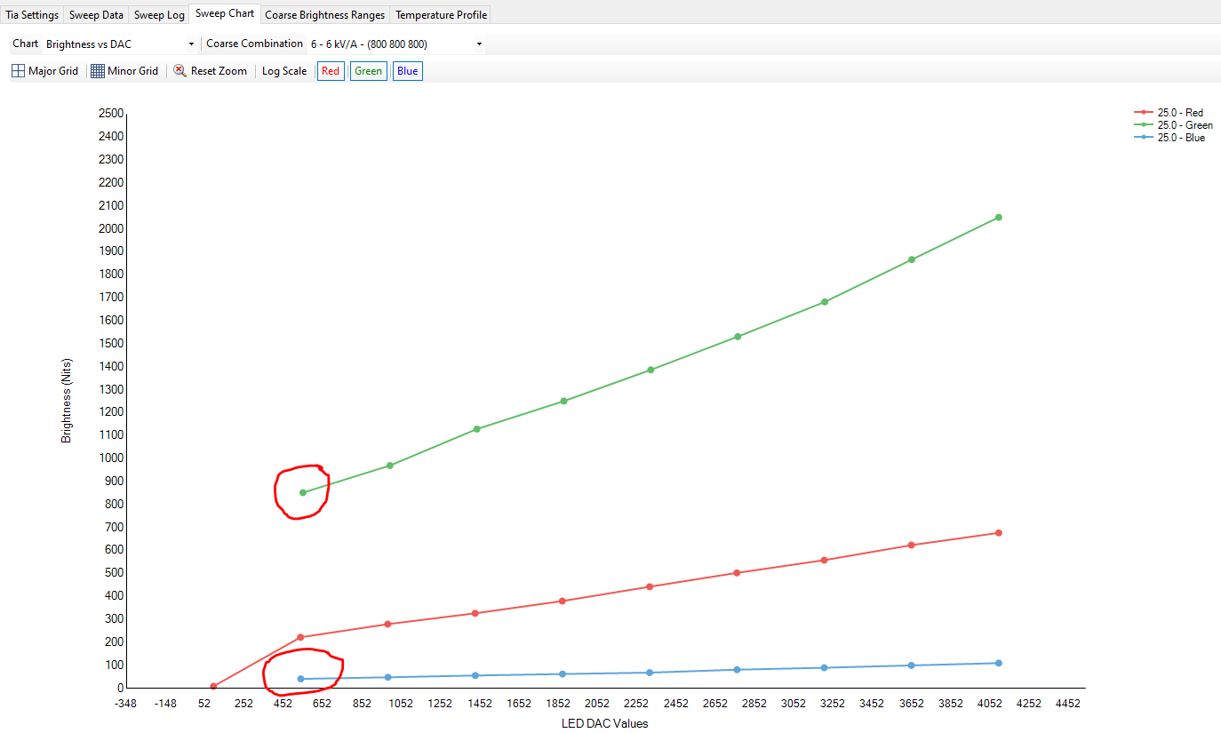
Discoloration Debug Step 4
Next I checked the Sweep Graph of coarse combination 6 – 6 kV/A 800 800 800
You can notice that there is missing data points on the graphs which can lead to the coarse combination bar being short and causing issues.

Slide 7
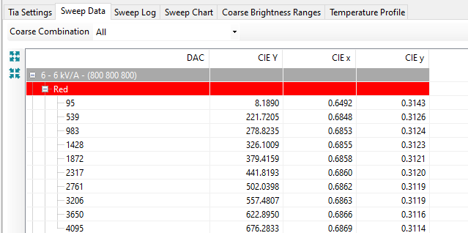
Discoloration Debug Step 5a
General rules include the following:
Make sure sweep charts are linear and continuous and do not have weird behavior, gaps, non-linear shapes.
Check the sweep data and ensure points are converging towards the correct color points for each respective color.You should be +/- (10-15%) these values for sweep data. If you are seeing issues, check the Color Analyzer Probe angle and position.
Red – 0.65, 0.3
Green – 0.3, 0.6
Blue – 0.14, 0.012

Slide 8
Discoloration Debug Step 5b
At the bottom of the DLPC230 Control Program, there is a tab to perform basic Color Analyzer Readings. You can check the color analyzer probe is in an optimal position or angle by taking measurements until you are in the range specified on the previous slide.

Slide 9
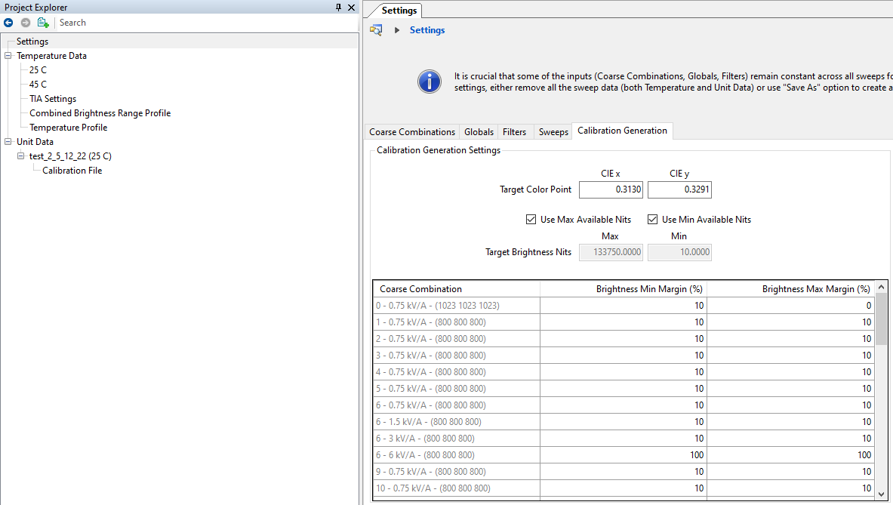
Discoloration Debug Step 6
To fix the issue you can go to the settings page and the Calibration Generation page and “remove” the problem coarse combination by making the max/min margins 100% to remove the bar. This will remove this coarse combination from the whole project including temperature and unit sweeps. This can be undone by simply changing the margins back to 10%

Slide 10
Discoloration Debug Step 7
When you check the Unit Sweep Coarse Brightness Range you will now see the bar is removed and a red circle next to that coarse combination which is normal.

Slide 11
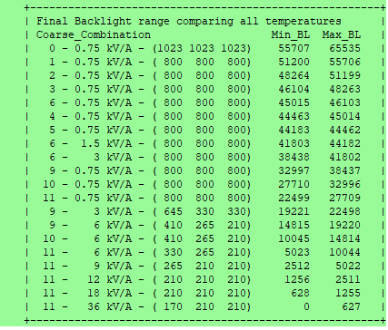
Discoloration Debug Step 8
Now you can generate a new calibration file. Note that you do NOT have to perform any new sweeps.
Notice that in the calibration file log the problem coarse combination 6 – 6 kV/A 800 800 800 is no longer included in the coarse combinations used to generate the final calibration file.

Slide 12
Discoloration Debug Step 8
Check and repeat this process for any other discoloration issues across the brightness range.
For a production test setup, the problem coarse combinations can be completely removed instead of temporarily removed using the method in this training.

