Slide 1
DLPC230 Calibration >>>Running Calibration Routine with Command Line Interface
Alex Chan

Slide 2
Introduction
In this training, steps will be shown to run the calibration routine from command line interface or be called from an external script by creating a batch file.

Slide 3
Parameter Settings
Parameter | Details
--temp <temp> | Temperature of the system being calibrated in degree C. Must match a temperature in the temperature trend data.
--program | [Optional] Programs flash after calibration, if specified.
--mintarget <minbrightness> | [Optional] Min Target brightness in nits. If not specified, the value in the calibration project is used.
--maxtarget <maxbrightness> | [Optional] Max Target brightness in nits. If not specified, the value in the calibration project is used.
--pguname <name> | Unique name to identify the PGU.
--calibrate-nd-filter | [Optional] Re-calibrate ND Filters before each sweep, if specified.
--generatecal | [Optional] If specified, generates cal file without doing calibration.
--warning-to-errors | [Optional] If specified, treats warnings as errors and will fail calibration.

Slide 4
Example Command
DLPC230Calibration.exe --temp 25 --program --mintarget 2000 --maxtarget 90000 --pguname “20170914_01_100” “C:\calproject\cal.calproj”
If you type in “C:\Program Files (x86)\Texas Instruments\DLPC230 Control Program (Insert your version number)\DLPC230Calibration.exe –h” this will bring up the help guide explaining the previous parameter settings.

Slide 5
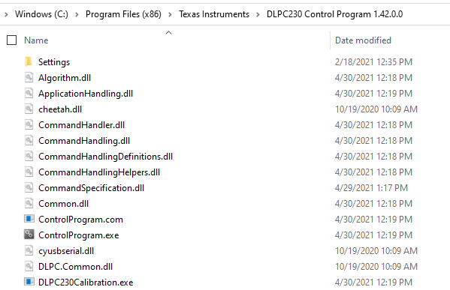
Running Calibration Routine from Command Line
Step 1:
Go to download folder of DLPC230 Control Program and ensure you have the correct version. Find the DLPC230Calibration.exe

Slide 6
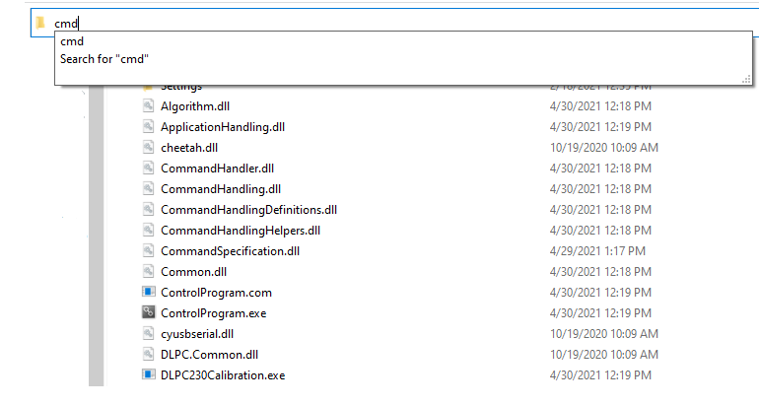
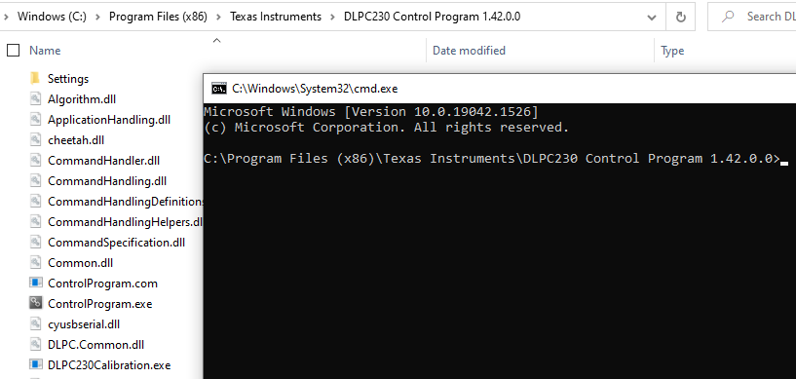
Running Calibration Routine from Command Line
Step 2:
Type “cmd” into the search bar and this will open a command line terminal already in the DLPC230 Control Program Folder

Slide 7
Running Calibration Routine from Command Line
Step 3:
Type in the command and associated parameters and press “Enter” on the keyboard and you will see the following.

Slide 8
Running Calibration Routine from Command Line
Step 4:
When the calibration routine is done and in this case the program parameter was specified so the EVM was already programmed afterwards, you will see the following message

Slide 9
Creating a Batch File
You can copy the command into a text file and save it as a batch file with extension “.bat” which can then be called from a script through system commands.
Make sure if the .bat file is located somewhere else, you may need to move to the location of the DLCP230Calibration.exe before calling the command in a script.

Slide 10
Now we will go through a video of this process

Slide 11
Video

Slide 12
This concludes the training

