Slide 1
1
Idea of the connection
How to plug J2 (name of cable or any reference)
2
J2
HDMI source

Slide 2
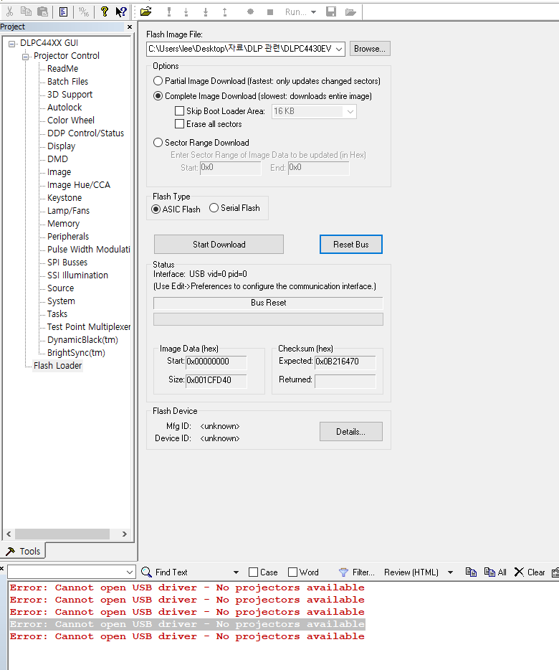
My solution for disconnection
Check USB connection
Using other port
Disable USB at device manager and reinstall
Changing USB cable
2. Power on/off
2-1. Power off and reconnect PC with USB
2-2. Change on/off status with switch SW1
-----
My connection on next page
2
3
1

Slide 3
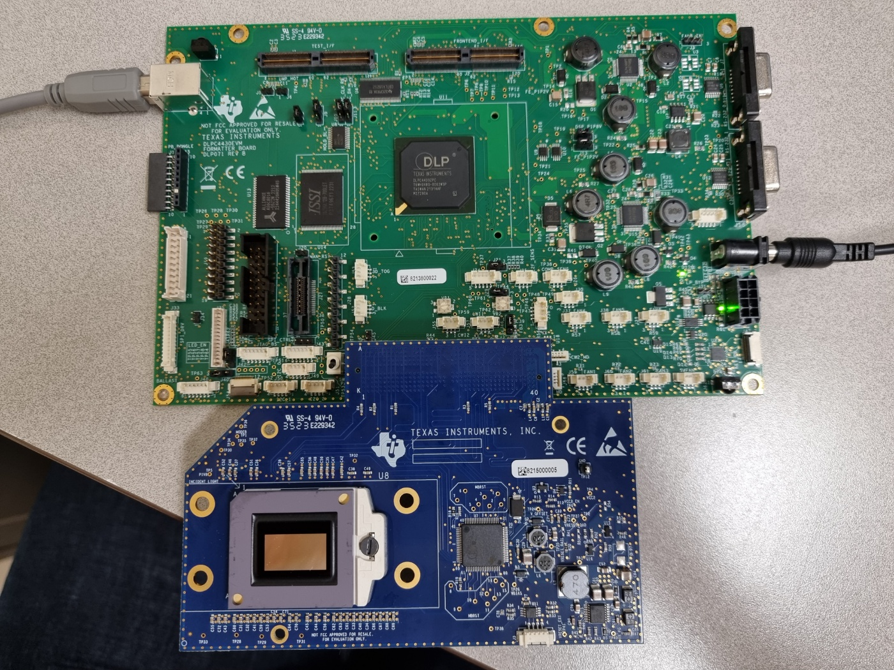
Some crack on L1
PC
Connecting J8
USB
12V, 5A
Question
Is there any mistakes?
Does crack on L1 causes USB disconnection?
Does initial point of switch SW1 (on/off) status affect this problem?
Green
Light on

