Slide 1
1. DMD display
Monitor connection
White scene
Black scene

Slide 2
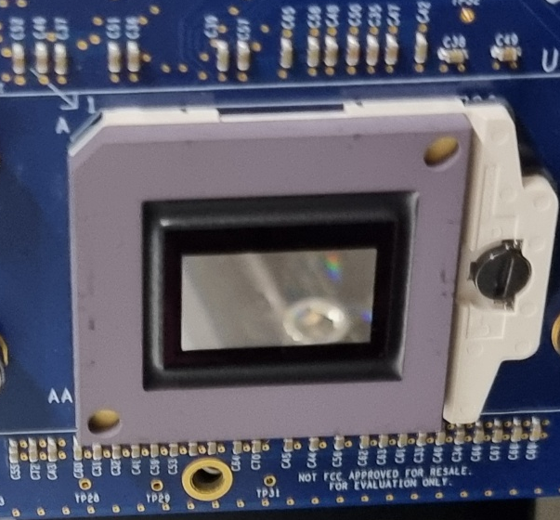
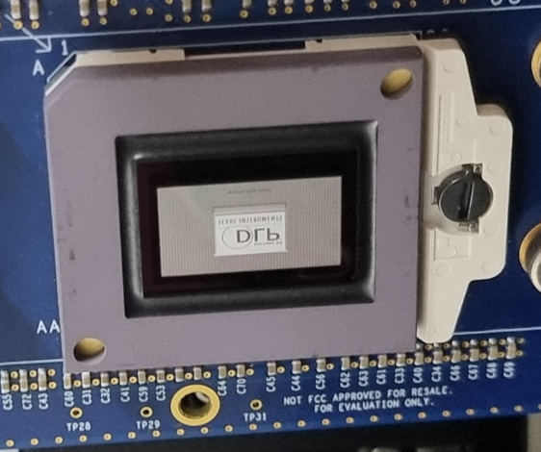
2. DMD on-off with 4430 EVM switch
Switch off
Switch on

Slide 3
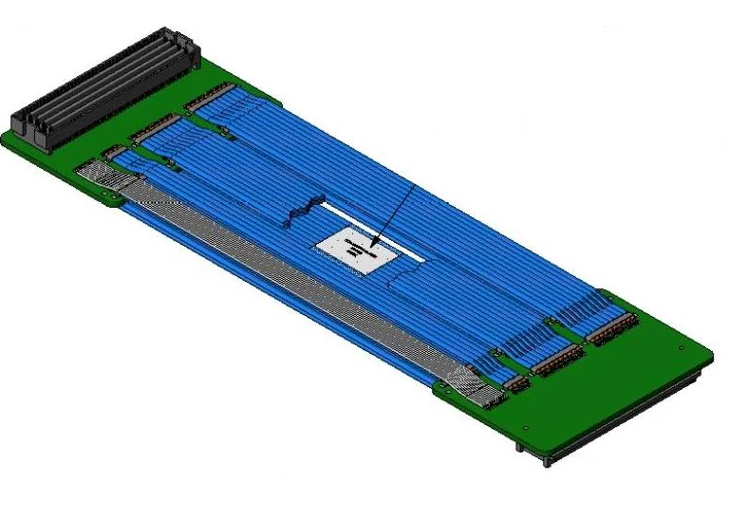
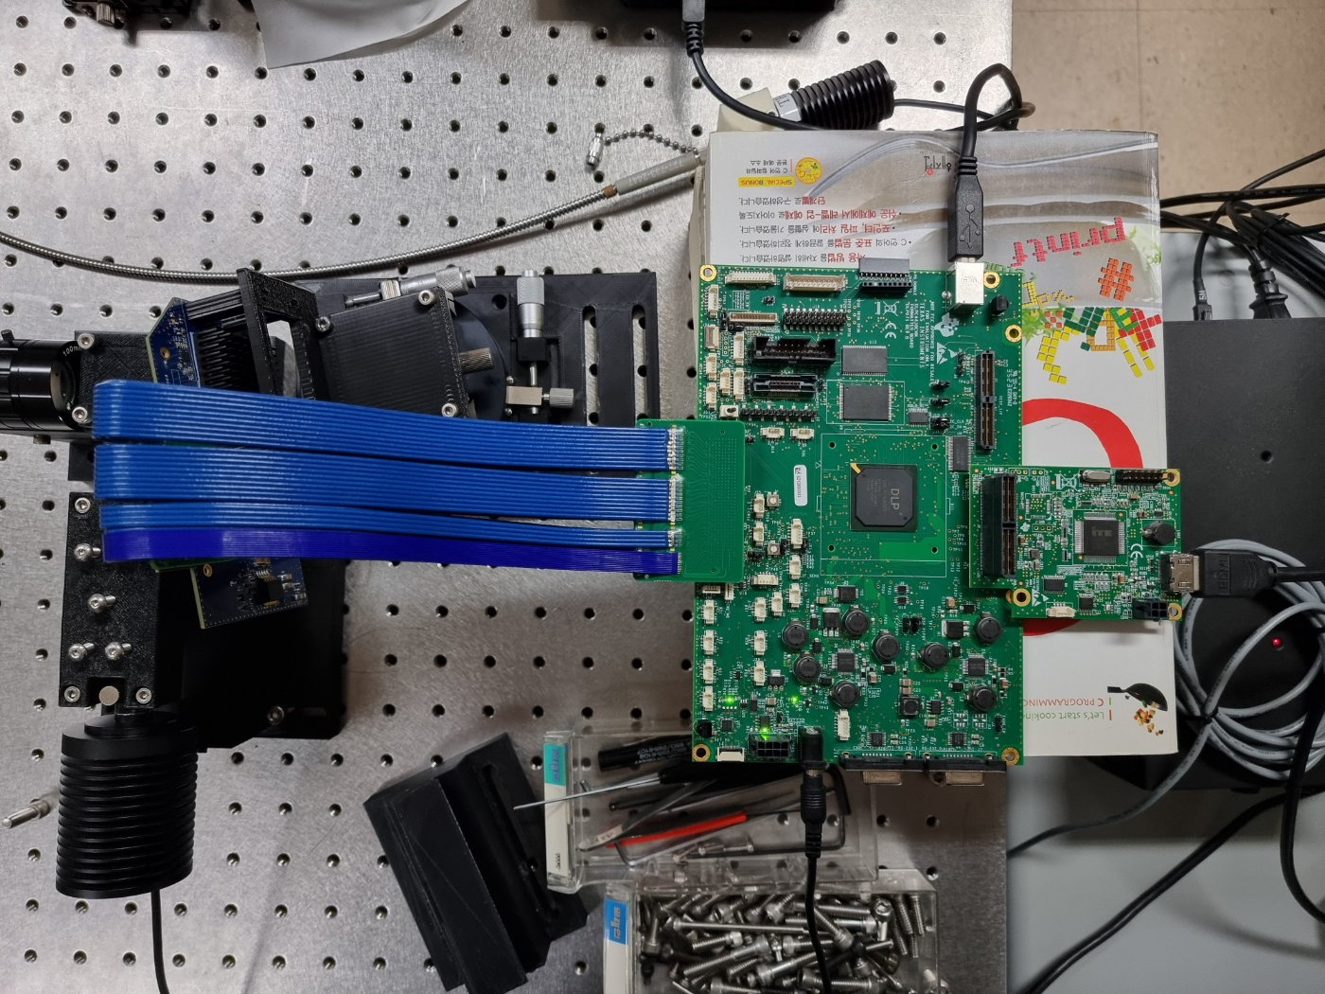
3. Configuration
HDR-169468-01 (Samtec)
DMD (780NEEVM)
Monitor

