Slide 1
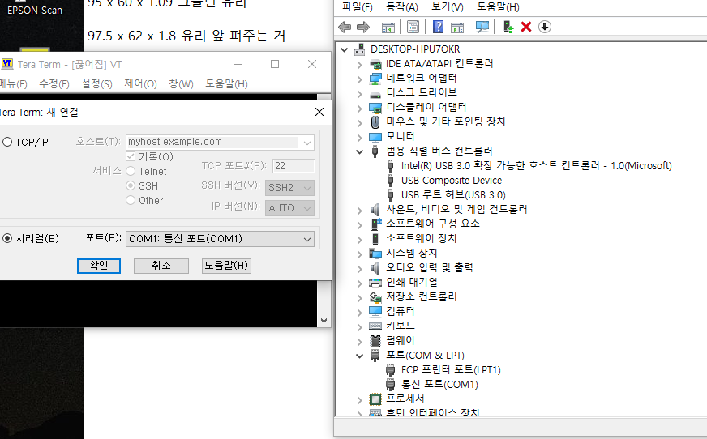
No available port (EVM)

Slide 2
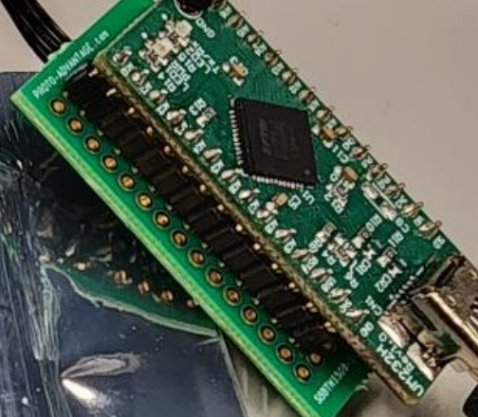
I have UM232H (1)
I want to know the board (2)
+
Is this method for connection is effective?
1
1

