Slide 1
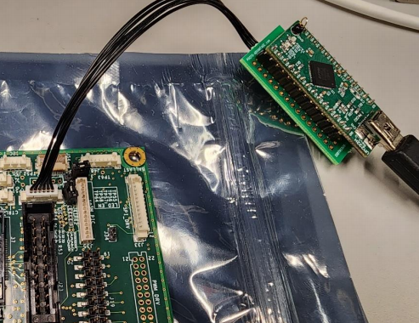
I have UM232H (left)
I want to know the name of the cable and the board under the UM232H
Name of the
cable
?
Name of the
Board
(under UM232H)

