Slide 1
CC3235 data communication using UDP
H C Trivedi
August 25, 2022

Slide 2
Algorithm for AP…
Reference file: platform.c
Start NWP in the default mode.
Change the mode of operation to AP mode if default start mode is not AP.
Set AP parameters including: Device Name, SSID Name, Country Code, Security Type, Security Password, Transmit Power etc and restart the device.
Set Static IP parameters.
Get configured device parameters through a function call get_device_config_parameters.
Socket functionality:
  Create socket => DGRAM type socket
  Bind socket => SL_INADDR_ANY (with any address)
  Connect socket => with the specified address
  Send and Receive through the established socket continuously (while(1)).
  Disconnect socket (however, the program never reached this point because of while(1)

Slide 3
Algorithm for STA …
Reference file: platform.c
Start NWP in the default mode.
Change the mode of operation to STA mode if default start mode is not STA.
Set STA parameters including: Device Name, Transmit Power etc and restart the device.
Set Static IP parameters.
Connect to an AP (by providing SSID name and security parameters) through wlanConnect function and corresponding event handlers.
Get configured device parameters through a function call get_device_config_parameters.
Socket functionality:
  Create socket => DGRAM type socket
  Bind socket => SL_INADDR_ANY (with any address)
  Connect socket => with the specified address
  Send and Receive through the established socket continuously (while(1)).
  Disconnect socket (however, the program never reached this point because of while(1)

Slide 4
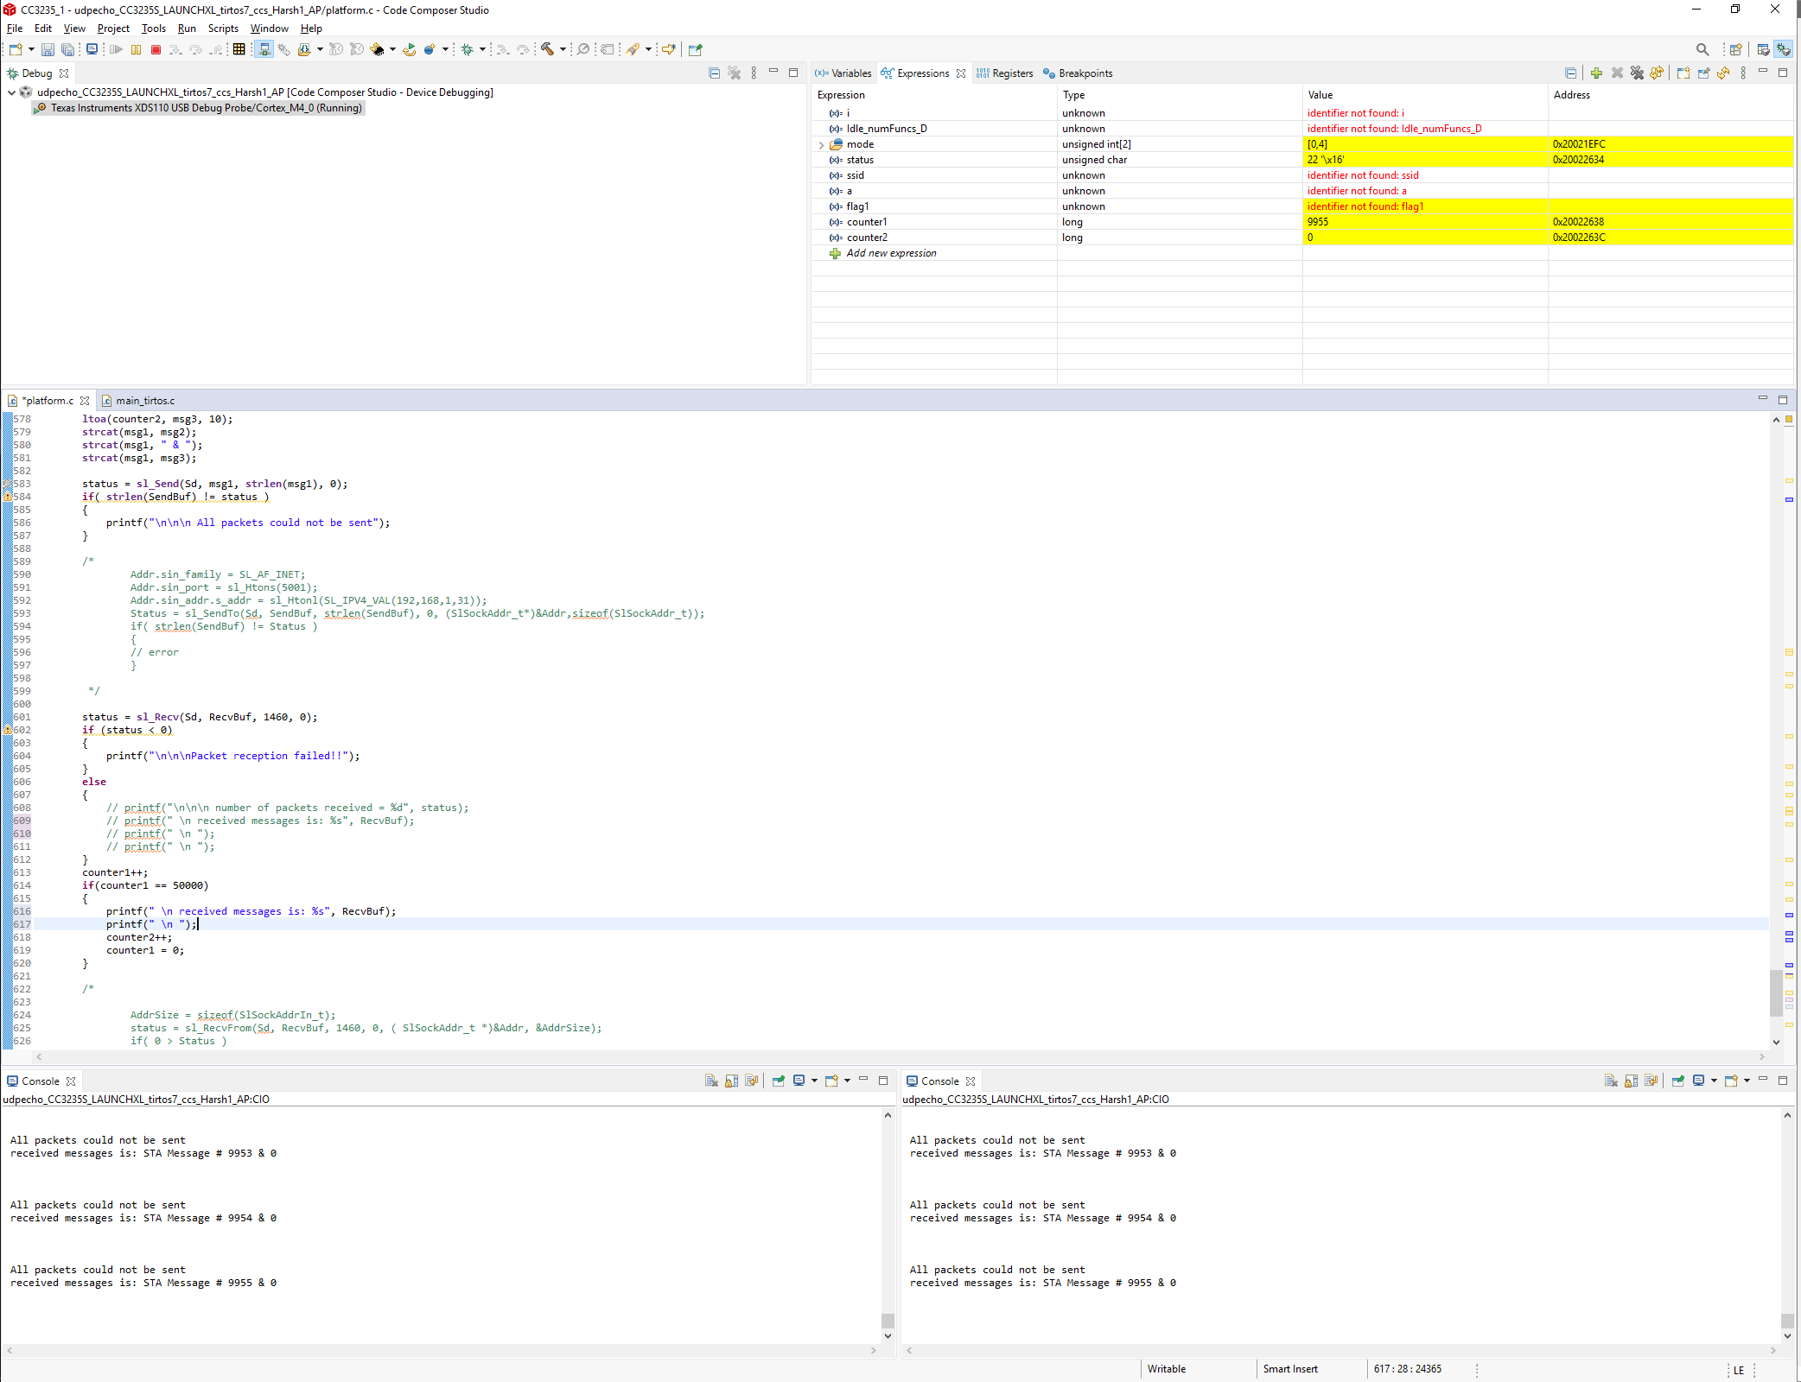
Inner Counter value (i.e. counter1) did not increase beyond 9955

Slide 5
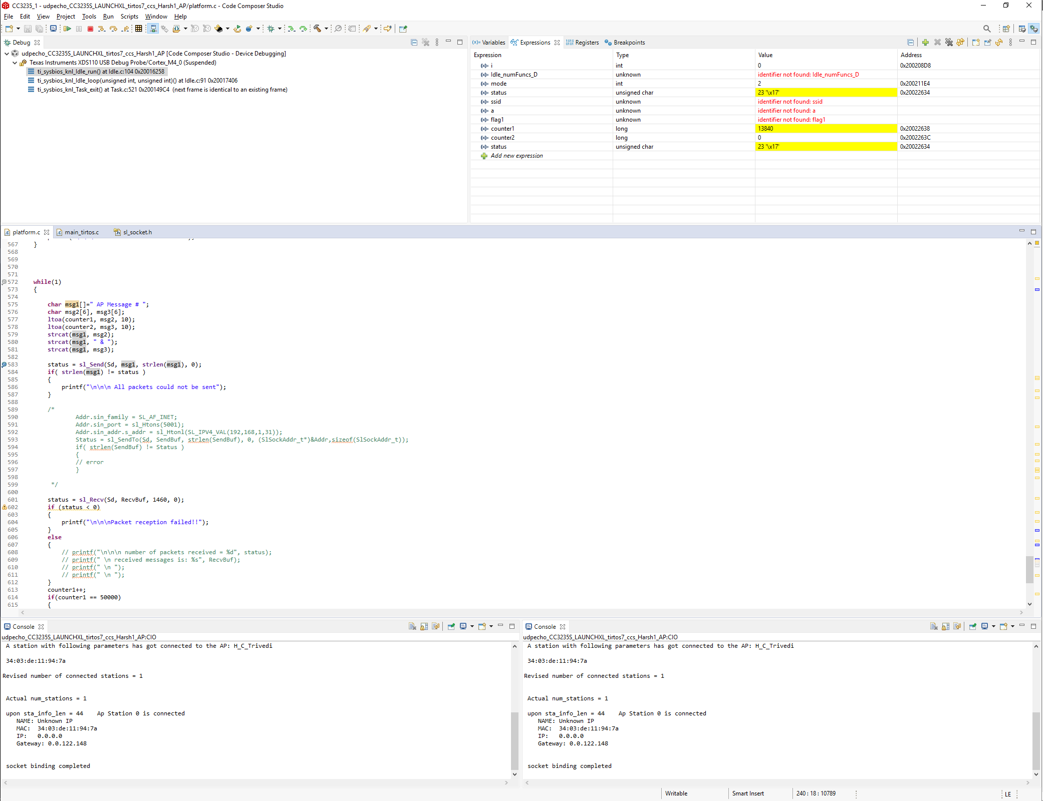
Inner Counter value (i.e. counter1) did not increase beyond 13840

