Slide 1
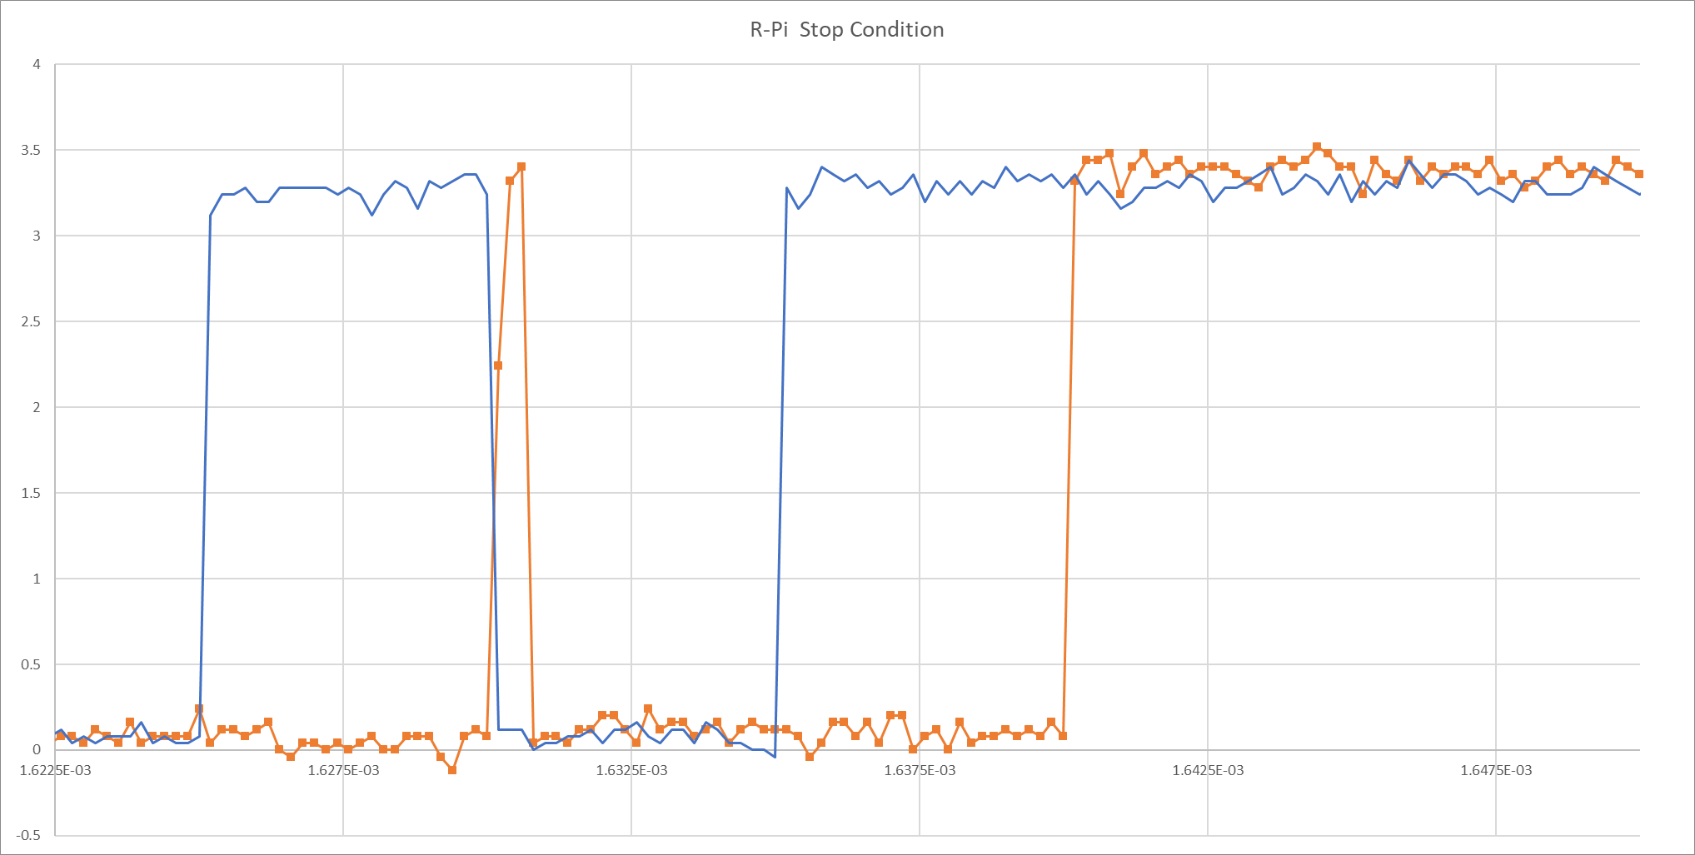
0.8 µs
pulse
Stop Condition
SCL
SDA

Slide 2
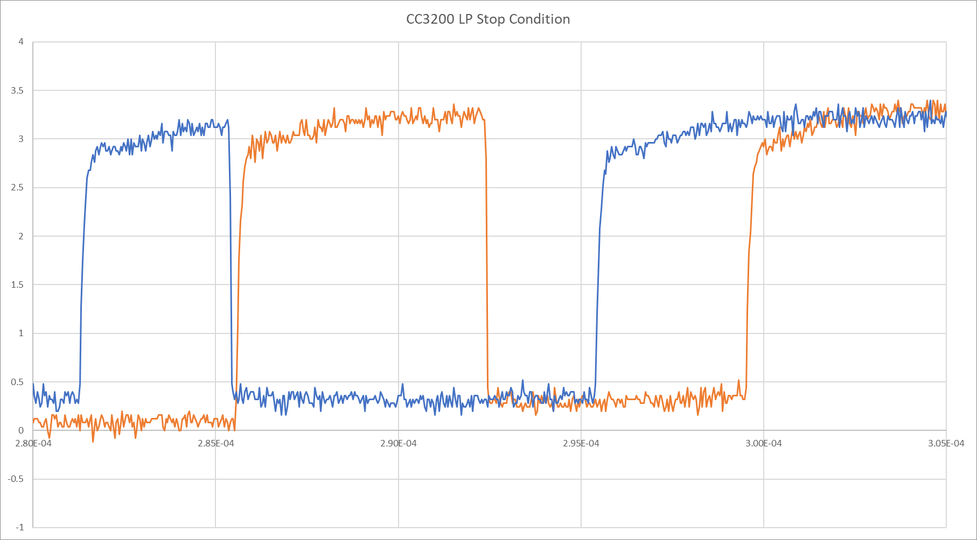
7.1 µs
pulse
Stop Condition
SCL
SDA

