Slide 1
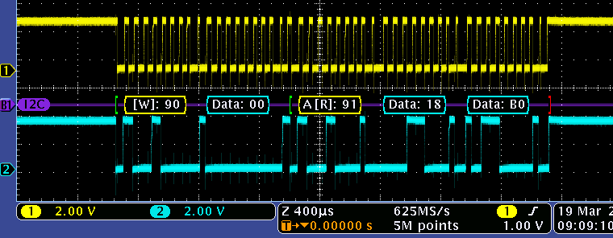

ACK by master on this clock pulse
TMP100
NACK by master on this clock pulse

