Slide 1
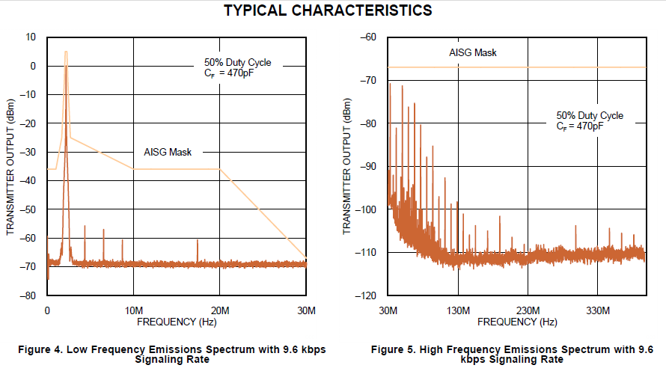
* Part Number : SN65HVD62
If see datasheet 9-page, Frequency emission mentioned as below.
Frequency emission range is 300KHz ~ 12.75GHz on AISG/3GPP Standard.
If see below graph, Frequency Range looks like 0Hz ~ 430MHz.
Our customer(KMW) want frequency emission result until 12.75GHz.
KMW is big customer for TI/ARROW.
Please frequency emission data until 12.75GHz as soon as possible.

