Slide 1
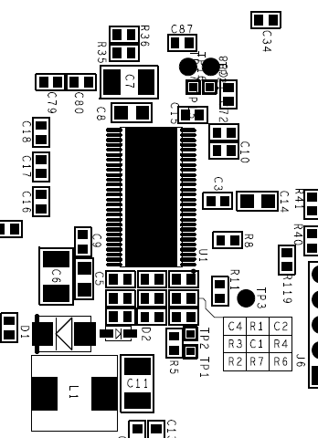
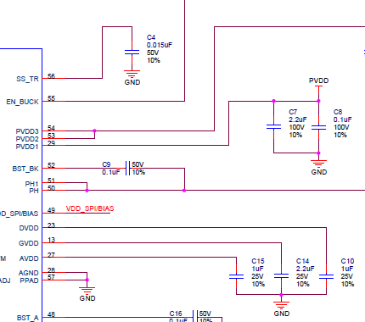
DRV 8301 Drive board
DRV830x_RevD_HWDevPKG
C14
Probe point
5.4V
C4
Probe point
0.61

Slide 2
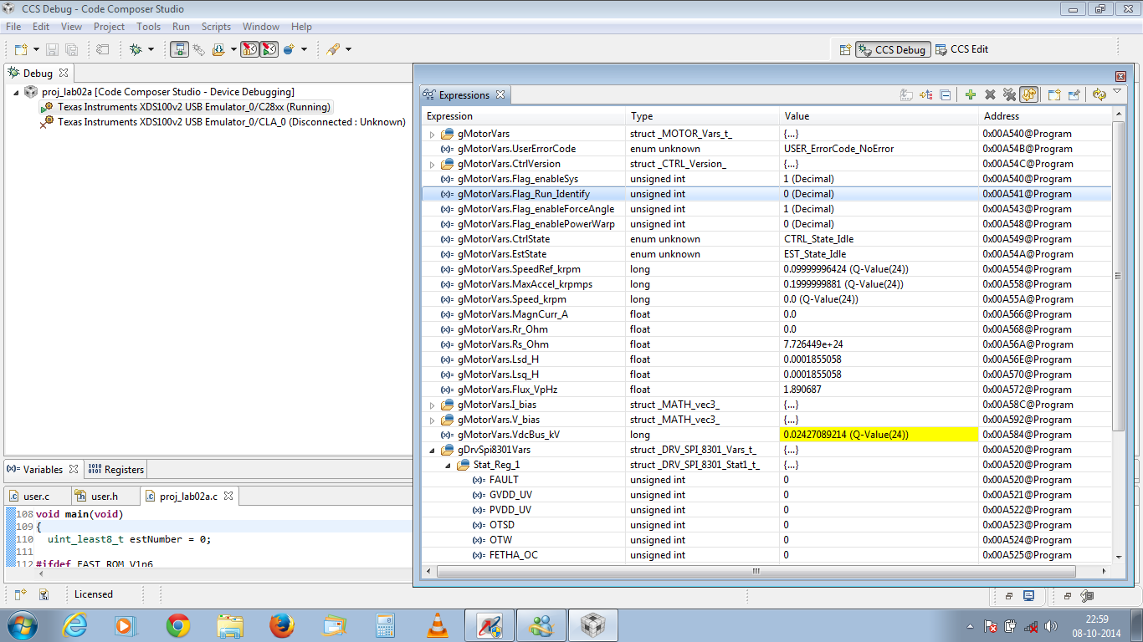
20141008
With PVDD 24V

Slide 3
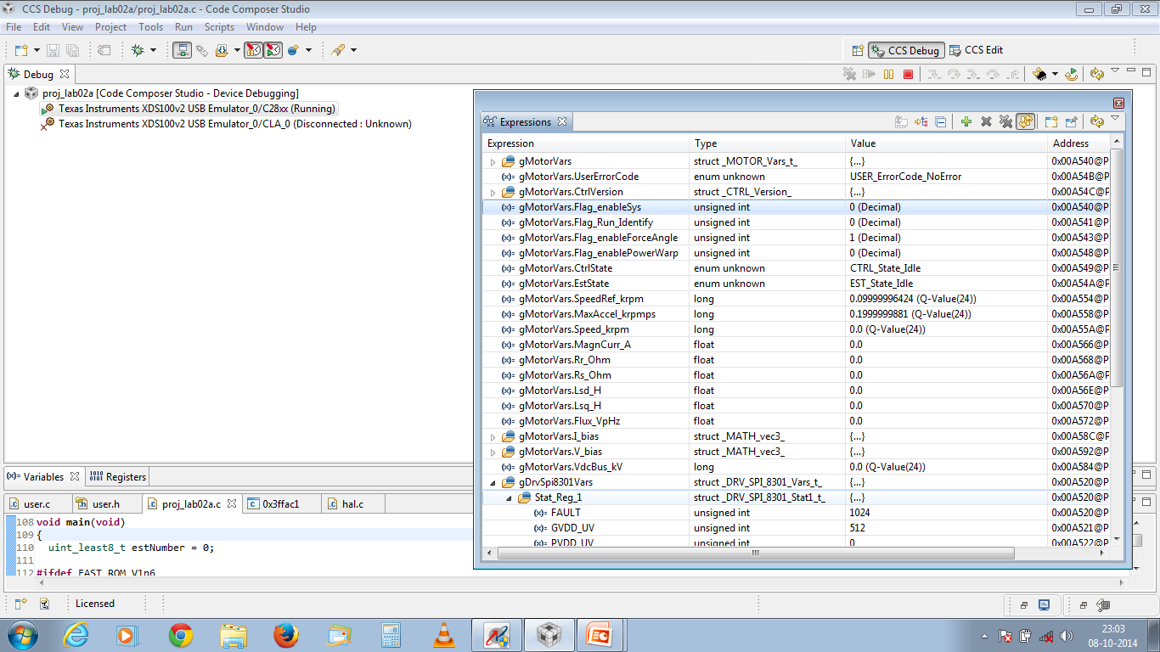
20141008
On repetition the fault LED is ON
With PVDD 24V

