Slide 1
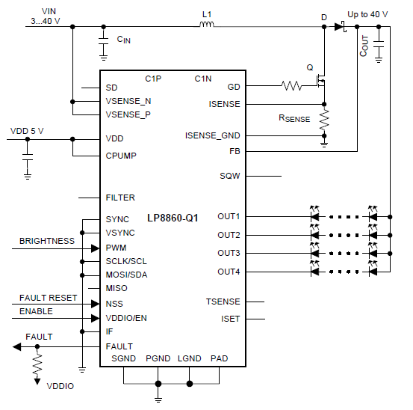
Q1
Can you make this circuit SEPIC?
Vout:14V
Vin:6V～16V
MAX 150mA×4＝600mA
Q2
I am connected to the LED4 unit series and want to drain 600mA.Is such a connection possible?

