Slide 1
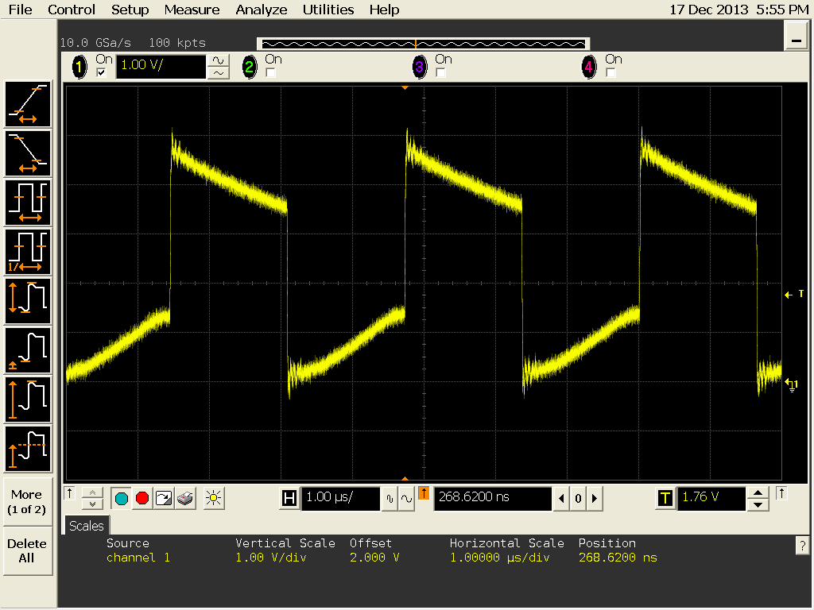
External synchronize circuit
Measurement point
LM25117-Q1
390pF
external clock input
RT
15kΩ
Question
Is there a problem with this external clock?

Slide 2
External clock enlarged picture

