Slide 1
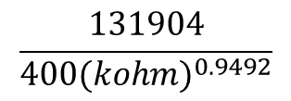
TPS57112-Q1 Question of Frequency
Question 1
There is switching frequency at Rt=400kohm
But It become 447.1kHz when I substitute 400 for the following expression.
Which is right?
I think that a calculating formula is right.
ELECTRICAL CHARACTERISTICS
TIMING RESISTOR AND CLOCK(RT/CLK PICN) Data sheet p4.
⇒Data sheet p16
$$\frac{131904}{{400(kohm)}^{0.9492}}$$
=
=
447.1kHz

Slide 2
Question 2
What accuracy of frequency at 1.9MHz?
Is accuracy ±10%?
Question 3
What accuracy of frequency at External Clock 1.9MHz?
Question 4
Please tell me MIN Voltage of “VIN UVLO STOP”.

