Slide 1
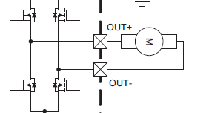
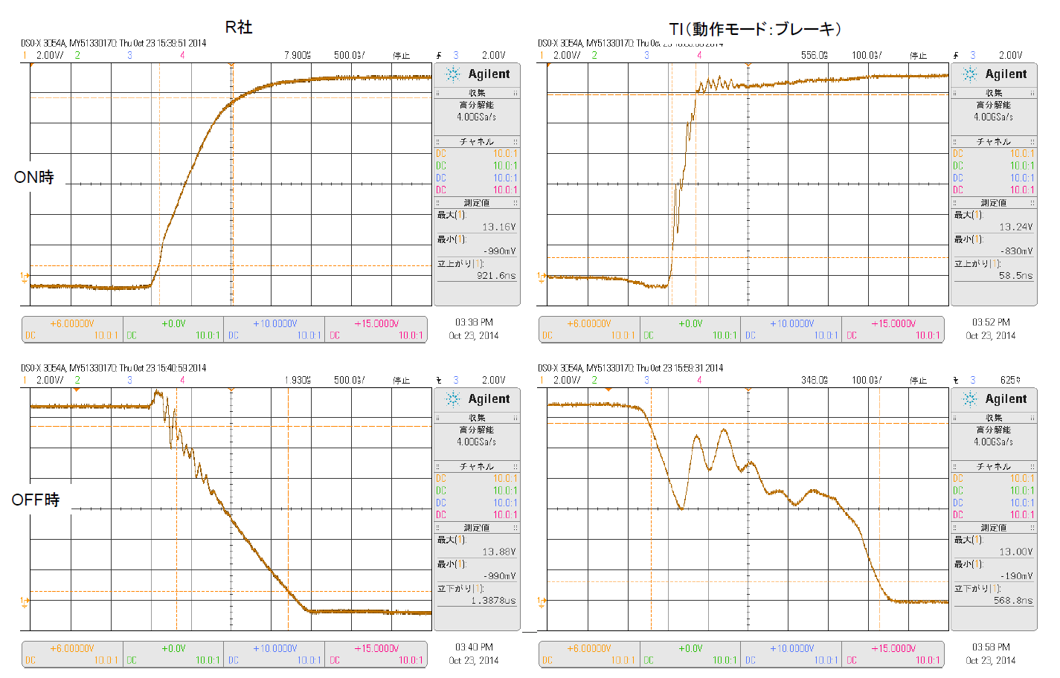
DRV8801 Question
PHASE | ENABLE | MODE1 | MODE2
1 | 1 ⇔ 0 | 1 | 0
Rohm
DRV8801 Brake mode

Slide 2
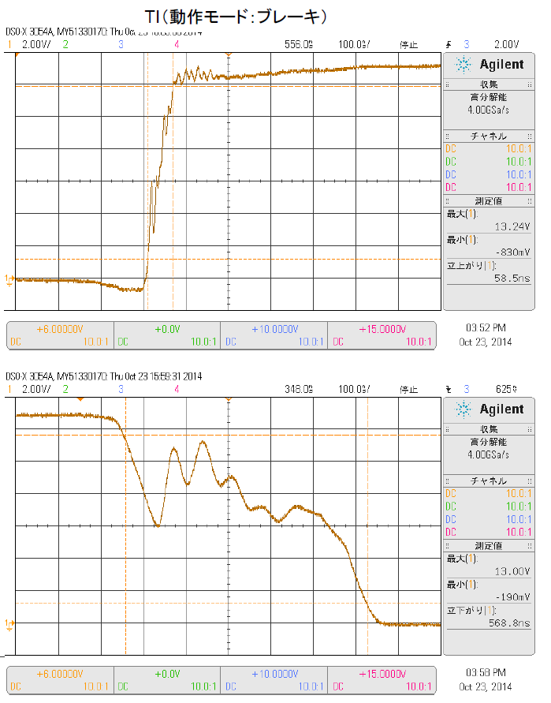
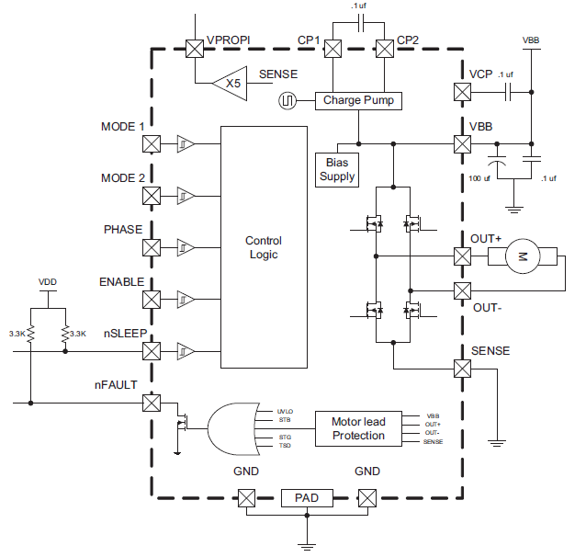
Q1
Is there the method to reduce a noise?
Please tell me some measures method.
Q2
I think to put a capacitor between OUT and OUT, and to take measures.
However, I fall into an overcurrent limit when I use capacitors more than 0.22uF.
I cannot take the noise in 0.22uF.
I think that 10uF is necessary.
Please tell me some measures method.

