Slide 1
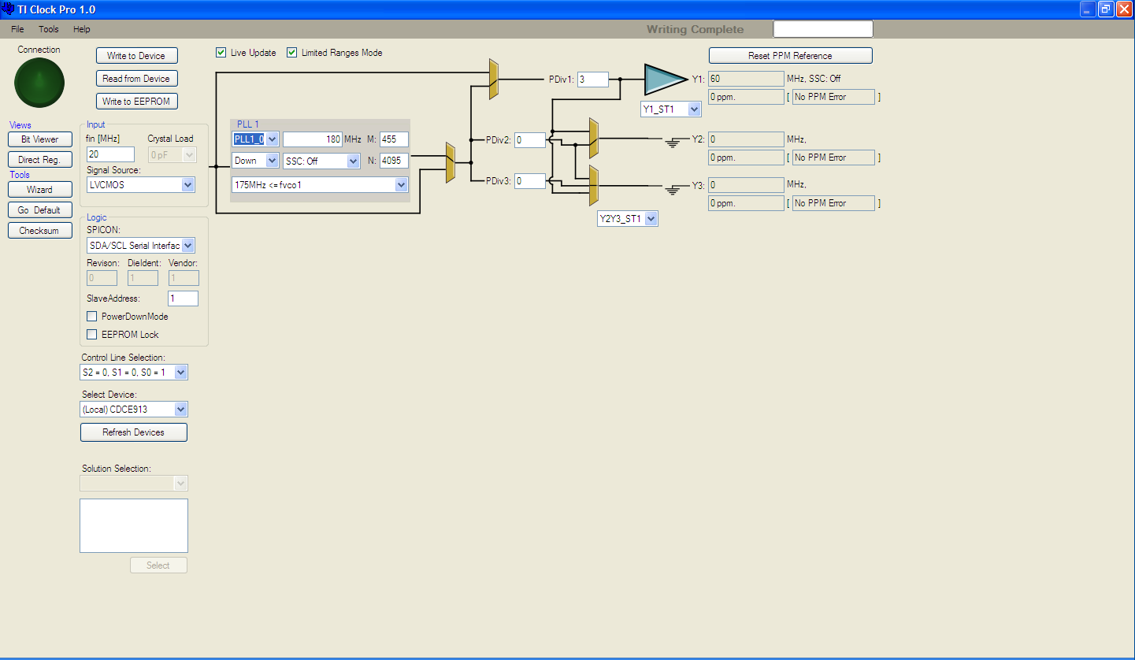
You programmed PLL1_0 to generate Y1=60MHz
But you use S0=1, meaning that PLL1_1 setting will be loaded by the device. The PLL1_1 settings are …. please see next slide

Slide 2
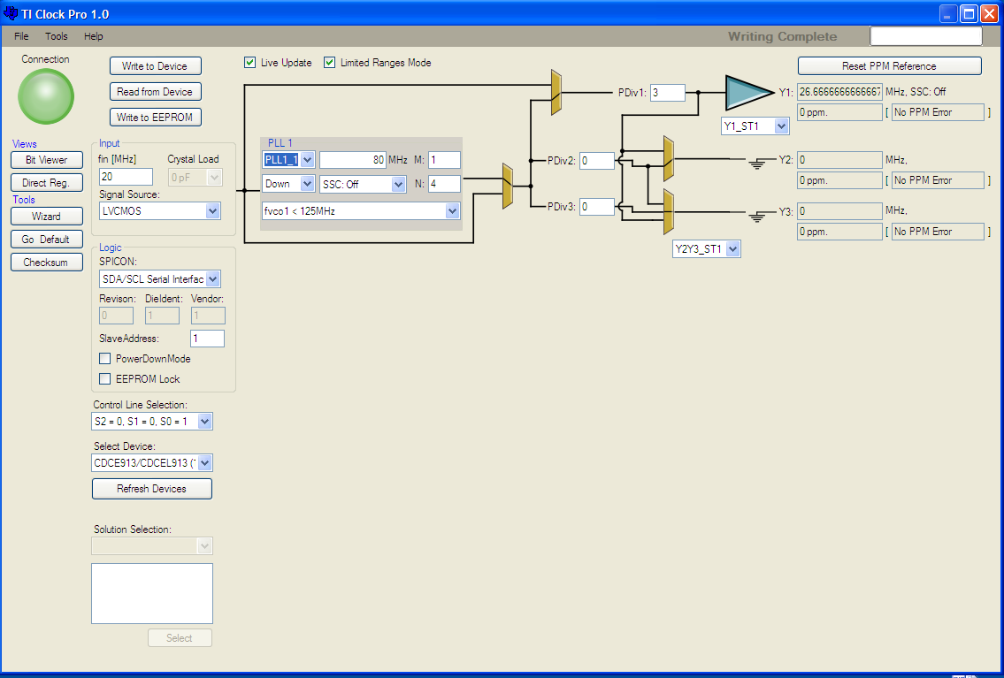
PLL1_1 generates Y1=26.666MHz
Therefore you do not find 60MHz clock on Y1

Slide 3
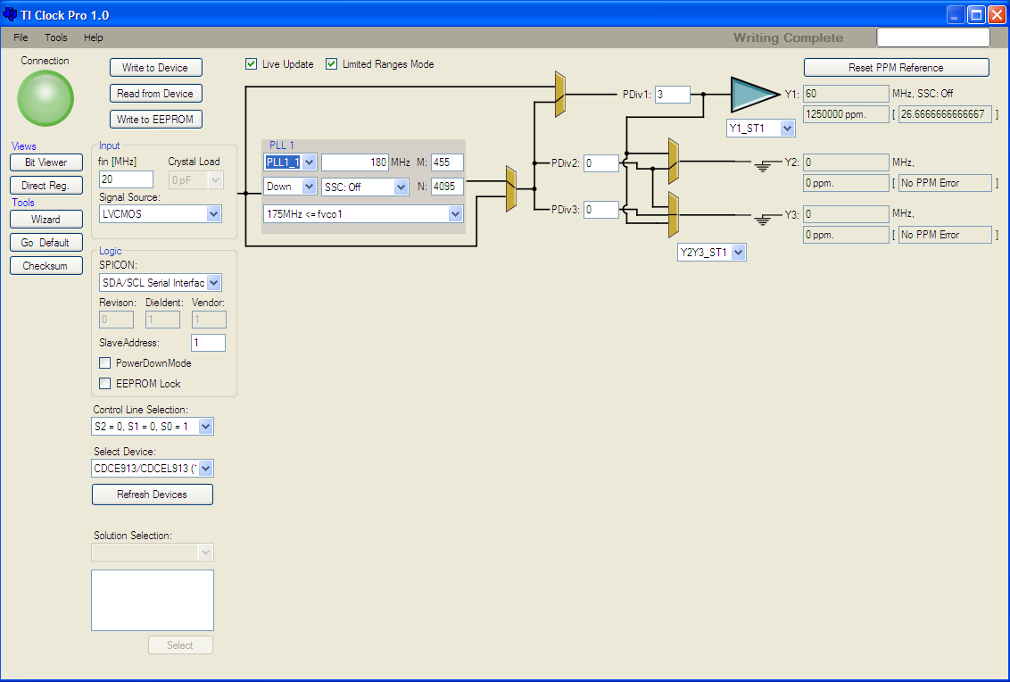
According to the .txt I sent to you, with S0=1 the device will generate the PLL1_1 setting ➔ Y1=60MHz, and with S0=0, the Y1 is in tri-state

