Slide 1
Testing for
Designed Board

Slide 2
1.1 Customer Concept
sampling frequency : 138.24MHz / Interpolation : 4x
Enable Digital Mixer fs/2
Disable NCO
FPGA
138.24MSPS
DATA
ADC
DAC3484
241.92MHz
241.92MHz

Slide 3
1.2 Test Result
[DAC3484 Register]
1.3 Question
-- Why signal is break ?
-- Center Freq is not 241.92MHz. Why?

Slide 4
Testing for
TSW1400 + DAC3484 EVM

Slide 5
1. Test Configuration
Signal Generator
Spectrum
TSW1400
DAC34H84EVM
PC

Slide 6
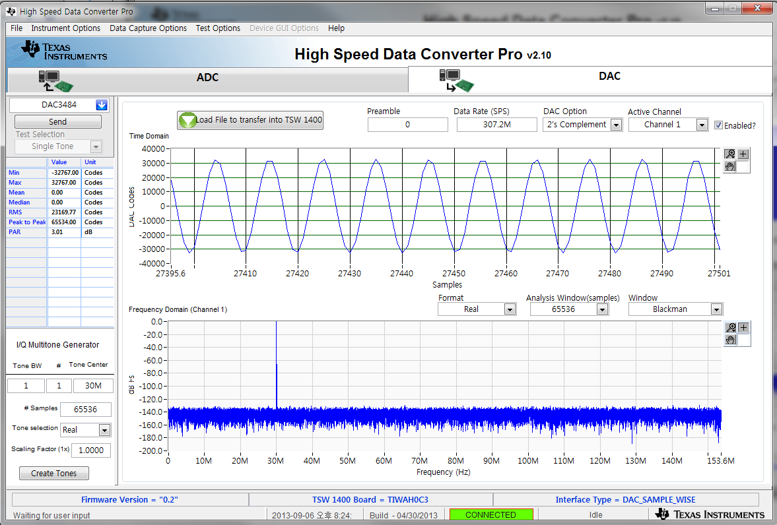
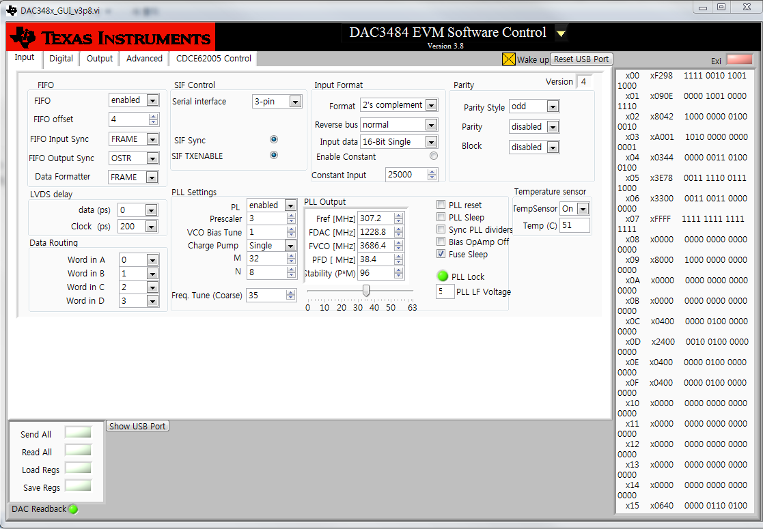
3. Test Result
- Signal source file: single tone
- F sampling frequency : 307.2MHz / Interpolation : 4x
[TSW1400]
[DAC3484]
[DAC34H84 Register]
[Spectrum]
Test Result : Normal

Slide 7
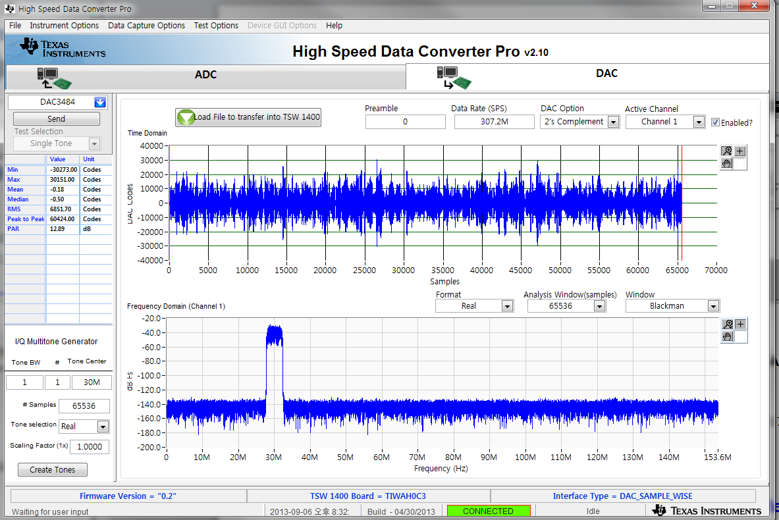
3. Test Result
- Signal source file: WCDMA_TM1_complexIF30MHz_Fdata307.2MHz_1000
- F sampling frequency : 307.2MHz / Interpolation : 4x
[TSW1400]
[DAC3484]
[DAC34H84 Register]
[Spectrum]
Test Result : Normal

Slide 8
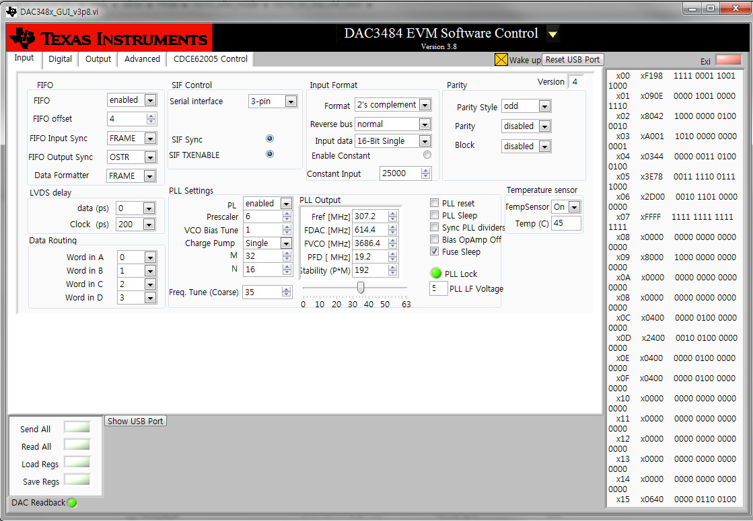
3. Test Result
- Signal source file: WCDMA_TM1_complexIF30MHz_Fdata307.2MHz_1000
- F sampling frequency : 307.2MHz / Interpolation : 2x
[TSW1400]
[DAC3484]
[DAC34H84 Register]
[Spectrum]
Test Result : Normal

Slide 9
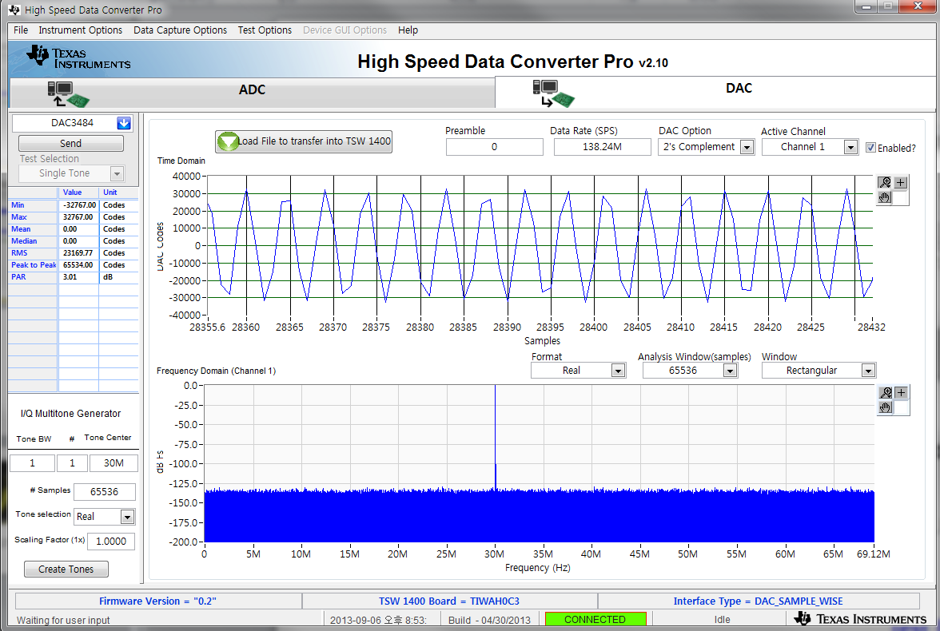
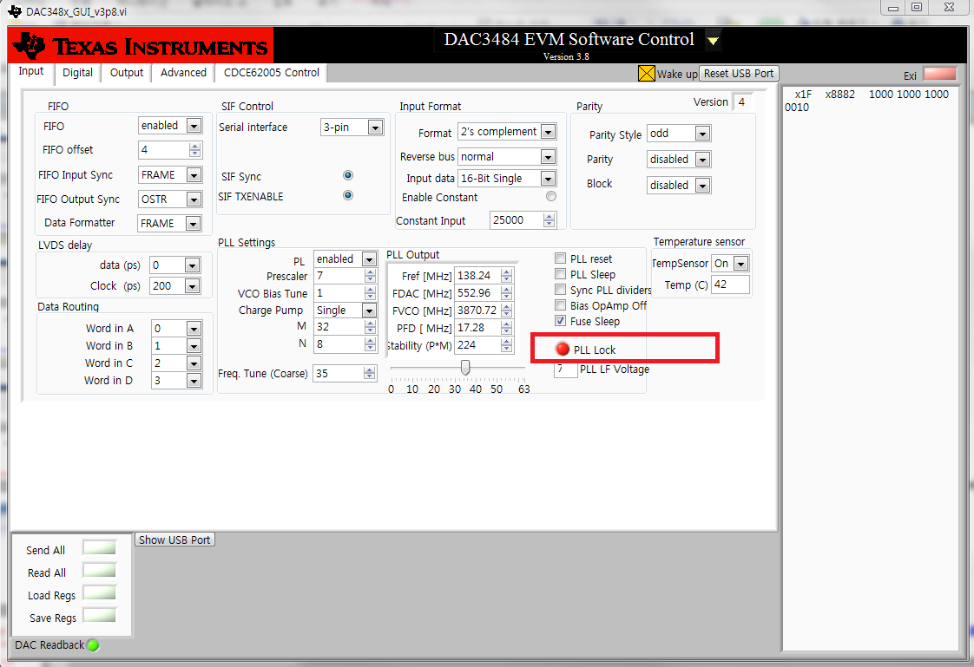
3. Test Result
- Signal source file: single tone
- F sampling frequency : 138.24MHz / Interpolation : 4x
[TSW1400]
[DAC3484] PLL unlock
[DAC34H84 Register]
[Spectrum]
Test Result : Abnormal
Signal unstable
Center Freq mismatch

Slide 10
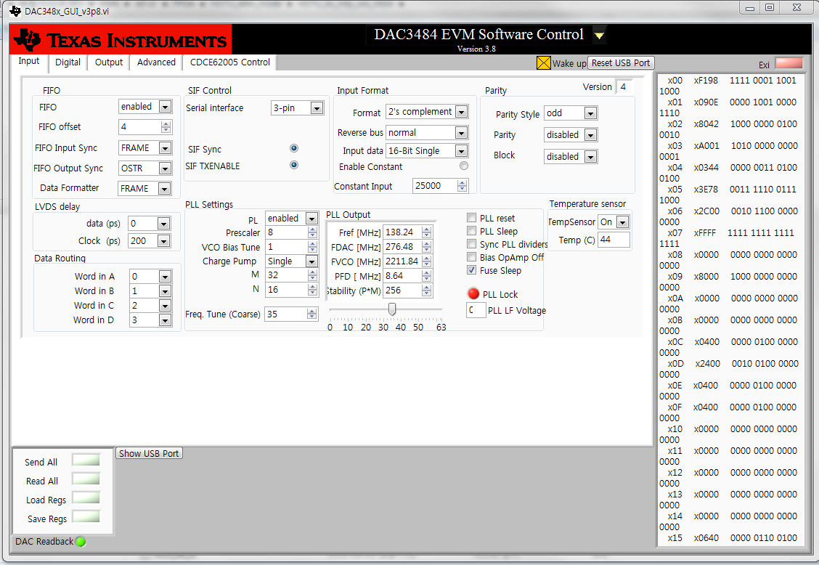
3. Test Result
- Signal source file: single tone
- F sampling frequency : 138.24MHz / Interpolation : 2x
[TSW1400]
[DAC3484] PLL unlock
[DAC34H84 Register]
[Spectrum]
Test Result : Abnormal
Signal unstable
Center Freq mismatch

