Slide 1
Hardware Pace Using Slope Detection
Tony Calabria
10/22/2012

Slide 2
The Concept
Subhead text here

Slide 3
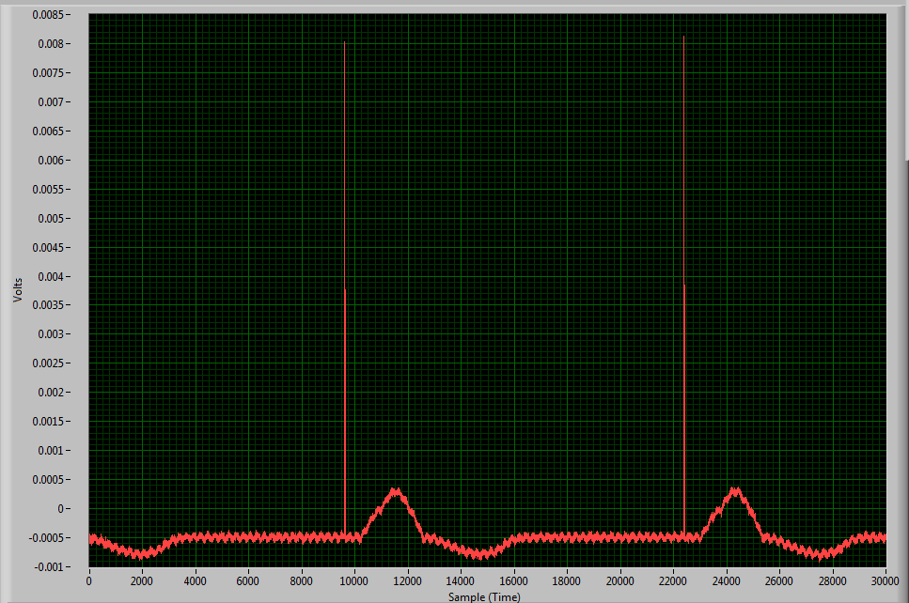
ECG + Pacemaker Signal

Slide 4
Slope Detection
Frequency components of ECG lie in 0.05 – 150Hz. Frequency of PACE components reside in >1KHz.
Monitor for Slope of Pace Signal while ignoring ECG signal slope.
Need to measure the rate of change of voltage to determine slope: Differentiator Circuit
  Output signal should not respond to ECG
  Pace Signal should only pass
  Looking for a specific dV/dT
Pace Spec required to meet:
  2mV Amplitude Signal
  100us Period Signal

Slide 5
Alert/Trigger
Need to trigger an Alert bit when Pace is present
Using a window comparator, a pulse can be created once the output of the Differentiator Circuit shows a change outside the preset window.
Threshold limits set externally depending on amplitude of Differentiator Output at minimum Pace signal spec requirements (2mV, 100us).
SR Latch can be used to latch and hold the value of the Comparator output indicating a Pace Signal has occurred.
Mandatory that an ECG Signal does not create a response by the comparator outputs.

Slide 6
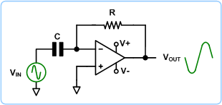
Differentiator Circuit
Looking for specific slope: dV/dT change
Duration of slope produces output amplitude
R used to set gain
Frequencies above fc, the circuit is acting as ordinary inverting amplifier
Source: http://circuitalley.phpnet.us/circuit3.html

Slide 7
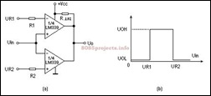
Window Comparator
The Differentiator output signal will idle within the window when PACE is not present
When PACE appears, the output of the differentiator circuit will toggle, forcing the voltage outside the limits of the window comparator
  The output to pulse low.
  That low pulse must be latched and held until read back by a uC or GPIO

Slide 8
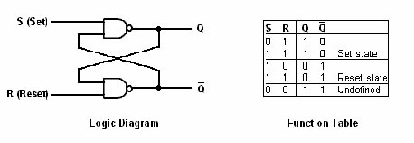
SR Latch
SR Latch output high once Window Comparator outputs low pulse
Reset line is pulled high
Latch stays until reset by user.
Would need to reset with every QRS waveform if wanting to monitor for pace with each heartbeat

Slide 9
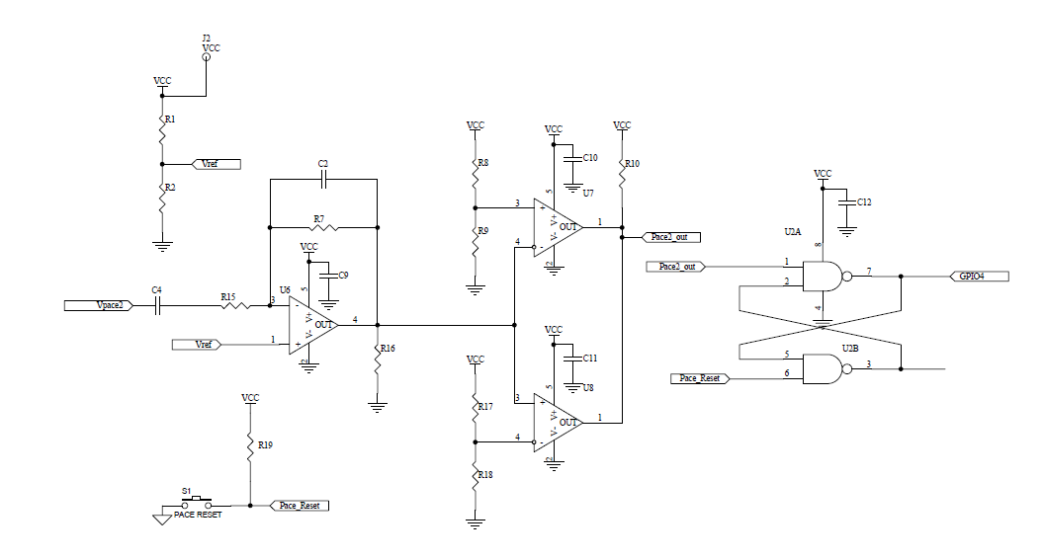
Proposed Circuit

Slide 10
Circuit Stability
Subhead text here

Slide 11
Differentiator Circuit Analysis
C2 used for Op amp Stability and High Freq gain control

Slide 12
Differentiator Circuit Stability
Rate of Closure = 20dB/Dec

Slide 13
Time Domain Analysis
2mV Amplitude
100us Period
Model to replace internal ADS1298 Pace Amplifier

Slide 14
Time Domain Analysis Cont.
Set threshold point for Window Comparator
Pace input pulse

Slide 15
Window Comparator Threshold
~ 2.77V
~ 2.48V

Slide 16
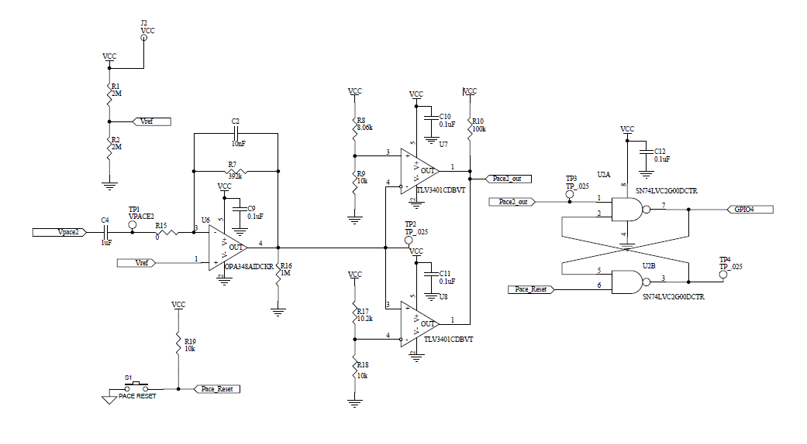
Pace Circuit Design with Values

Slide 17
Testing
Subhead text here

Slide 18
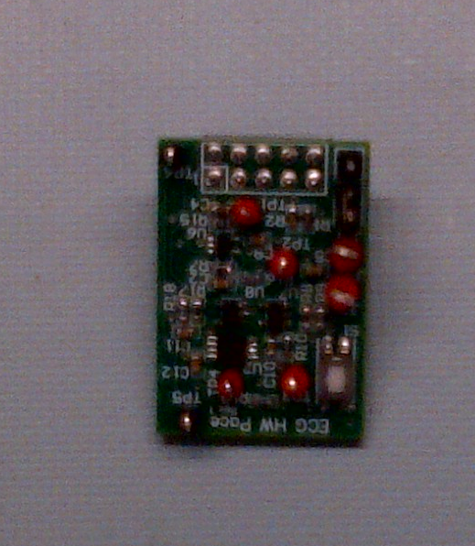
Pace Card Design
Designed to mate with ADS1298ECG-FE board
Top side populated for PACE OUT 2 and bottom side for PACE OUT 1
Requires one 5V supply
SR Latch Outputs routed to ADS1298 GPIOs
Analysis required for circuit stability

Slide 19
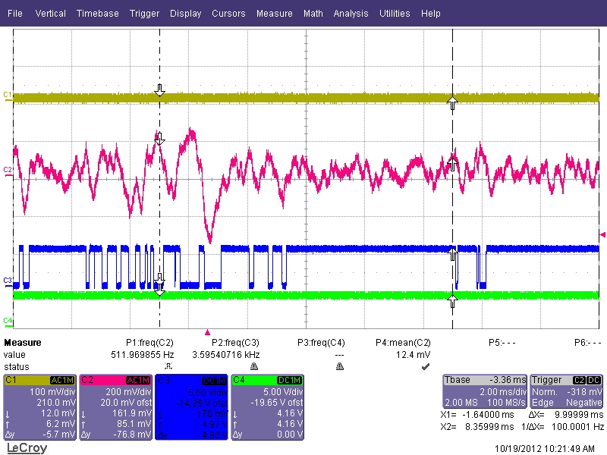
Unstable Design
Differentiator out
Comparator out
SR Latch

Slide 20
Pace Circuit Unstable Design Analysis
Rate of Closure = 40dB/Dec

Slide 21
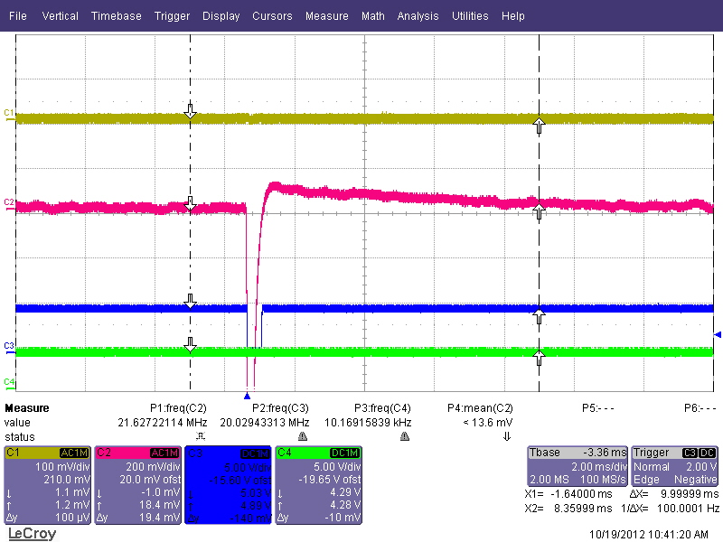
Stable Design
Differentiator out
Comparator out
SR Latch

Slide 22
Pace Circuit Design with Values

Slide 23
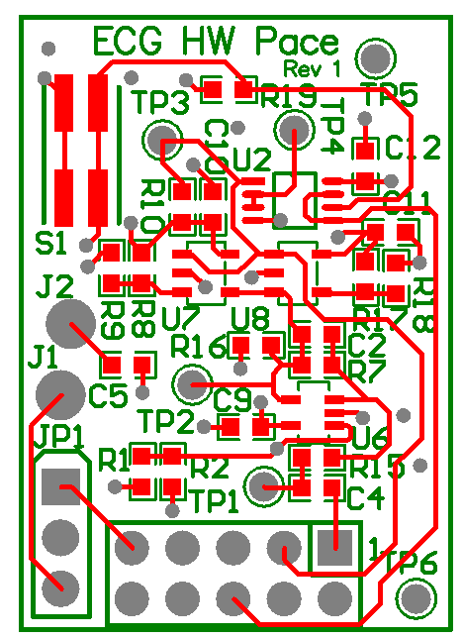
Pace Circuit Layout

