Slide 1
Software PACE detect with ADS1292
Tony Calabria
Texas Instruments

Slide 2
Statement
PACE detections used to determine if a patient has a pacemaker.
PACE signal frequency is generally above 500Hz.
  Beyond the typical clinical ECG bandwidth of interest.
  Requires higher passband from digital filter → i.e. Increase data rate
Using a higher data rate increases bandwidth and, therefore can add to noise.
  Digital Filter used to help clean up ECG signal
All tests with the ADS1292ECG-FE Board and the Evaluation software available online.

Slide 3
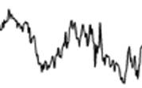
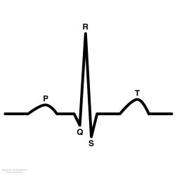
Bandwidth of interest
~10mV
EMG Signal
~5mV
ECG Signal
Max Signal Amplitude
~5mV
Pacemaker Signal
Including Gamma
~1mV
EEG Signal
Respiration 0 to 0.4Hz
*Amplitude dependent on external current source
0.05Hz
20Hz
60Hz
120Hz
150Hz
500Hz
10 KHz
50Hz
*Frequency ranges are estimates. Actual frequency range will depend on specific application
Frequency

Slide 4
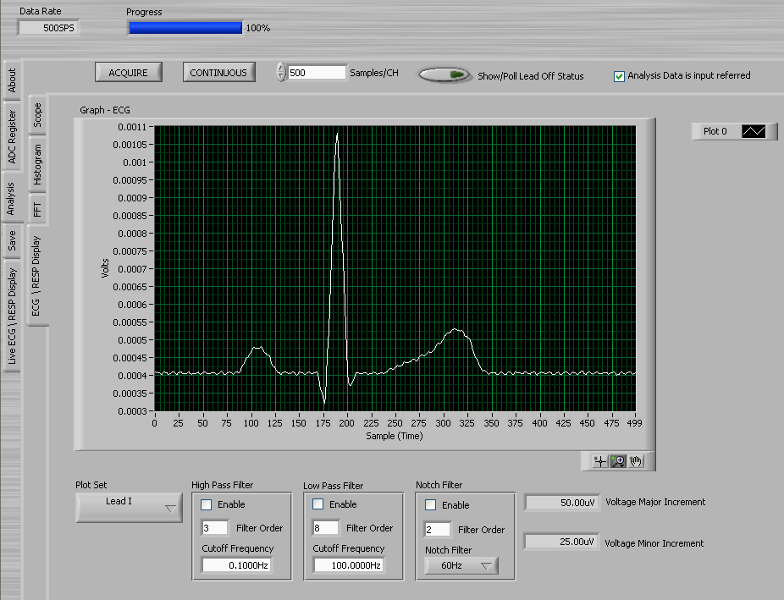
ECG Signal at 500SPS (no filtering)

Slide 5
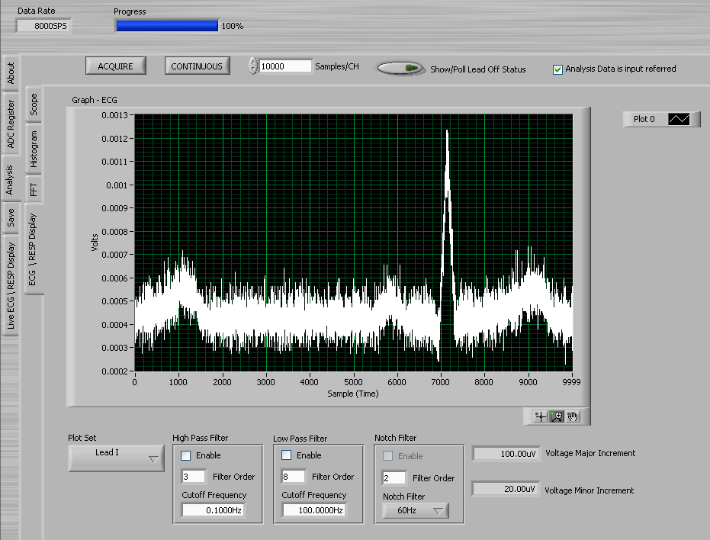
ECG Signal at 8kSPS (no filtering)

Slide 6
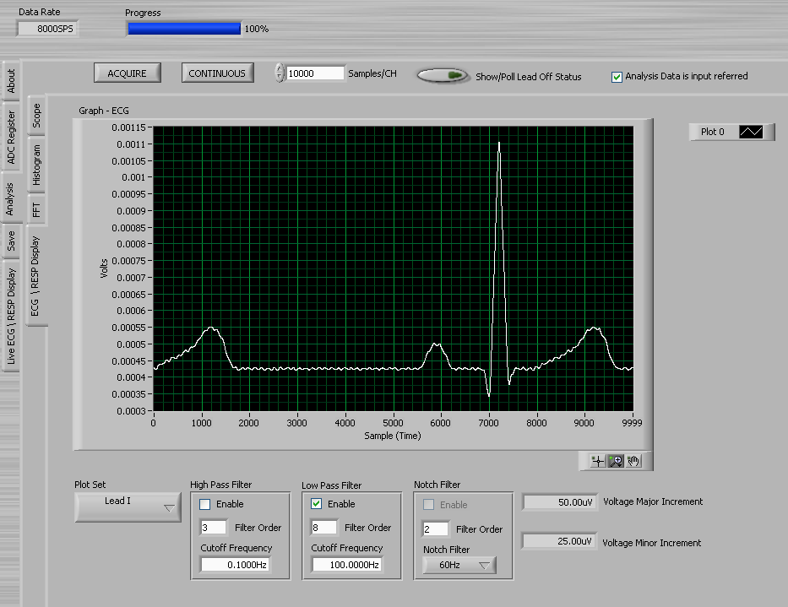
ECG Signal at 8kSPS with Digital Filter
100Hz Digital LPF enabled

Slide 7
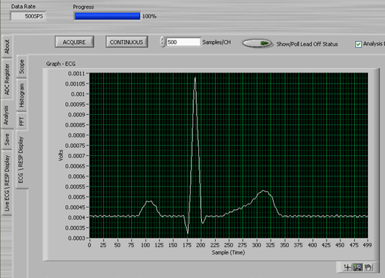
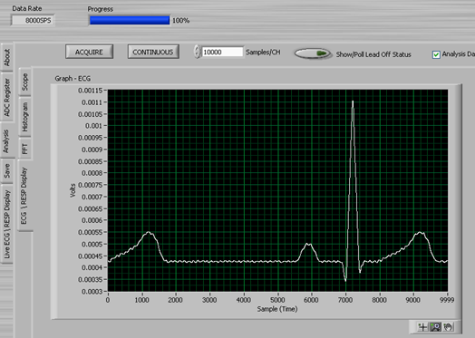
Side by Side Comparison
500SPS no digital Filter
8kSPS 100Hz digital Filter
Comparable ECG pulses using 500SPS and 8kSPS (w digital filter)
Running at 8kSPS will be sufficient bandwidth to monitor PACE

Slide 8
Enabling PACE
All tests with the ADS1292ECG-FE Board and the Evaluation software available online.
Data Rate set to 8kSPS for PACE detection
  Digital Filter cutoff frequency is 2kSPS.
  10,000 samples used
Ventrical Pacer option enabled in Fluke Medsim 300B for test
  Control over Ventrical Pace signal width and amplitude
    Amplitude Range: -100mV to 100mV
    Signal Width Range: 0.1ms to 2 sec

Slide 9
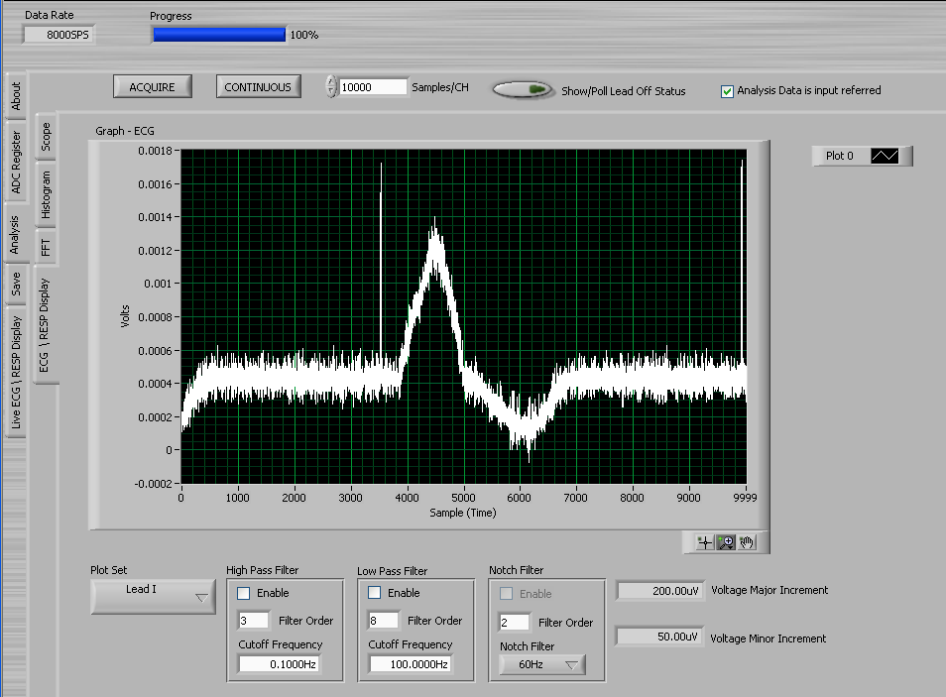
Ventrical PACE Test 1
Simulator set to 2mV Amplitude and 1ms pace signal width

Slide 10
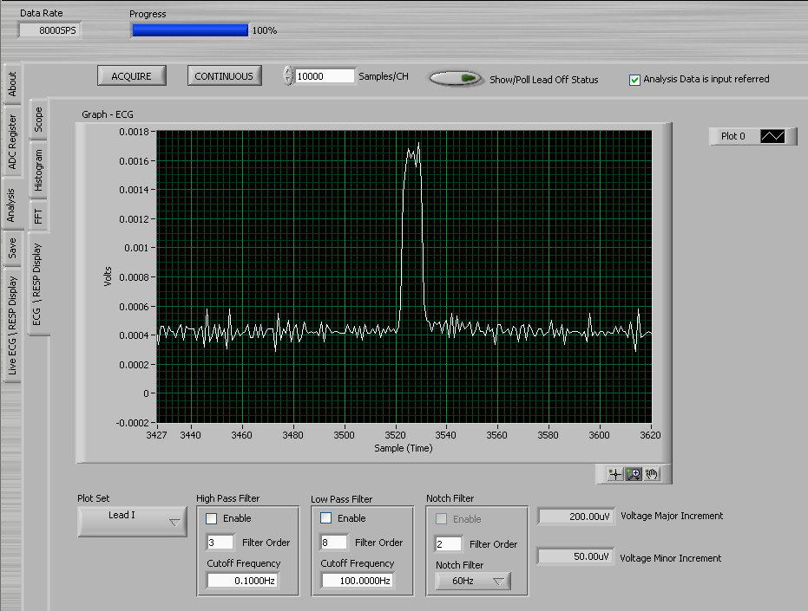
Ventrical PACE Test 1 Zoomed

Slide 11
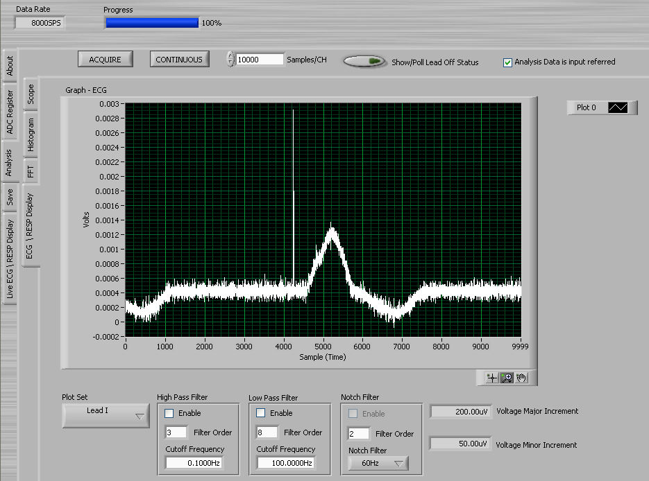
Ventrical PACE Test 2
Simulator set to 10mV Amplitude and 0.1ms pace signal width

Slide 12
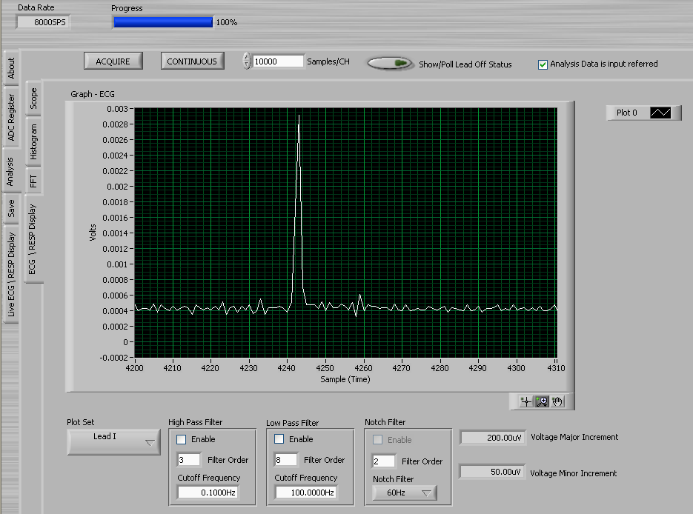
Ventrical PACE Test 2 Zoomed

